Slide 1


+ Introducing Paratext 7.6 (Beta)
Notes:
What do you think when you see this picture? Can you see any relation to Paratext?
Parallel – railway lines are parallel
Different tracks

Slide 2
Paratext has changed and grown!
Think back
What was your first version?
  3.0
  5.0
  6.x – 6.0, 6.1, 6.2
  7.x – 7.0, 7.1, 7.2, 7.3, 7.4, 7.5
Notes:
I first heard of version 3.0 back in Australia (don’t remember 4.0)
When I arrived in Cameroon in 2004 just changing from 5.0 to 6.0
Since then gone through 3 versions of 6, then version 7 – 6 changes
What about you? Which was your first version?

Slide 3
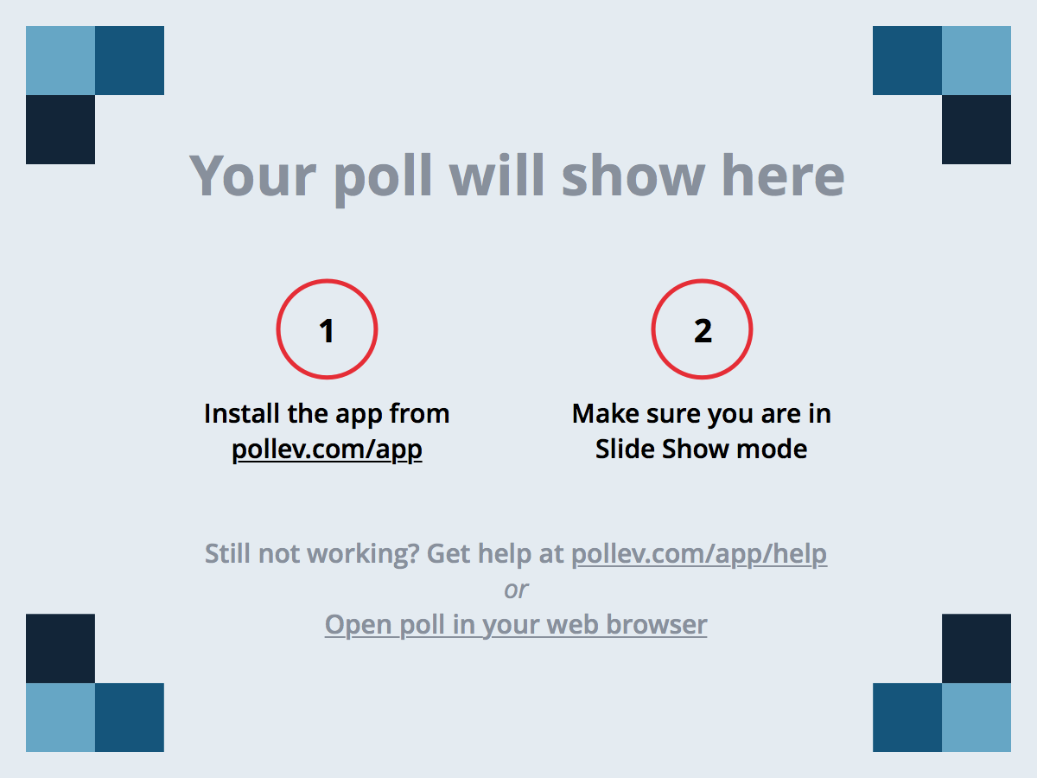
Notes:
Poll Title: What was your first version of Paratext?
https://www.polleverywhere.com/free_text_polls/3NRr3brrMDB6chR
Go to pollev.com/ltct and type in which version you first used

Slide 4
Paratext has changed and grown!
Think back
So how many times have you upgraded?
  0-2
  3-5
  6-7
  8 or more

Slide 5
Notes:
Poll Title: How many times have you upgraded?
https://www.polleverywhere.com/multiple_choice_polls/3BxIJFT5YVfyUYv

Slide 6

Paratext has changed and grown!
Parallel texts
  Access resources in parallel with yours
  Focus on meaning
Check your translation (6.0+)
  Checking continual
Collaboration
Print drafts
Back translation
Glossaries
Notes …
Notes:
That’s a lot of changes.
Paratext has gone from just Parallel texts, to checking …. Just before leaving Chad I ran a 1 week Paratext course and I just couldn’t fit it all in.

Slide 7
Training – one size doesn’t fit all
Exegetes
  Explore meaning of original text
Translators
  Type and check, prepare for consultant
Consultants
  Consultant notes, dictionaries, biblical term renderings, back translations, manage notes, comparing versions
Notes:
Can’t do it all in one course, but then we have several different courses for different types of users.

Slide 8

So much more!
Assist with other tools
  Transcelerator
  Project progress
  Bible modules
  Proper names
Notes:
But there are so much more in Paratext, that we can’t get to but are very useful for the teams. Without neglecting the basics, this year want to expand out to the other tools that are available.

Slide 9
Paratext - objectives
Perform the top 100 skills in the current version of Paratext
Use the Biblical Terms tool to Adapt Proper Names
Insert a Bible module containing the Advent lectionary readings
Use the Transcelerator tool to translate testing questions for a short passage
Use the Project progress tool to report on progress of a project and check the health of the project
Investigate some new features coming in Paratext 7.6
Try out some of the top 100 skills in Paratext 7.6
Notes:
What I thought we would do in the seven sessions that we have is …
The first may take longer so we many shorten the 7.6

Slide 10
Notes:
Poll Title: What are your priorities for the extra Tools?
https://www.polleverywhere.com/multiple_choice_polls/tWrkh7UafmC3lDX

Slide 11
Learning task 1
– Top 100+ skills
In pairs, work through the first 83 of the
Top 100+ Paratext skills.xls
Assigned to your group.
Be ready to explain any changes
to the whole group.
Did you find all 22 changes?
106
22
83
Notes:
Let’s look at the file, lists the module from my course, the skill, any prerequites

Slide 12
Grouped by Modules
OD : Organising your desktop (1-14)
ED : Entering data (14 -20)
BC : Basic checks (21-31)
SP : Spell check (32-38)
CC/BT : Checking the content
(using Biblical terms tool) (39-50)
GL : Glossary (51-55)
PD : Print Drafts (56-57)
FM : File management (58-59)
UN : Using notes (60-72)
BT : Back translation (73-79)
SR : Send/Receive (80-82)
PP : Project progress (83-87)
A
B
C
D
E
F
106
22
83
Notes:
Start with your assigned group, then move on to another section. Find all the 22 new or changed skills. Share with the group what you found. Let’s look

Slide 13
Reflect: Top 100+ skills
Which of these skills do you need to work on?
Where can you find more information on these?
Who else needs to know these?
Notes:
BREAK

Slide 14
Review: Top 100+ skills
Very new?
Modified?
Most memorable?
Very different?

Slide 15
Notes:
Poll Title: Which of the top 100 skills do you need to work on?
https://www.polleverywhere.com/free_text_polls/v37SyHU2I0ZWZCW

Slide 16
Learning task 2 – Adapt names
Demo
  Go to Biblical Terms tool
  Tools - Adapt Names
  Choose language
  Adapt characters
  Fine tune names (e.g. adding vowels to separate consonant clusters etc.)
Task
Adapt names for the EPP75 project.

Slide 17
Reflect: Adapt names
What are your remaining questions?
Who else needs to know this?

Slide 18
Review: Adapt names
Which tool?
Biblical terms
Which command?
Tools-Adapt Names
What next?
Choose language
And then?
Adapt characters
Fine tune

Slide 19
Learning task 3 – Bible module
What is a Bible module?
  Selected scripture verses
What will we be doing?
  Open draft Advent Bible module in the EPP75 project
  Edit and check it
  Print draft

Slide 20
Learning task 3 – Bible module Demo
Open the Advent Bible module in the EPP75 project.
  [Tools-Open Bible Module, browse Paratext course]
Preview the output of the Bible module
  [View-Preview Output]
Experiment with editing the specification. [See help]
Check the module for errors
  In pairs or individually, look up the “Introduction to Bible modules” help topic for instructions on how to work with Bible modules

Slide 21
Reflect: Bible Module
What are your remaining questions?
  Are there any specifications already?
Who else needs to know this?

Slide 22
Review: Bible module
Open
Tools-Open Bible Module
Add contents
Preview
Check errors
Print
Formatting
Edit
View Preview Output
File-Print Draft

Slide 23
Comprehension Testing

Slide 24
Notes:
Poll Title: How is comprehension testing done in your branch?
https://www.polleverywhere.com/multiple_choice_polls/5n7yDbE0vyA4DHN

Slide 25
Learning task 4 – Transcelerator
What is it?
  Add-in to speed up translating the 17,000+ testing questions.
What will we do?
  Make sure Transcelerator is installed
  Prepare a project and short text
  Translate the questions for 1Jn 2:12-17.
  Export the questions script.

Slide 26
Learning task 4 – Transcelerator
Install the Transcelerator plug-in.
  Open Paratext 7.5 (won’t work yet in 7.6)
Create a King James Training project
  Import 1Jn 2:12-17
Check Biblical terms

Slide 27
Learning task 4 – Transcelerator
Choose project
Tools-Transcelerator
Filter-Set reference range
  1Jn 2:12-1Jn 2:17.
Translate the questions into King James English (in order)
File-Generate Checking Script

Slide 28
Reflect: Transcelerator
What are your remaining questions?
Who else needs to know this?

Slide 29
Review: Transcelerator
(Install plug-in)
Set scripture range
Translate questions
Choose keyterms
Generate checking script
Tools-Transcelerator
Open project

Slide 30
Learning task 5 – Project progress
Watch demo
In pairs or individually, look up the “Introduction to Project Progress tracking” help topic for instructions on how to track project progress
  Using the EPP75 project
  Add details for the Project progress settings
  Add tasks and checks
  View/Edit project progress
  Check project health.

Slide 31
Reflect: Project progress
What are your remaining questions?
What are people in your branch currently doing?
Who can help define tasks and checks?

Slide 32
Review: Project progress
Project progress Settings
View project progress
Required tasks and checks
Project health report

Slide 33
What’s new in 7.6
Schedule send/receive
Checks – limit to range of chapters
Insert 679 cross references
Checks in project window
Icon for reference
Reference checks
View Biblical keyterms in text
Highlight current verse in other windows

Slide 34
Learning task 7 – What’s new in Paratext 7.6

Slide 35
1. Schedule send/receive
  Open the EPP75 project
  Share to USB key
Schedule the send/receive for when startup/shutdown

Slide 36
2. Reference icons/errors
  Go to Luke 3
Correct any reference errors
Jump to other references
Notes:
Checking references difficult

Slide 37
3. Insert cross-references
  Setup scripture properties
  copy from NIV (edit)
Insert-cross references

Slide 38
4. Text collections
Change the view of text collection
Notes:
Luke 3:4 - Text collection great, but when working with quotations, need to see markers.
Instead of opening up in normal window, now can change the view.

Slide 39
5. View errors in text
Highlight Biblical terms renderings in text
Highlight invalid characters
  (right-click)
Notes:
We can use red squiggly lines for spelling mistakes, but often character

Slide 40
6. Spelling note
In text
  Insert spelling note
In Wordlist
  Filter by spelling note
Notes:
Rather than note type insert spelling note in the text, then filter wordlist by spelling notes

Slide 41
7. Wordlist checks
Wordlist checks
  Tools-Wordlist
  Tools-Spell check
    various

Slide 42
8. Searching/replacing
Find/Replace – only verse text

Slide 43
9. RegexPal
RegexPal from menu
  (Tools-Advanced)
Notes:
No longer have to try and find it!

Slide 44
10. Spell check by morphology
Tools-spell check by morphology
  Approve root (e.g. appeal)
  Approve words with suffixes
    (e.g. appeal-ed, appeal-s)
  Approve next root (e.g. perform)
    Words with suffixes automatically approved

Slide 46
Work through the Top 100+ skills, see how many have changed.

