Slide 2
Objectives
Explain the basic Unicode concepts in plain language
Install SILConverters 4.0
Install the converters for your branch
Convert several files to Unicode

Slide 3
Objectives - assignment
Identify whether a file needs to be converted to Unicode
Install a suitable .tec file (if not already installed)
Convert a Word document to Unicode
Convert a LibreOffice document to Unicode

Slide 4

Notes:
Poll Title: Why do we need to know about Unicode?
https://www.polleverywhere.com/multiple_choice_polls/eHVGuB39Vv1FfYU

Slide 5
What is Unicode?
When looking at data, people look at shapes of characters, computers deal with numbers.
So each thing (code point) needs a number.
Unicode is a standard which defines
a unique code for each thingy.
  used when storing data
  used by fonts when displaying data (rendering)

Slide 6
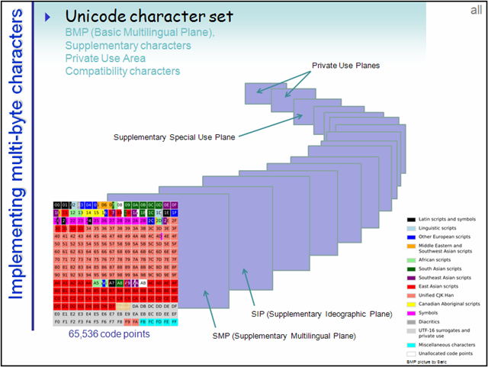
Unicode
Over 1,000,000 possible codes.
  Much better than 256 (2⁸) in old fonts [legacy fonts).
Divided into 17 groups (planes) of 65,536 characters (2¹⁶)
First group = BMP (basic multilingual plane)
  all living languages

Slide 7
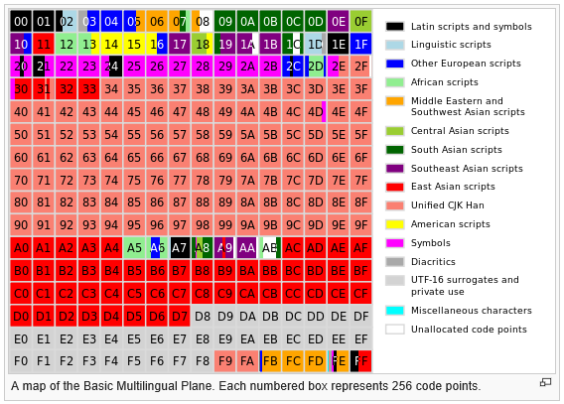

Slide 8
UTF-8, Unicode 16, 32
UTF-8
  One byte for ASCII characters
  Two bytes for ANSI
  Three bytes for Asian
  Four bytes others
Unicode 16
  Two bytes for first 65,535, four for the rest
Unicode 32
  Four bytes for everything

Slide 9
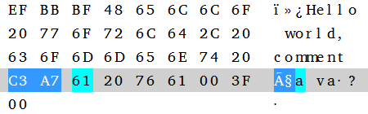
UTF-8
One byte for ASCII
Two bytes for ANSI
Hello world,
comment
ça va?

Slide 10


Same code different bytes
UTF-8
UTF-16 BE
UTF-32 BE
UTF-32
LE

Slide 11
Legacy (pre-Unicode)
Old font system (2⁸)
  only 256 possibilities
    128 (all the characters on US keyboard) = ASCII
    + 128 extra
  In those days there was no Unicode [King] and every man did what was right in their own eyes [Jud 17:6]
    PC, MAC, each SIL branch

Slide 12
Unicode consortium
Committee meetings to decide on a unique code for every “thing” (code point)
  Letters
  Numbers
  Punctuation
  Diacritics …

Slide 13
Unicode conversion
So old data (non-ASCII) needs to be converted to Unicode
How?
Special software is available for conversions

Slide 14
Notes:
Poll Title: What software can we use for converting to Unicode?
https://www.polleverywhere.com/multiple_choice_polls/vtuJjJflTN31Vhy

Slide 15
Unicode Conversion
Software
  SIL Converters 4.0
  Consistent Changes (ccWin)
Conversion table (map/tec/cct)
  Some installed with SIL Converters
  Write your own

Slide 16
Install SIL Converters 4.0
SEC_FullInstall.exe
Choose converters for your branch/area
You try!

Slide 17
Learning task 1 – Needs converting?
Identify if a file needs converting to Unicode
  Examine the files in the Unicode folder.
  Identify which files are already in Unicode.

Slide 18
Notes:
Poll Title: How do we know if a file is in Unicode?
https://www.polleverywhere.com/free_text_polls/pvEbPTQhDMffBiJ

Slide 19
Is your file in Unicode already?
Name of the file
  ends with –u
  or (SFMConvert'd)]
Name of font
  SIL Doulos, Cam Cam SILDoulosL
  Doulos SIL, Charis SIL, Andika
Insert, Symbol, font how many characters? Do they match the names?

Slide 20
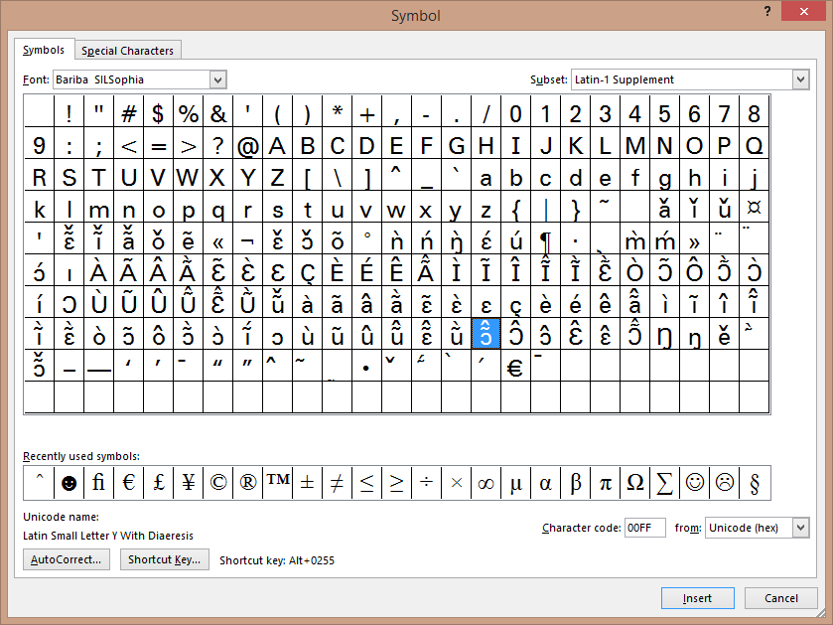
Is your file in Unicode already?
In Word,
  Insert > Symbol
  How many
  characters?
  Does it match
  the names?

Slide 21
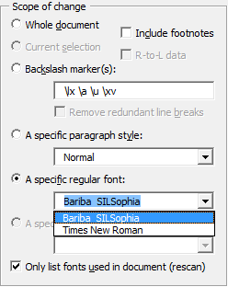
Are there any legacy fonts?
In Word
  Add-ins
  Data conversion macro
  Only list fonts used in document (rescan)
Are there any legacy fonts in list?
  Only works for fonts installed

Slide 22
Your turn
Examine the files in the Unicode folder.
Identify which files are already in Unicode.

Slide 23
2. Add a converter
Add Baatonum converter through Word or LibreOffice
Hint
  From Word, Add-ins, Data conversion macro
  Select, Add new, Select type
  Click Setup tab, find map/tec file,
  Save in Repository, Give name, OK

Slide 24
Learning task 2 – Install a .tec file
In pairs or individually,
  Install the tbb.tec file
  Go to Word or LibreOffice
  Select the data conversion
  Select converter
  Choose Add new
  Choose the converter engine
  Choose the file
  Add to repository

Slide 25
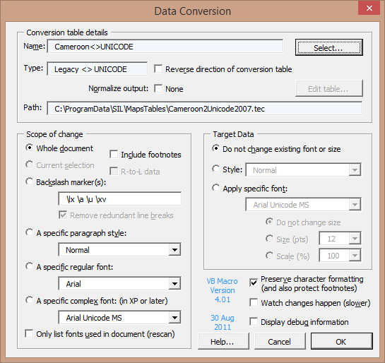
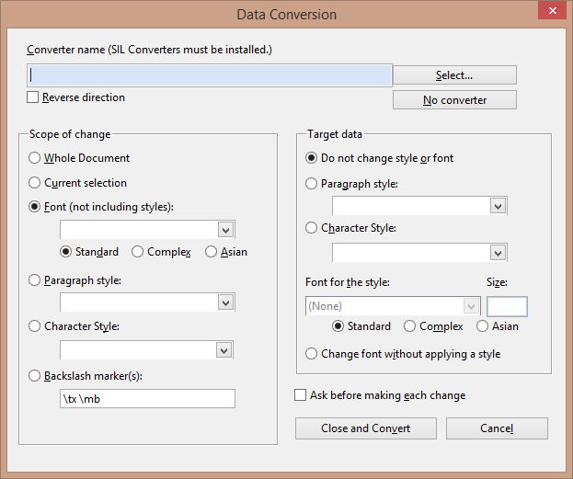
Run the converter
Conversion table details
Scope of change
Target data
Other options

Slide 26
Save as …
Rename to file to indicate Unicode.
Suggestions?

Slide 27
Other applications?

Slide 28
Useful links
Various MAPs different entities
  http://scripts.sil.org/cms/scripts/page.php?cat_id=ConversionMaps#e8af644d
Uniview
  http://rishida.net/uniview/
  Type or paste text, shows you the Unicode values

Slide 29
Learning task 3 – Word document
In pairs or individually,
  Open the document to convert.
  Add-ins tab
  Run the Data conversion add-in
  Select the convert, scope to change, target,
  Ensure preserve formatting is checked.
  Convert
  Examine the document for possible errors
  Save the file as renaming the document.

Slide 30
Assignment
Follow the instructions in “Assignments Unicode.docx”

Slide 31
Notes:
Poll Title: What are you taking away about Unicode conversions?
https://www.polleverywhere.com/free_text_polls/ATVb62rV0HNDXtw

Slide 32
Scenario 1 – Branch TEC file
Install SIL Converters 4.0
Install Map files for your branch
If not available to install
  check server or website for TEC
  http://scripts.sil.org/MappingFiles

Slide 33
Scenario 2 – no MAP/tec exists
Drop Font file (xxx.ttf) on Encore2Unicode61.exe
Edit the draft MAP file
Compile to TEC file
Add as installer to SIL Converters

