Slide 2
Objectives
Know what the Digital Bible Library (DBL) is.
See how a NT is put into the DBL
Search for languages in the DBL
Access a NT using YouVersion

Slide 3
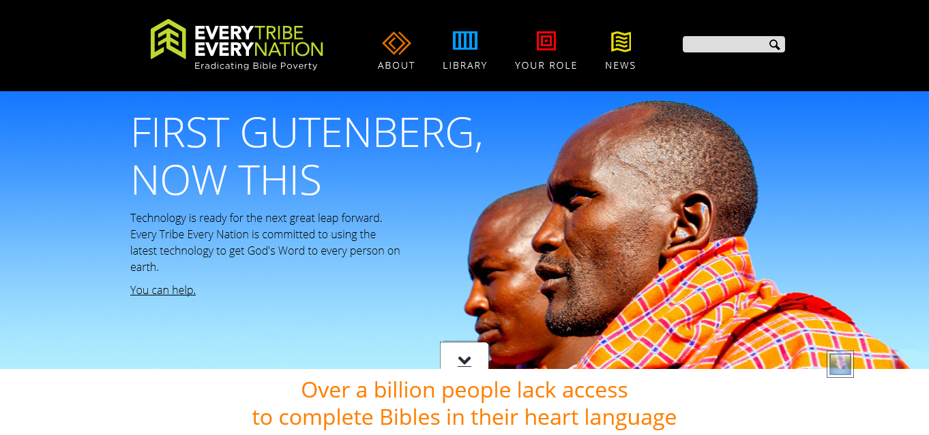
What is the DBL?

Slide 4
<The Digital Bible Library.mp4>

Slide 5
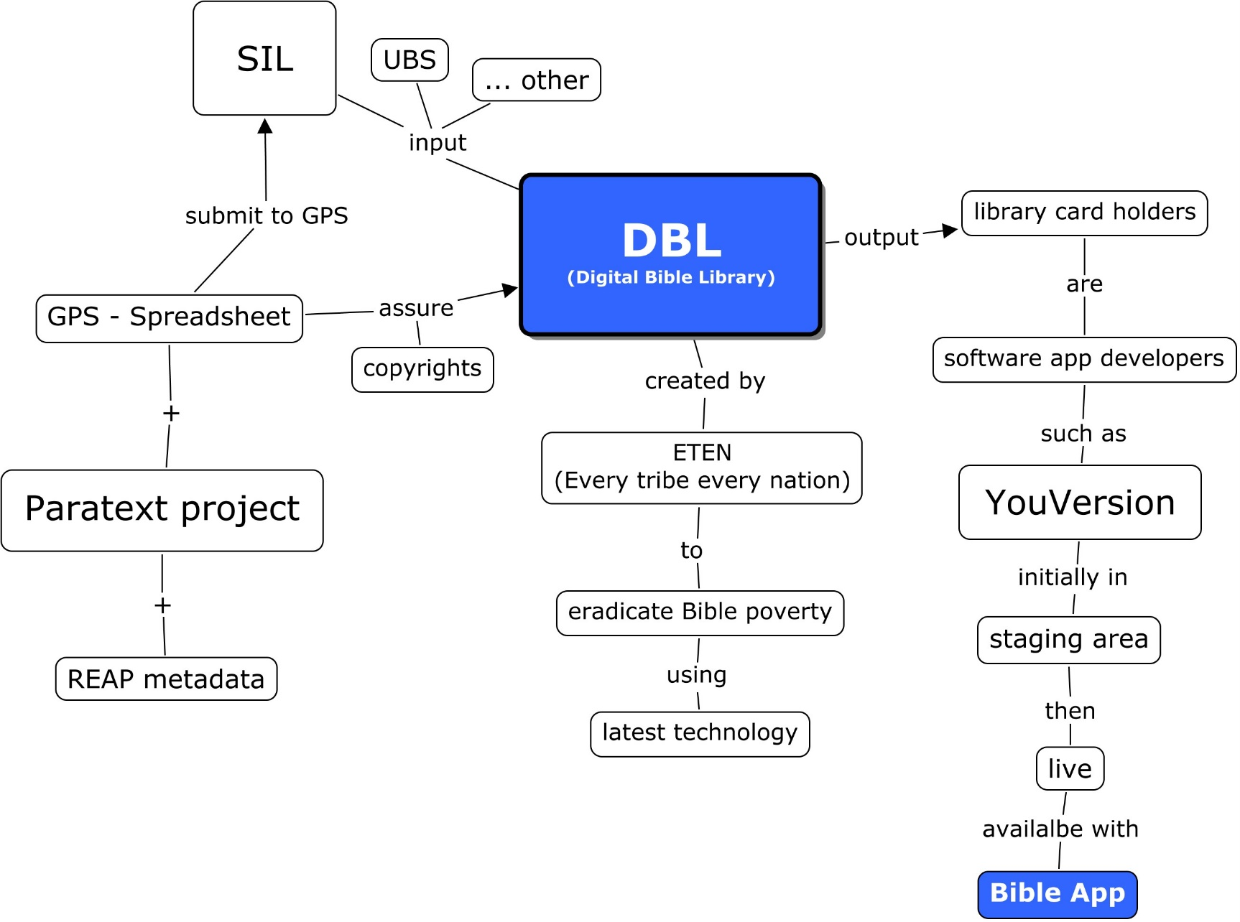

Slide 6
DBL Process
Send/
Receive
to GPS
GPS
Spreadsheet
Prepare
Paratext
Prepare
Metadata
Create
Canon
People group
Published scriptures
Dates of stages
Unicode
Restore copy
Language info
Figures folder
Checks
\toc
Extract REAP
Review
google
Paratext
DBLmetadata
Paratext
Paratext
DEMO
DEMO
DEMO

Slide 7
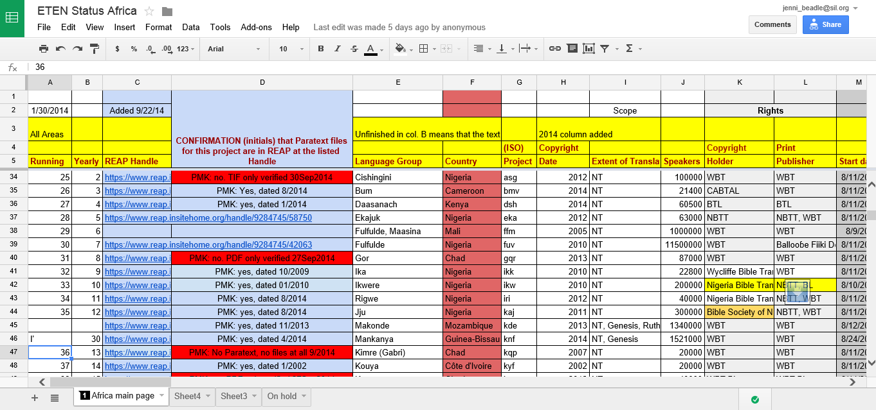
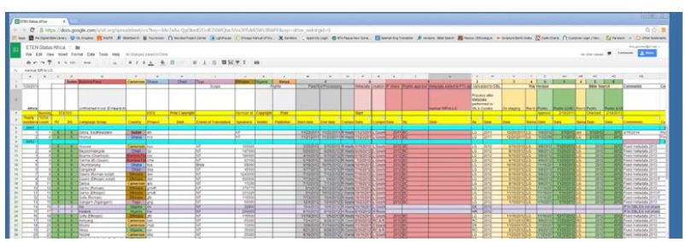
Log the project on
GPS spreadsheet
DEMO
Request an invitation to the google spreadsheet
Fill in the following details
  People
    Language group
    Primary country
    ISO code
    No. of speakers (ethnologue)
  Published scriptures
    Copyright date
    Extent of translation (NT, OT, portions …)
    Copyright holder
    Print publisher
  Preparation of data for DBL

Slide 9
Preparing the Paratext project
Try
Must be in Unicode
Restore a copy to new project (isoDBL)
  Check language info
  Create figures folder
  Place PDF of text
Do Paratext Checks
  Chapter/verse, Markers, Characters, quotations, scripture reference settings and reference check
Add toc markers
  \toc1, \toc2, \toc3

Slide 10
Prepare the Metadata
DEMO
Launch DBlMetaData.exe
Extract the metadata from REAP
Review Project Data form
Save your edits

Slide 11
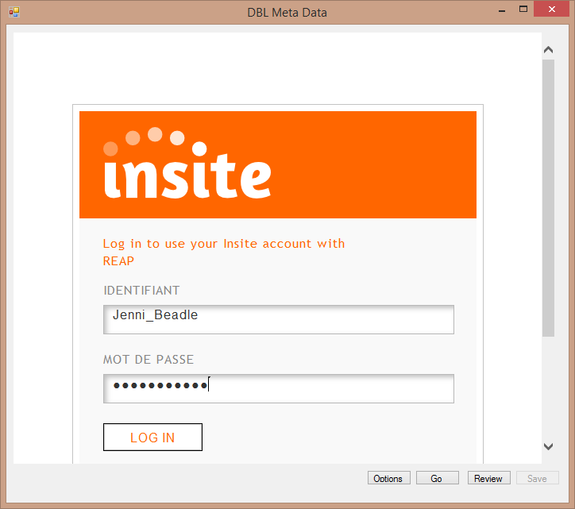
Prepare the Metadata
DEMO
Launch DBlMetaData.exe
Extract the metadata from REAP
Review Project Data form
Save your edits

Slide 12
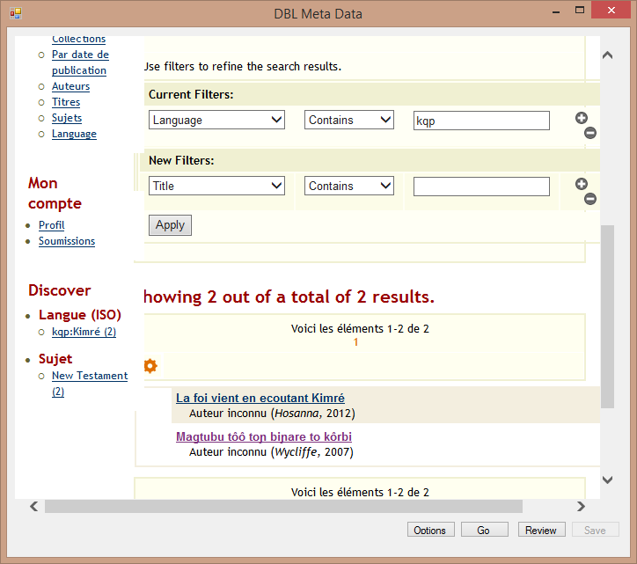
Prepare the Metadata
DEMO
Launch DBlMetaData.exe
Extract the metadata from REAP
Review Project Data form
Save your edits

Slide 13
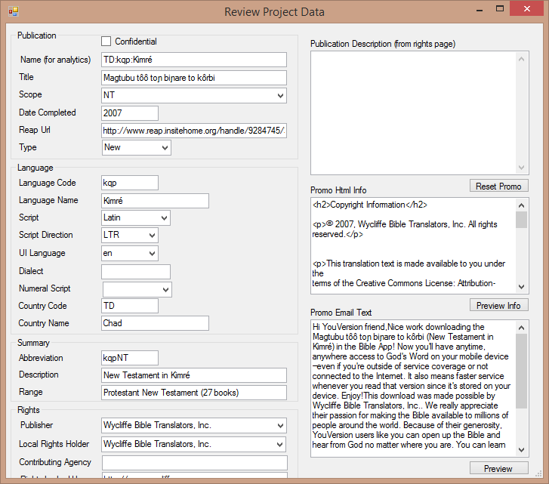
Prepare the Metadata
DEMO
Launch DBlMetaData.exe
Extract the metadata from REAP
Review Project Data form
Save your edits

Slide 14
Create a canon
Try
In Paratext
Check the schema
  Checking, SHIFT+Basic Checks
  Check Schema
Create the canon using
  SHIFT + Project menu, Project Canon
Fill-in details, OK

Slide 15
Send project to Lois
DEMO
In Spreadsheet
Record completion in the spreadsheet
Add Lois Gourley to project
Send/Receive
Lois will process and send to DBL

Slide 16
Access from DBL
Try
DBL
  Library card holders are software apps
  View metadata only (http://www.digitalbiblelibrary.org/allentries)
YouVersion
  Download app (https://www.youversion.com/ )
  Create user
  Download vernacular scriptures (from Bible App)
  Major languages online only (some exceptions)

Slide 17
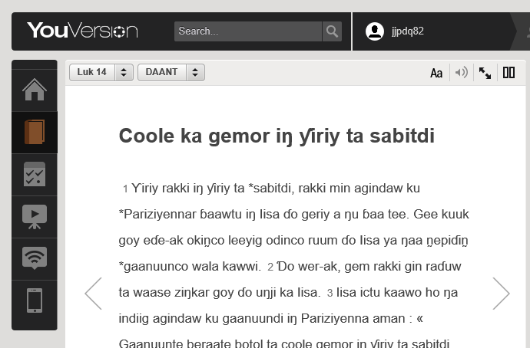

Slide 18
What is your role?
Raise awareness in your branch
New publications
  submitted by the typesetting centre
Old publications
  Various workshops
  What does your branch need?
Help users access

Slide 19
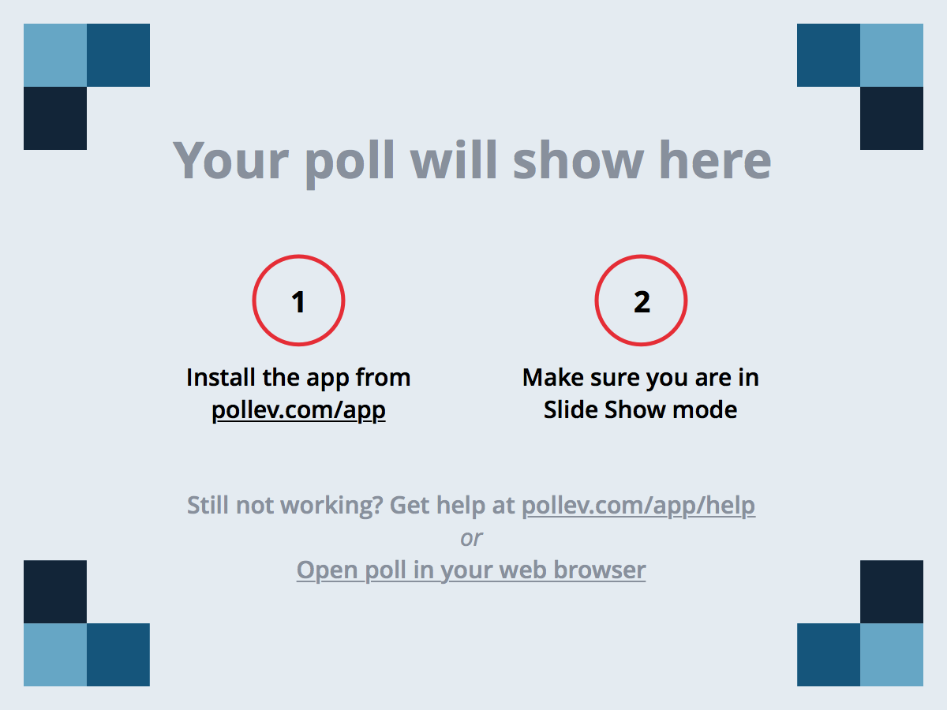
Notes:
Poll Title: What are you taking away with you about the DBL?
https://www.polleverywhere.com/free_text_polls/9I76p4FYZrNmbSh

