Slide 1
Nyangatom Verbs

Slide 2
Nyangatom Verbs
Verb Types:
Dynamic
Stative
Auxiliary

Slide 3
Nyangatom Verbs
Other possible types or sub-types:
Copulative
Negative
  Independent
  Subordinate
Conjoint
Disjoint
Imperative
Subordinate

Slide 4
Dynamic Verbs
Have at least three Aspects/Moods:
Active
Passive
Conjunctive

Slide 5
Dynamic Verbs
Verb extensions:
Causative
Benefactive
Ablative
Allative

Slide 6
Transitivity
Often only impacts syntax (constituent ordering) but templates may be required if the structure of the verb itself is affected.
If the changes to the verb morphology are slight consider adapting templates to work with all transitivity types, i.e. object

Slide 7
Inflectional Classes or Declensions
The verbs in Nyangatom can be divided into two Inflectional Classes. (Each has a different set of subject marker prefixes.)
TO -class
KI -class

Slide 8
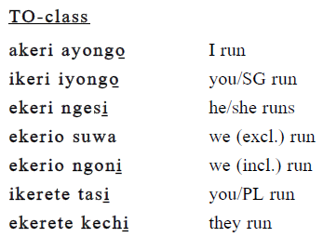
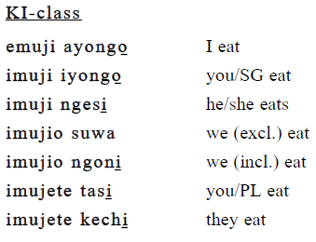
Examples of TO and KI Classes

Slide 9
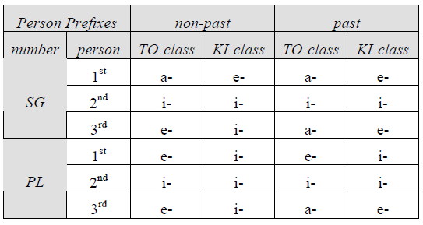
Summary Chart of Person/tense

Slide 10
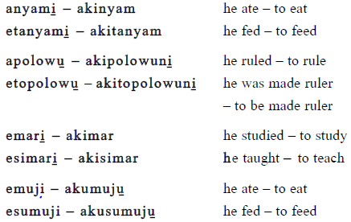
Causative Extension
s+tpx_extpx_verbstem_numsx

Slide 11
Reciprocal Verbs
arami | aramakinosi
he beat | they beat each other
engoliki | engolikinosi
he saw | they saw each other
arimaki | arimakinosi
he forgave | they forgave each other
ewuma | ewumakinosi
he married | they married each other
Template:
sbj+tenpx_verbstem_extsx_numsx

