Slide 1
A practical 4-step process for Biblical Terms
Taking small steps to achieve a big goal

Slide 2
Why users don’t have a Biblical Terms process
The job is too big (consistent BT renderings across the entire project)
It’s easier to ignore it (but not in Assignments and Progress!)
The tools are too scary
Too many menu items
Too many ways to use it
We don’t know how or where to start

Slide 3
It’s not a check, it’s a process
We want to do more than just pass a check where ParaTExt says there are “no issues”. We want to
Use the right renderings,
Use them consistently, and
Maintain a record of our Biblical Terms Renderings decisions.

Slide 4
It’s not a check, it’s a process
Start early so you have time to do it right.
Don’t wait until it’s too late!

Slide 5
Where do we start, and how?
Start where you are translating today
Use a simple process
Do a small part of a big job each day
Use only the tools you need (learn others later)

Slide 6
I went to the animal fair
The birds and the beasts were there
The big baboon by
The light of the moon
Was brushing his auburn hair

Slide 7
The monkey he got drunk
And sat on the elephant’s trunk
The elephant sneezed
And sat on his knees
And that was the end of the monk. The monk the monk the monk.

Slide 8
A fly and a flea in a flue
Were stuck, so what could they do?
Let us flee said the fly
Let us fly said the flea
So they flew through a flaw in the flue

Slide 9
Presentations by Phil Leckrone
They thrill me to the bone
But when Higby Doug
Reports on a bug
It makes Nathan want to go home.

Slide 10
And then there’s Brian and Bob
On notes they did a great job
But now it’s my turn
For Biblical Terms
And I get to teach this great mob!

Slide 11
Biblical Terms Limerick - 1
Renderings all over your text
And you don’t know what to do next
So listen to my rhyme
It will help you each time
You’ll see how to clean up your text

Slide 12
The Biblical Terms Limerick - 2
1. From renderings all over our text.
2. We will choose which ones are the best.
3A. We’ll reject all the others,
3B. Write notes for our brothers.
4. And then we’ll clean up our text.

Slide 13
The Biblical Terms Limerick
1. From renderings all over our text.
2. We will choose which ones are the best.
3A. We’ll reject all the others,
3B. Write notes for our brothers.
4. And then we’ll clean up our text.

Slide 14
The Four Steps
1. Find all the ways you have rendered this term, and enter them in the Edit Renderings dialog.
2. Choose which renderings are best, and record why.
3. Document why you rejected the other renderings.
4. Clean up your translation by making this rendering consistent throughout your translation.
Repeat with next Biblical Term you find in the Biblical Terms Renderings window.

Slide 15
From renderings all over our text, | Find all the ways you have rendered this term, and enter them in the Edit Renderings dialog.
We will choose which ones are the best. | Choose which renderings are best, and record why.
We’ll reject all the others, | Document why you rejected the other renderings (Who decided, What you decided, and Why)
Write notes for our brothers,
And then we’ll clean up our text. | Clean up your translation by making this rendering consistent throughout the current book or your whole translation.

Slide 16
Not covered in these presentations
How to
Know what a Biblical Term means in Greek or Hebrew
Check Biblical Terms Renderings with a local community
Use Advanced filtering in Biblical Terms tool
Adjust Biblical Terms display settings

Slide 17
The Biblical Terms Limerick
1. From renderings all over our text.
2. We will choose which ones are the best.
3A. We’ll reject all the others,
3B. Write notes for our brothers.
4. And then we’ll clean up our text.

Slide 18
Coming in the 2nd presentation
Use Biblical Terms Highlighting in a consulting session
Create a Project Biblical Terms list
Add a term or phrase to your Project Biblical Terms list

Slide 19
Coming in the 2nd presentation
Ensure consistency of Biblical Terms in a set of books (Saved verse filter)
Compare Biblical Terms Renderings with other translations (Biblical Terms Tool middle pane)
Connect glossary entries to Biblical Terms (and ParaTExt will keep them alphabetized)

Slide 20
Coming in the 2nd presentation
Automatically mark words as glossary entries
Add any word or phrase as a new Biblical Term (even if nobody else thinks it’s a Biblical Term)
Speed up approving Biblical Terms Renderings by having ParaTExt guess what they are.

Slide 21
Coming in the 2nd presentation
Print a Biblical Terms Renderings List

Slide 22
The Biblical Terms Limerick
From renderings all over our text.
We will choose which ones are the best.
We’ll reject all the others,
Write notes for our brothers.
And then we’ll clean up our text.

Slide 23
Set up
Associate a Biblical Terms list with your project
Today, choose anything. For real, be aware.
Add Biblical Terms to your list
Start with Major Biblical Terms (or some other list)
Remove the ones you do not want
Notes:
If you are going to associate a FLEx project with your ParaTExt project, you will want to choose this list: Major Biblical Terms (SIL Semantic Domains).

Slide 24
Set up, cont’d
Arrange Biblical Terms Renderings Window
Transliterate Terms (if you can’t read Greek or Hebrew)
Arrange the Biblical Terms tool -- Comparative Texts

Slide 25
The Biblical Terms Limerick
From renderings all over our text.
We will choose which ones are the best.
We’ll reject all the others,
Write notes for our brothers.
And then we’ll clean up our text.

Slide 26
Demo of the 4-step process
Don’t try to write down the details of each step.
Screen shots are in this presentation.
Details of each step are in my speadsheet:
What to do
Which ParaTExt tool to use
How to use that tool (e.g. what filter to use, and how)

Slide 27
Screen shots of the steps
1A Double-click on the term in the Notes List Window

Slide 28
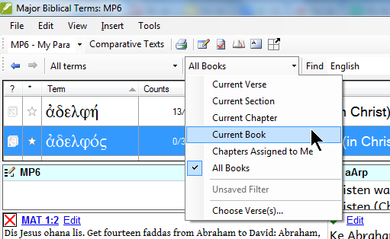
1B. In the Biblical Terms Tool, filter for the current book.

Slide 29
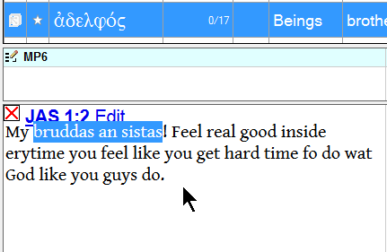
1C. Highlight the rendering and press Ctrl-A

Slide 30
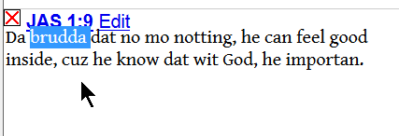
1D. Do the same with all your all renderings

Slide 31
2A. Double-click the rendering field in the upper pane

Slide 32
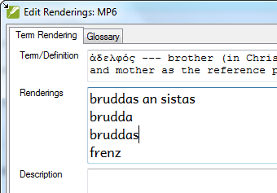
All renderings are in the rendering field

Slide 33
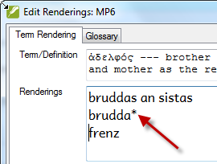
2B. Combine some renderings using *

Slide 34
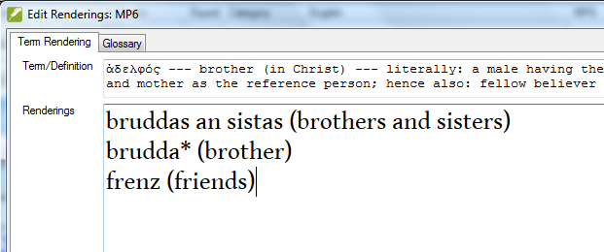
2C. Add back translations

Slide 35
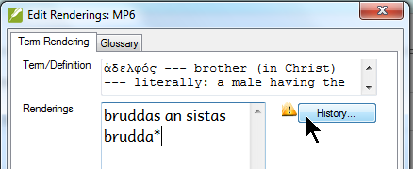
3A. Reject renderings you don’t want to use

Slide 36
3B. Write a note about why you rejected them
Click the top line in the history and write your reasons for changing the renderings. Include why you rejected some rendernigs.

Slide 37
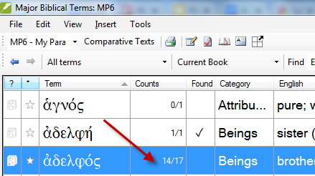
4A. Check to see if all occurrences are accounted for

Slide 38
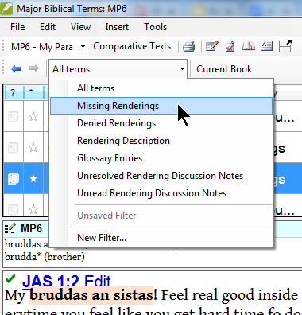
4B. Find verses with missing renderings

Slide 39
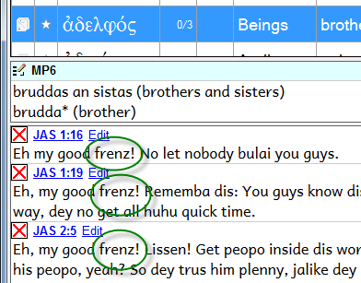
4C. Here they are so let’s change them

Slide 40
4D. Click to open a quick-edit window

Slide 41
4D. Or click to open verse in ParaTExt main window

Slide 42
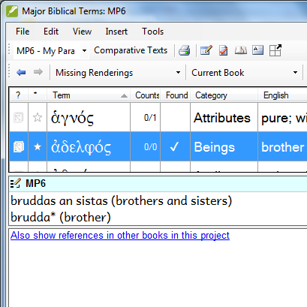
4E. Evidence: ParaTExt shows no verses with missing rendering for this book

Slide 43
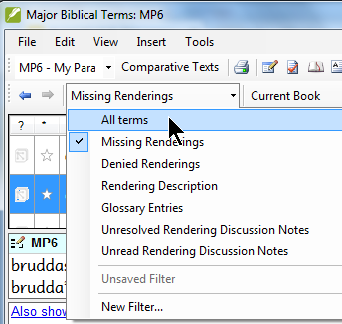
4F. Change filter to “All Renderings”
Now how did we do? We are 17 for 16. We got them all!

Slide 44
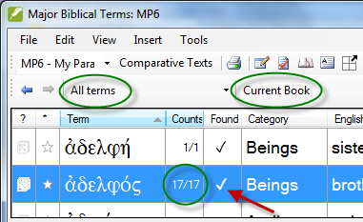
4F. Evidence: ParaTExt shows it can find them all in this book

Slide 45
4G. Evidence: Biblical Terms Renderings Window agrees
Tick mark in “found” column means ParaTExt sees this Biblical Term Rendering in this verse.

Slide 46
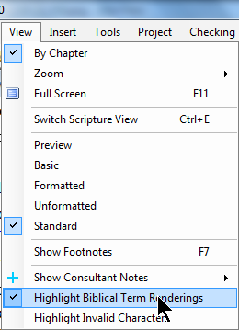
4H. View > Highlight Biblical Terms Renderings

Slide 47
4H. Evidence: Rendering highlighted

Slide 48
Next term or go deeper?
Now that you have that term consistently rendered in this chapter, you can
Move on to the next term in Biblical Terms Renderings Window, or
Keep working on this Biblical Term: Filter in Biblical Terms tool for “all books” or “my current books” (custom saved filter) to make it consistent in more of your translation.
You have to weigh what is urgent and what is important:
I want to finish this chapter soon, but
Eventually I need consistent renderings everywhere.

Slide 49
Why record your Biblical Terms decisions?
Those who don't record their Biblical Terms history are doomed to repeat it.

Slide 50
3 types of Biblical Terms notes
 | Rendering Discussion Notes | Rendering Description | History Notes
Where to find it | Far left column in Biblical Terms tool or Biblical Terms Renderings Window | Renderings dialog, Description | Renderings dialog > History
When to use it | Team is still deciding how to render a term. | Team has decided how to render a term. | Team has changed renderings.

Slide 51
The Biblical Terms Limerick
From renderings all over our text.
We will choose which ones are the best.
We’ll reject all the others,
Write notes for our brothers.
And then we’ll clean up our text.

Slide 52
I need . . .
To make my Biblical Terms Renderings consistent in 1-2 Thessalonians. 1-2 Timothy, and Titus.
How can I do that?

Slide 53
Save a filter for a group of books
Verse Filter > Choose Verses
Choose books you want
Give this set of books a name
Save it
Use that list in Biblical Terms, Wordlist, Notes List Window, Parallel Passages
Others in your project receive the list via send/receive

Slide 54
You try it
Associate a Biblical Terms list with a project
Practice on some Biblical Terms in the practice project. (See spreadsheet for detailed steps)
In 1 Timothy 1:2 grace, mercy, and peace
Any other Biblical Terms you want to try
Write a short mnemonic (memory aid) device for your language or a LWC in your region

Slide 55
The Biblical Terms Limerick
From renderings all over our text.
We will choose which ones are the best.
We’ll reject all the others,
Write notes for our brothers.
And then we’ll clean up our text.

Slide 56
How we taught this in Papua New Guinea
Painim (Find)
Skelim (Evaluate)
Rausim (Remove)
Raitim (Write notes)
Stretim (Make consistent)
How will you teach it?

Slide 57
Prefixes and suffixes
Tools > Word prefixes and suffixes
This might be more helpful than using asterisks for words.

Slide 58
What level of detail are you trying for today?
1 Identify a rendering
2 Make rendering consistent in current book
3 Add a back translation 3 Add a glossary entry 3 Document alternative renderings
4 Renderings consistent in all books already published
5 Renderings consistent in all book to be published

Slide 59
What level of detail are you trying for today?
Be realistic
Be specific
Decide on a plan for achieving consistency everywhere eventually

Slide 60
If you see a problem in the text
Fix it now or
Write a note!
You may never notice it again.

Slide 61
How to make this part of your process
Teach it more than once
Use it consistently
Put the check “Biblical Terms Renderings Found” early in your Project Plan so it will be in Assignments and Progress.

Slide 62
Reflection
Do you want to teach this method in your context?
How will you teach this method?
What resources will you need?

