Slide 1
Paratext 8 Project Plan Setup for Administrators
Notes:
So there is a Paratext 7.5 server and a Paratext 8.0 server
Kent & Doug Higby probably get a request from Cameroon every so often when I am in search of a Paratext license for someone

Slide 2
Setting the project scope
Creating a project plan
Modifying a project plan
Configuring task settings
Assigning checks to stages
Assigning tasks to the team

Slide 3
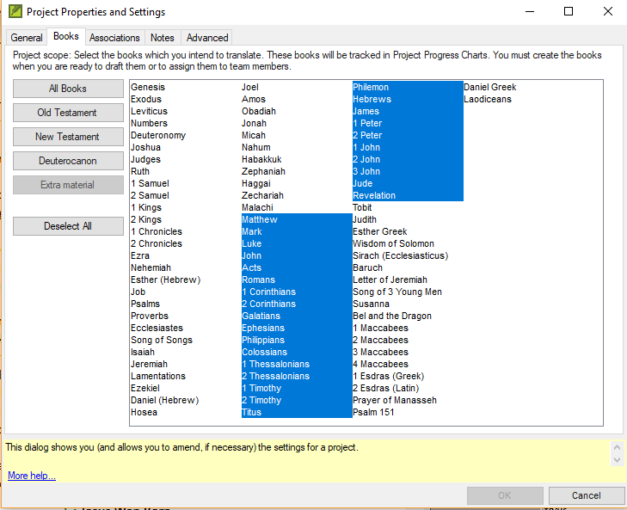
Project Plan Setup

Slide 4
Creating a project plan
Selecting a base plan and applying it to project
In the Project menu, click Project Plan
Click Manage Plans
Select a base plan
Click Copy Plan
Click OK

Slide 5
Modifying a project plan
Reorder tasks
Add tasks
Delete tasks
Combine tasks

Slide 6
Modifying a project plan
Reorder tasks
Tasks can be moved earlier or later in a stage
Tasks can be moved to different stage
Tasks should be placed where they must be completed
Add tasks
Delete tasks
Combine tasks

Slide 7
Modifying a project plan
Reorder tasks
Add tasks
Select preceding task
Click Add task button
Give the task a name and description
Delete tasks
Combine tasks

Slide 8
Modifying a project plan
Reorder tasks
Add tasks
Delete tasks
Select task and click on X or Remove task button
No undo function
Can cancel if you delete the wrong task
Combine tasks

Slide 9
Modifying a project plan
Reorder tasks
Add tasks
Delete tasks
Combine tasks
Select the task you wish to edit
Edit the name and description
Delete the other task

Slide 10
Configuring task settings
Three task settings
Mark task as complete
When can this task start
Requires Editing

Slide 11
Configuring task settings
Three task settings
Mark task as complete
By chapter of a book
By entire book
By entire project
When can this task start
Requires Editing

Slide 12
Configuring task settings
Three task settings
Mark task as complete
When can this task start
Dependent tasks: after a previous task for chapter or for book or after a previous stage
Non-dependent tasks can be set to begin
Effects the task shown on the translator’s to do list
Requires Editing

Slide 13
Configuring task settings
Three task settings
Mark task as complete
When can this task start
Requires Editing
Project name
No

Slide 14
Assigning checks to stages
Automatic checks are set at the stage level
In Checks tab in the Project Plan dialog box
At least 20 checks available to you
There are five categories of checks: Basic, Spelling, Unresolved Notes, Back Translation and Other
Each Note tag will have a potential check

Slide 15
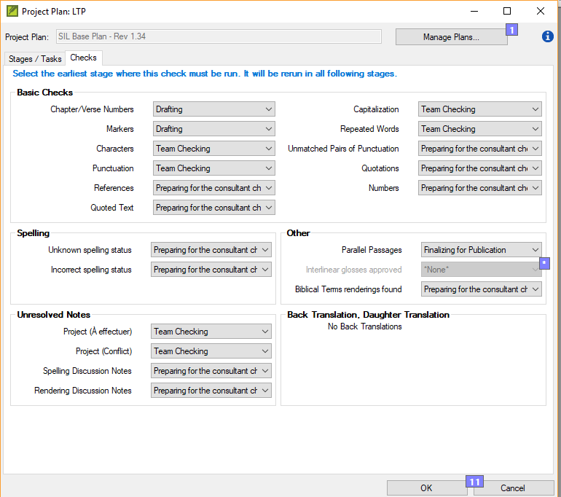
Assigning checks to stages

Slide 16
Assigning tasks to the team
There are three kinds of activity
Editing the text
Resolving issues
Marking progress

Slide 17
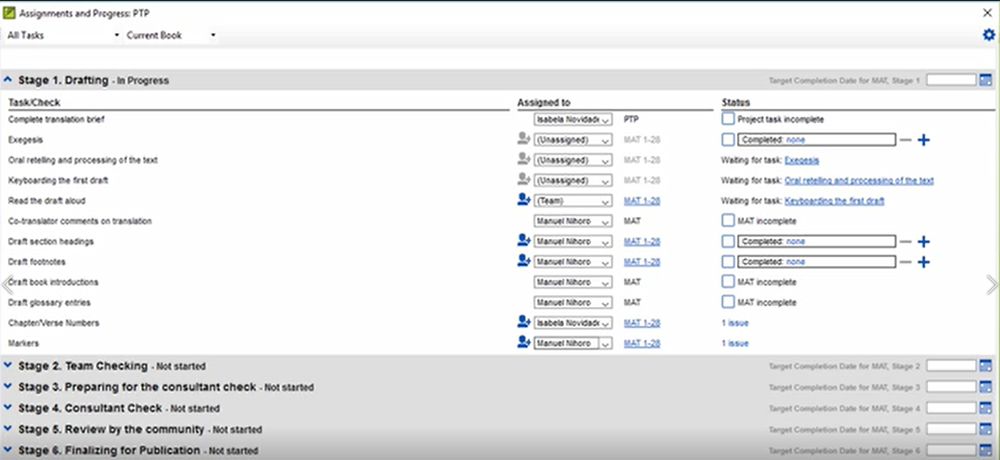
Assigning tasks to the team
In the Assignment and Progress dialog box, there are three columns:
Task/Check
Assigned to
Status

Slide 18
Assigning tasks to the team
In the Assigned to column, there are options to select:
Unassigned
One team member
Status

Slide 19
Your Turn
Create a new standard translation project with language of your choice and with at least one book
Apply SIL base plan to your project and save it.
Stage 1: Move insert illustrations task up 2 spaces
Stage 2: Move Biblical key terms check down one space
Stage 1: Delete Draft glossary entries task

Slide 20
Your Turn
Stage 3: Add a task “Have an celebration” as the last task in the stage. Mark task complete = book and when can this task start? = after team check is complete and requires editing = no.
Stage 2: Naturalness check task, change when can this task start? = after previous task is complete for chapter
Stage 3: First comprehension check task, change when can this task start? = after previous task is complete for chapter.

Slide 21
Your Turn
Stage 6: Combine money – final check and weights – final check into one task.
In Checks, change repeated words to drafting.
In Checks, change parallel passages to review by community.
Assign translation brief to the team.
Assign a chapter of book to yourself.

Slide 22
Summary
A project plan is built upon an _______ plan.
To add a task to the plan, you select ______ task, click _______ button and give the task a name and __________.
You can mark a task as complete by chapter, by ______ or by _______.
Answers: organizational, preceding, Add task, description, book, project
Notes:
You should demonstrate these in Paratext

