Slide 1
Learning to use HearThis
…and HearThis Android, and Glyssen
John Thomson, LsDev Dallas
Kenya workshop, April 2018

Slide 2
What is HearThis?
Easy to train/use software for recording audio Scriptures and preparing the recordings for loading onto various hardware devices for publishing

Slide 3
What is HearThis Android?
Easy to train/use software for recording audio Scriptures on an Android device (phone or tablet)
Exchanges data with HearThis desktop for publishing and merging

Slide 4
What is Glyssen?
Software for creating scripts for multi-voice Scripture recordings
Breaks the text up into chunks that should be spoken by one person
Helps you assign parts to available voice actors

Slide 5
How do Glyssen and HearThis cooperate?
Glyssen can export a form of its script that HearThis can import
HearThis can then restrict the passages offered for recording to those that should be read by a particular voice actor (one character at a time)

Slide 6
Where does HearThis shine?
Designed for use by translation team or affiliated local users, not highly trained recordists
Readers with limited skills can keep trying, in private, until satisfied with the results. In some cases this gives a better final result than working with expert recordists.
Low cost; it can be used for incomplete, even unpublished translations
Pulls data directly from Paratext and/or the Digital Bible Library

Slide 7
Is it a good way to record?
Fears:
Some loss of fluency reading one sentence at a time
No professional help with studio, mic, whatever
But:
Early and often allows audio to feed back into translation process
early access and community involvement
Repeat-until-right with no pressure VERY helpful to marginal readers
also for learning to read

Slide 8
What does HearThis Android add?
More devices to use for recording
Sync allows multiple people to work on recording at the same time
A logical enhancement would be multi-voice, but this is not yet implemented
It can’t (yet) do the whole job…no import or publishing except by sync with desktop

Slide 9
Basic recording (demo)
Run HearThis
Open project
Record
Check
Next
Other controls (font size, break at pause, two parts, skip)
Notes:
If I have time to practice, might add demo of publishing end result to megavoice

Slide 10
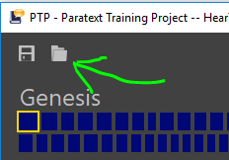
You try it
Use the HTP project, which should be shared with you
If necessary use send/receive in Paratext to get it
Run HearThis; select the HTP project when it asks you to choose
If you’ve used it before use this icon to switch projects:
Select 1 John (the first dark blue book)

Slide 11
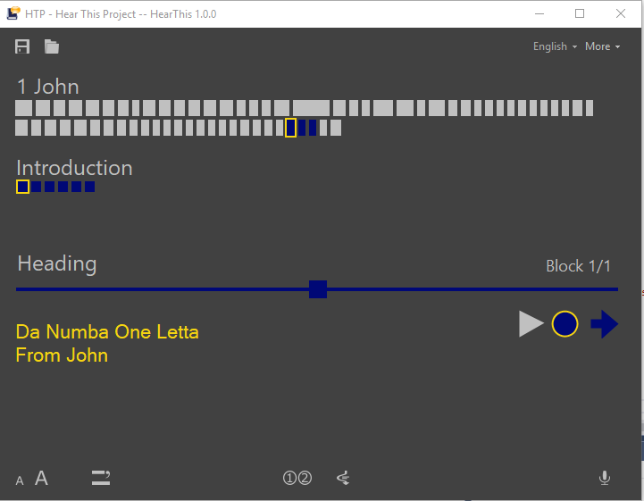
Screen should look like this:
Let’s practice recording a few sentences together.

Slide 12
Now try recording in a project of your own
Use this icon to select your project:

Slide 13
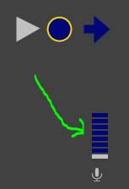
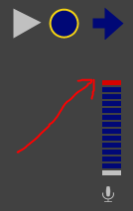
Levels
This is a level meter. It indicates how loud the recording is. This is a good level:
If you hardly see any bars the recording may be too quiet.
When you see red bars at the top the sound is too loud. You may get distortion.

Slide 14
Microphones
The microphone built in to a laptop is unlikely to make good recordings
Try to get something that holds the microphone near your mouth, typically a headset
Get as good a quality as you can.
http://x-cult-media.boards.net/ is one source of information on recording equipment

Slide 15
Microphone specs
The frequency range for (excellent) human hearing is 20Hz to 20,000Hz
Microphone should cover this as well as possible
If possible get recommendations from an audio expert

Slide 16
HearThis Android: demo
Sync project
Make recordings on phone
Pinch zoom
Sync again
Check recording

Slide 17
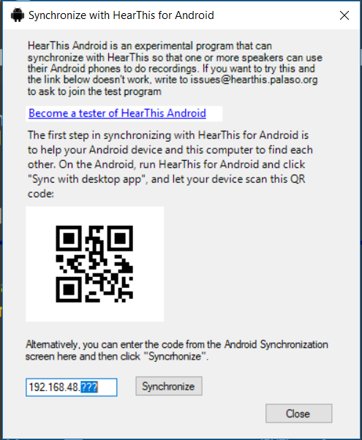
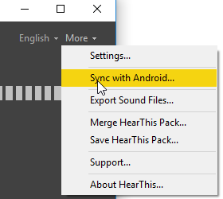
You try it
If necessary go to Play Store and install HearThis Android on your device
Sync: on desktop

Slide 18
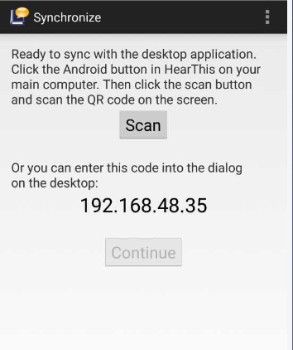
Sync: on Android
Click the sync button and focus scanner on the desktop bar code
The first three numbers must match (otherwise, the devices are not on the same network)
If you don’t have a scanner app copy the last number

Slide 19
HearThis Android level meter
Again, distortion may occur if you are seeing red

Slide 20
Now try some Android recordings
Choose a book and chapter
Use Record, Check, Next buttons as on laptop
Or you can just tap the line you want to record
Pinch zoom for larger or smaller text
After recording a few lines, do another sync and confirm the recordings transfer to the main computer

Slide 21
Limitations of HearThis Android
Does not yet know about not-recorded lines
No record-in-two-parts option yet.
Can’t publish; designed as a helper app to work with desktop
Does not show which lines have recordings made on other devices
It is possible to work on a multi-voice project, but HT Android doesn’t yet help you record only the lines for a particular character
Some Androids have Automatic Level Control which messes things up
Please let us know if it is useful (or would be, with these or other enhancements)

Slide 22
HearThis Android microphone notes
An external microphone is particularly important because your hand operating the controls will otherwise get in the way.
Bluetooth microphones don’t work (simply won’t be used)
With a headphone jack you have to be careful about plugs
With a USB you have to think about power and drivers

Slide 23
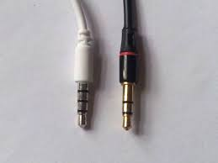
Android headset/mic plugs
✔
✖
You need a plug with four rings
Problem: two kinds that look the same
OMTP: OnePlusOne, some older phones, all phones sold in China after 2009.)
CTIA: Apple, HTC, recent Samsung, most Androids)
Make sure your microphone uses the same system as your phone!

Slide 24
USB microphones
Work well, one article suggests quality may be higher than headset plug
Only some phones can provide power to the headset, you may need a powered USB hub (look for the feature “USB host”)
Only some phones can even detect and use a USB microphone
Battery life may be a problem since you can’t charge the phone and use a USB mic; a powered hub might help with this too

Slide 25
Exercise: listen
Try to notice all the sounds you usually ignore.
Birds, cars, squeaky chairs, air conditioner
(All quiet for a minute or two)
What did you notice?
How could you avoid such sounds getting into your recording?
Try to notice such sounds as you check recordings

Slide 26
This is the sort of script we are aiming for:
Notes:
Thousands of lines in a New Testament. For example, in the Kuna language, the NT contains 10,707 lines spoken by more than 407 Biblical characters. Glyssen figures out 90% of them and makes it easy to adjust the rest. Typically an NT script can be produced in 4-8 hours…a task that took six weeks when first attempted.

Slide 27
Glyssen demo
Open the sample project
Show Project settings and emphasize punctuation settings
Identify Speaking parts
Simple view and filter to specify unknown characters
Rainbow view to align reference text and more easily specify characters
Open “finished” project and show assigning cast
Export to HearThis

Slide 28
Notes:
Skip this slide unless the demo fails somehow. If it does, this can be used to explain the basics of assigning characters.

Slide 29
HearThis multi-voice demo
Open the finished Glyssen project
Show choosing actor, character
Note how choice of books, chapters changes
Note how Next button behaves

Slide 30
Notes:
Here’s an example where a more complex edit is needed. The translation has turned the warning into direct speech. There are three parts to this verse where Glyssen expected only one. To fix it, copy the most relevant parts of the reference text and paste them in the lines below.
Notice that even here Glyssen has correctly guessed that the direct speech is spoken by “the dream” and the rest by the narrator.

Slide 31
Notes:
In this example, two lines are out of order compared to the reference text. Just select one and click “move down”.

Slide 32
Questions?
John_Thomson@sil.org

