Slide 1
Language Forge

Slide 2
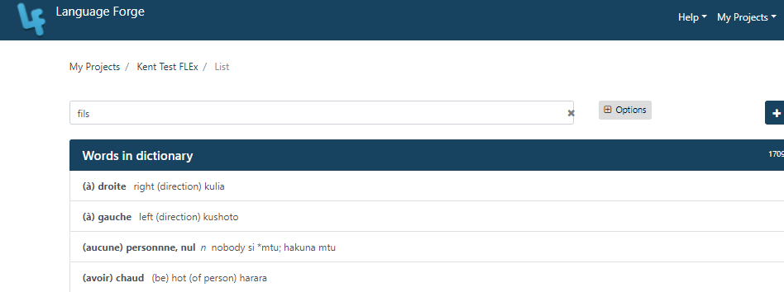
Learning Objective
The participant will know how to build an online lexicon using language forge

Slide 3
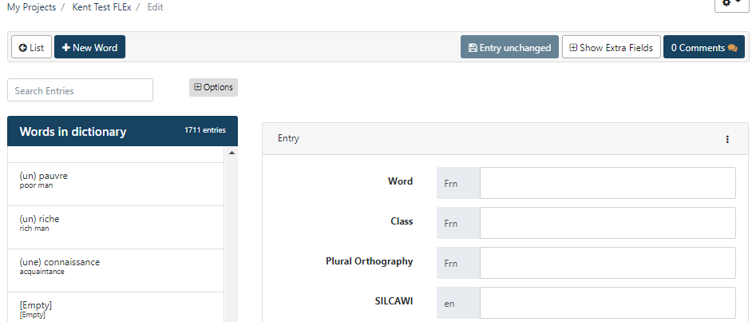
Discussion
Why would you want to use Language Forge?

Slide 4
Language Depot
Language Forge
FLEx

Slide 5
Demo of Project Owner
User Management
Project Settingss
Configuration
Fields
Input Systems
Option Lists
Import data
Notes:
User Management – add & remove members
Project Settings - UI lang, delete project
Fields - hide or ṣhow to whom
Input Systems = add audio or ipa
Options list – add to list

Slide 6
Learning Tasks
Sign in to Language Forge
Add you to Kent Test FLEx project
Find entries
Add new entries
Change existing entries
Delete an existing entry
Synchronize

Slide 7
Your Turn
Sign in to Language Forge
Add you to Pig Latin project
Add three new entries
Find these three entries using the Search box
Synchronize

Slide 8
Your Turn
Edit one of your existing entries by adding Example sentences
Edit another entry by adding a CV Pattern
Edit another entry by adding a Semantic Domain
Delete one of your three entries
Synchronize

Slide 9
Your Turn
Create a non-send/receive language forge project
Add a couple of entries to the project.
Add someone as a contributor to the project
Add another language to the project
Make some changes to the configuration of the project
Delete the project

Slide 10
Summary
Language Forge syncs with Language __________.
To add a language to a project, you would use the ______ tab in the Configuration dialog box.
The Word field is an _______ level field.
The Part of Speech field is a _________ level field.
To add and remove members from the project, you would use the ____________ menu option.
Answers: Depot, Input Systems, Entry, Meaning, User Management.

Slide 11
Discussion
What are your thoughts about Language Forge?
Would it be useful in your organization? Why or Why not?

