Slide 1
Paratext 9 Planning for success Project Plan Setup
Laying a firm but flexible foundation [for Administrators only]
Notes:
It was great to hear that so many of you are actually using the project plans.
What sorts of problems have you run into?
Too long, complex, fiddly to keep up to date?
Too hard to get up to date on established project
- Doesn’t match current practice? In Cameroon they work on groups of chapters not whole books. SIL plan can’t start stage 2 unless finished the book. If the plan is going to be useable must work without telling it you have done something you haven’t. Paratext 9 (and updated Paratext 8) has a new feature where you can consultant check groups of chapter. Testing it last night and I believe it will work, but we will see.

Slide 2
Learning Outcomes
Incomes?
Setting the project scope
Apply an organisational plan
Tweaking the project plan
Configuring task settings
Assigning checks to stages
Assigning tasks to the team
Learner
Practitioner
Trainer
Expert
Notes:
So rather than the review I had planned we will work with the new plan test it.
Our outcomes are
But let’s just reflect on our incomes, is there anything on this list that you are at learner level, what about the other levels?

Slide 3
Copy project plan
Make sure the base plan is in the correct folder
Sync your Resilio
Course > Project plan folder,
Copy LTCT base plan PT9.xml
To C:\… \My Paratext 8 Projects\_StandardPlans

Slide 4
Project Plan Setup
Applying a project plan
Modifying a project plan
Configuring task settings
Assigning checks to stages
Assigning tasks to the team

Slide 5
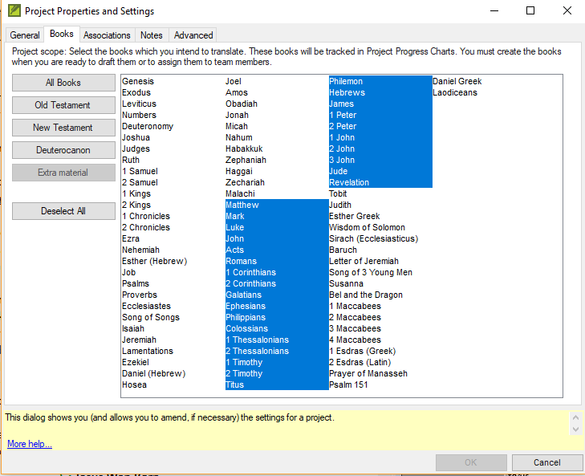
Setting the project scope
Project icon > Project menu > Settings > Project > Books

Slide 6
Managing a project plan
Select a base plan and copy it to the project
Click the Project icon, then in the Project menu, choose Settings, then click Project Plan
Click Manage Plans button
Select a base plan from the Show Base plan list
Click Copy Plan
Click OK

Slide 7
Your turn
Send/Receive LT19 using Internet
Work in pairs, administrator needs to add plan to project
Send/Receive using USB

Slide 8
Modifying a project plan
Reorder tasks
Add tasks
Delete tasks
Combine tasks

Slide 9
Modifying a project plan
Reorder tasks
Tasks can be moved earlier or later in a stage
Tasks can be moved to different stage.
Tasks should be placed where they must be completed
Add tasks
Delete tasks
Combine tasks

Slide 10
Modifying a project plan
Reorder tasks
Add tasks
Select preceding task
Click Add task button
Give the task a name and description
Delete tasks
Combine tasks

Slide 11
Modifying a project plan
Reorder tasks
Add tasks
Delete tasks
Select task and click on X or Remove task button
No undo function
Can cancel if you delete the wrong task
Combine tasks

Slide 12
Modifying a project plan
Reorder tasks
Add tasks
Delete tasks
Combine tasks
Select the task you wish to edit
Edit the name and description
Delete the other task

Slide 13
Configuring task settings
Three task settings
Mark task as complete
When can this task start
Requires Editing

Slide 14
Configuring task settings
Three task settings
Mark task as complete
By chapter of a book
By entire book
By entire project
When can this task start
Requires Editing

Slide 15
Configuring task settings
Three task settings
Mark task as complete
When can this task start
Dependent tasks: after a previous task for chapter or for book or after a previous stage
Non-dependent tasks can be set to begin
Effects the task shown on the translator’s to do list
Requires Editing

Slide 16
New setting
Notes:
Look through and see this plan, how does it compare with yours, a lot has been changed already
Notice after previous task is complete, after previous task is complete for book

Slide 17
Configuring task settings
Three task settings
Mark task as complete
When can this task start
Requires Editing
Yes
No

Slide 18
Assigning checks to stages
Automatic checks are set at the stage level
In Checks tab in the Project Plan dialog box
At least 20 check available to you
There are five categories of checks: Basic, Spelling, Unresolved Notes, Back Translation and Other
Each Note tag will have a potential check

Slide 19
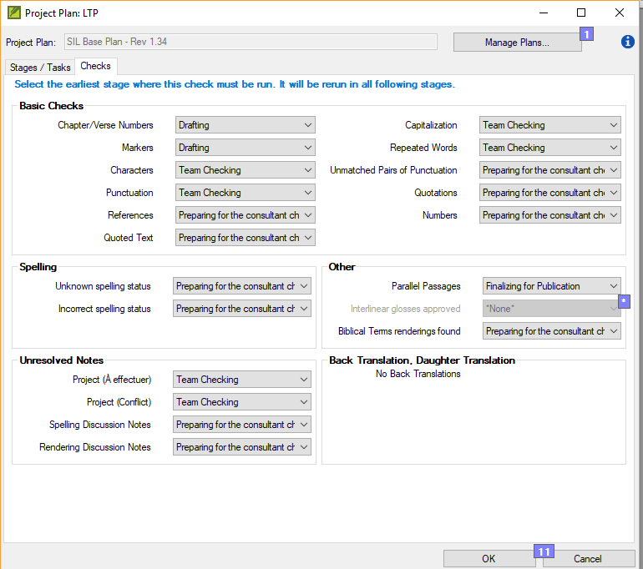
Assigning checks to stages

Slide 20
Assigning tasks to the team
There are three kinds of activity
Editing the text
Resolving issues
Marking progress

Slide 21
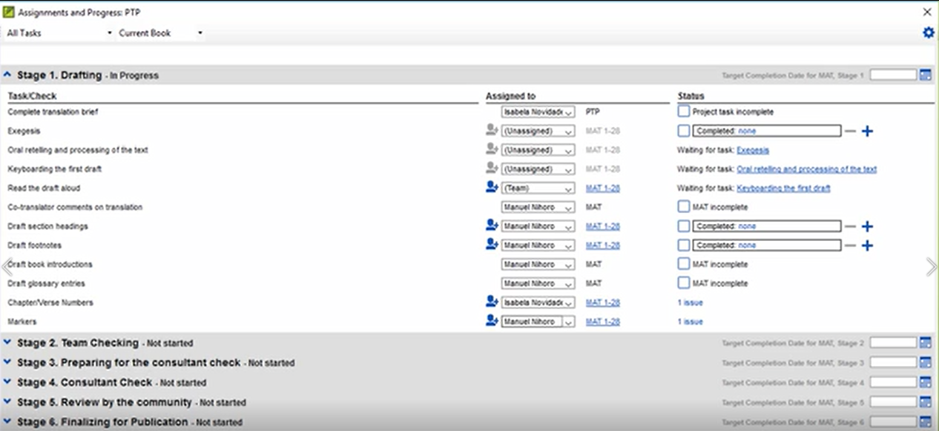
Assigning tasks to the team
In the Assignment and Progress dialog box, there are three columns:
Task/Check
Assigned to
Status

Slide 22
Assigning tasks to the team
In the Assigned to column, there are options to select:
Unassigned
One team member
Status

Slide 23
Your Turn
Make sure you can copy a plan.
Move a task
Delete a task
Modify a task
Add a task
Change when a task can start
Add checks
Assign tasks

Slide 24
Summary
A project plan is built upon an _______ plan.
To add a task to the plan, you select the ______ task, click the _______ button and give the task a name and __________.
You can mark a task as complete by chapter, by ______ or by _______.
Answers: organizational, preceding, Add task, description, book, project
Notes:
You should demonstrate these in Paratext

Slide 25
Learning Outcomes?
Setting the project scope
Apply an organisational plan
Tweaking the project plan
Configuring task settings
Assigning checks to stages
Assigning tasks to the team
Learner
Practitioner
Trainer
Expert
Notes:
How did you go?
Did you meet your learning outcomes?
Did you progress? Or at least update?

