Slide 1
What’s happening in LsDev?
John Thomson, March 2019

Slide 2
Big change: project funded
LsDev now has to seek funding for specific projects
Still have supported staff like me.
But, we are considered SIL’s contribution to a partnership. Generally we seek another partner to provide money.
So: it may be easier to get your project done if it has a sponsor
It may be harder if it has no sponsor.

Slide 3
Choosing major features
Some are determined by prioritization process
Some are determined by agreements with partners
Some are requested by users (and voted on by others)
https://community.software.sil.org/c/bloom/featurerequests
Some are suggested by the development team
Some may be suggested by domain leaders
Usually one “product owner” or “analyst” makes the final decisions for each product

Slide 4
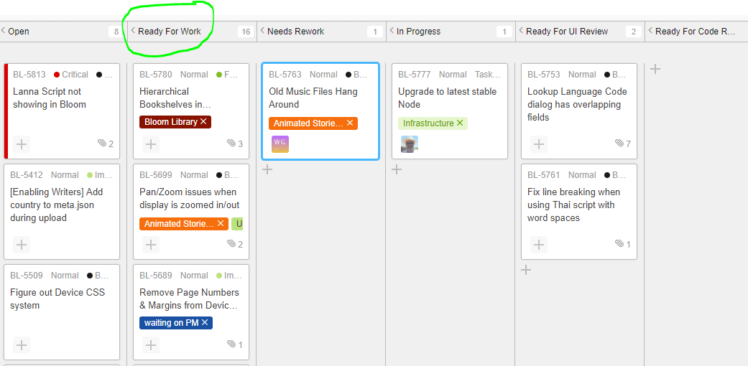
Daily work: pick a card to work on

Slide 5
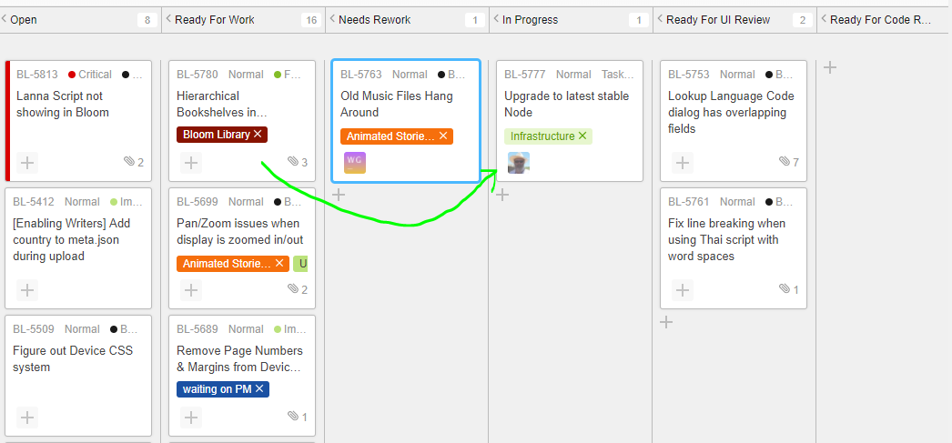
Move to “In Progress” and assign to me

Slide 6
Develop it

Slide 7
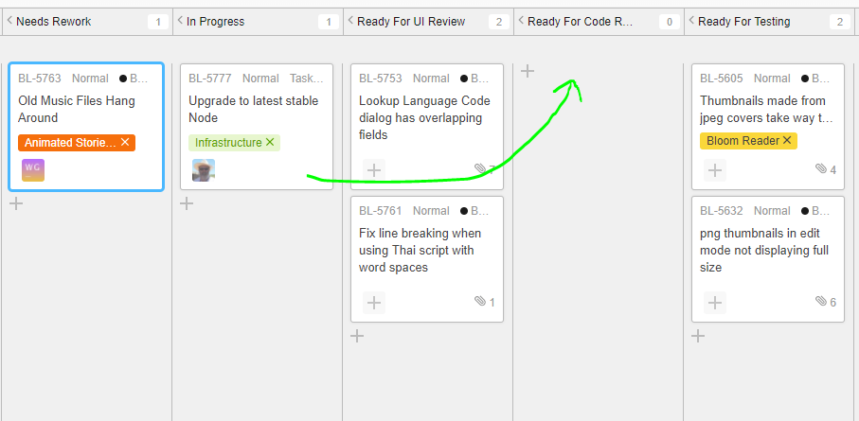
Someone checks the code

Slide 8
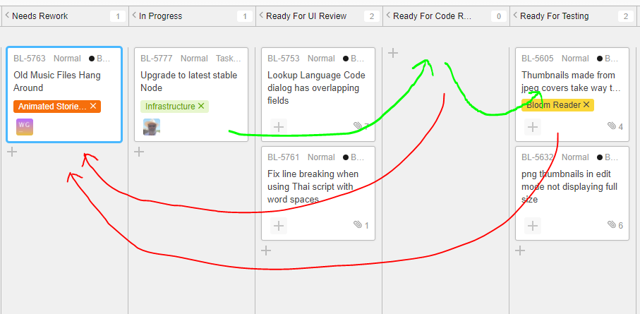
Then someone tests it…maybe more work is needed

Slide 9
Release process: alpha, beta, release
Changes which pass code review are checked into a version control system
They are built automatically (by a TeamCity server)
They immediately become part of Bloom’s alpha release (mainly used by testers, sometimes by brave users)
Every few months we do a few days of intensive testing, fix more bugs, and promote to beta
When we think there’s been a good amount of beta testing we promote to release

Slide 10
Dealing with bugs
When a problem is reported, we try to determine the first version that has it.
We develop a fix, usually for that version
When we’ve fixed a serious problem or several minor ones, a new revision is released on the appropriate channel (e.g., Release 4.1.0 -> 4.1.1; beta 4.2.100->4.2.101)
Fixes usually must also be made to any later versions

Slide 11
Dealing with bug reports: a typical report
Report reads: BL-5693 JavaScript Error: "Error: Network Error“
[a long mess of stacks, state, etc]
To Reproduce: I'm deleting pages from the book The Gospel of John, 1:19-34, John the Baptist identifies Jesus as the Messiah.
Result: email: “Sorry you're having this problem. Do you get this all the time, or was it just once? If you get it regularly, can you possibly attach a book in a state where it happens when you delete a particular page?”
Report used about 10 minutes of my time. The program was not fixed.

Slide 12
Dealing with bug reports: another example
Report reads: BL-5799Exception: Cannot switch recording devices while recording is…
[a long mess of stacks, state, etc]
To Reproduce: my microphone wont turn off.
Result: email: “Sorry you're having this problem. Can you be a little more specific? Do you mean that you press Record and then when you release the mouse button you get this dialog box? Did Bloom ever get into a state where you could play back the recording? If so, did it actually continue recording after you released the mouse button? Do you have more than one recording device connected? (e.g., laptop built-in microphone plus headset) Were you in any way trying to change recording device (e.g., clicking the input device picture in the talking book tool, unplugging a device, plugging in a new one)? Do you get this whenever you try to record, or only sometimes? If only sometimes, can you identify anything special about those times?”
Report used about 15 minutes of my time. The program was not fixed.

Slide 13
A better report, but…
I made a font with TypeTuner and tweaked it with feature settings in customCollectionStyles: [lang="thr"] {font-feature-settings: "jhav" 1;} This works in edit mode as you can see in the screenshot: The problem comes when creating the PDF. This is what I get:
Result:
Can you give us the book that has this text?
Can you give us your customized font?
Problem may get fixed sometime, if they send us the information…

Slide 14
Sometimes even a good report fails
BL-5811 Cannot remove text over picture text box
Problem description: I try to delete the text box from the picture by right click and delete, It is is not removing
Report included the book! I could find the page and the box
But when I tried, the text-over-picture box was deleted normally.
All I could do was ask a few questions, like “Is it just this box on this page of this book, or does it always happen? Does restarting help? Do you know anything unusual about your system?”
An even better report would try to anticipate these questions.

Slide 15
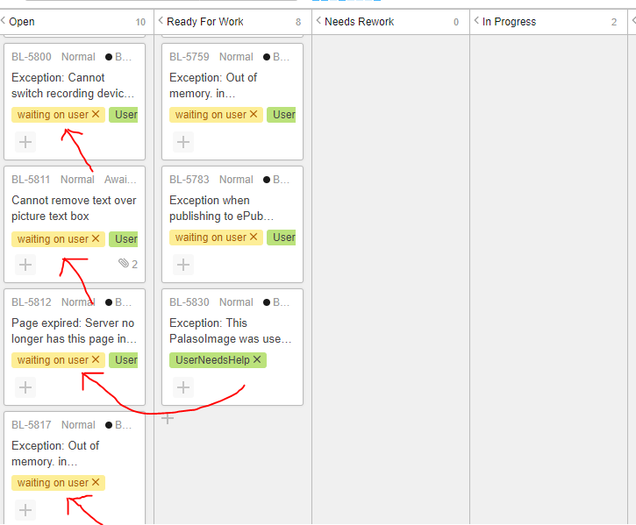
What if there’s no response?
Problem is no longer ready for work!
It’s tagged to indicate we are waiting for a user response
After a month or so it just gets closed.

Slide 16
Product releases in 2018
Keyman 10 and 11 across 6 platforms
Bloom (4)
Motion Books
Visually Impaired
Hearing Impaired
Fieldworks 9 beta
Glyssen
Paratext USFM
Paratext
Ruby for Japanese Bible Society
Enhanced Resources (alpha)
Windowing (alpha)
Scriptoria Alpha
SIL Transcriber 1.0
Transcelerator
Localizable

Slide 17
NRSI is now WsTech
Writing Systems Technology
scripts.sil.org

Slide 18
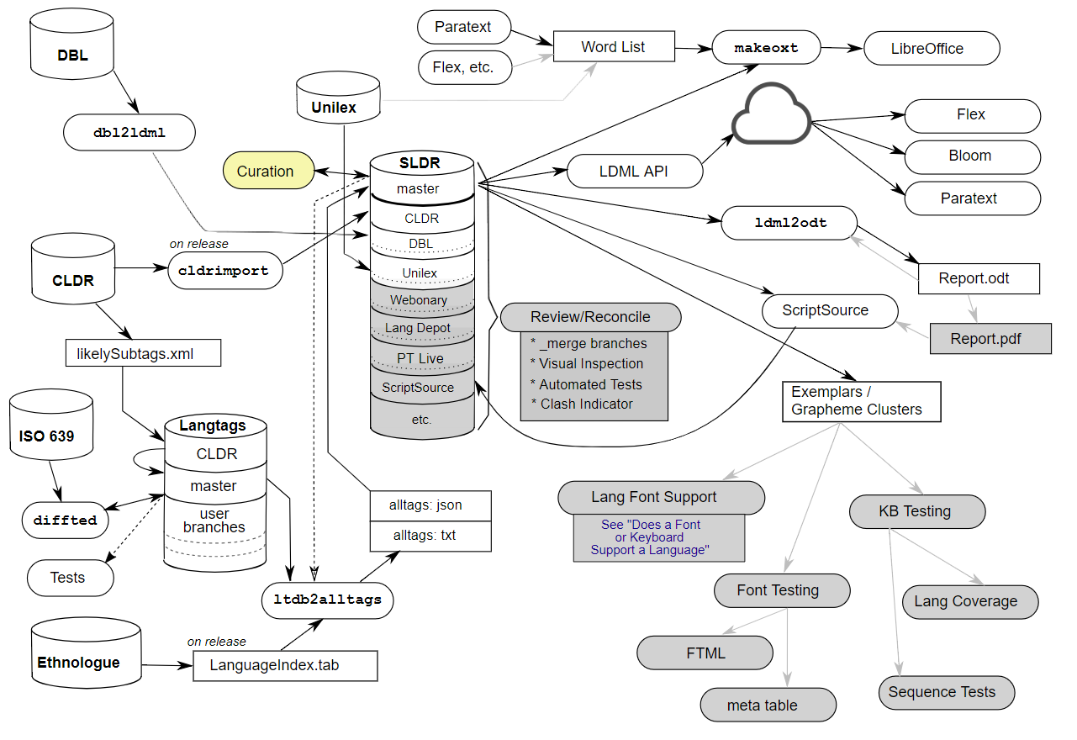

Slide 19
Paratext Major accomplishments
Enhanced Resources
Windowing Framework
Mega Menus
Ruby Glossing
USFM 3 Support
New Management

Slide 20
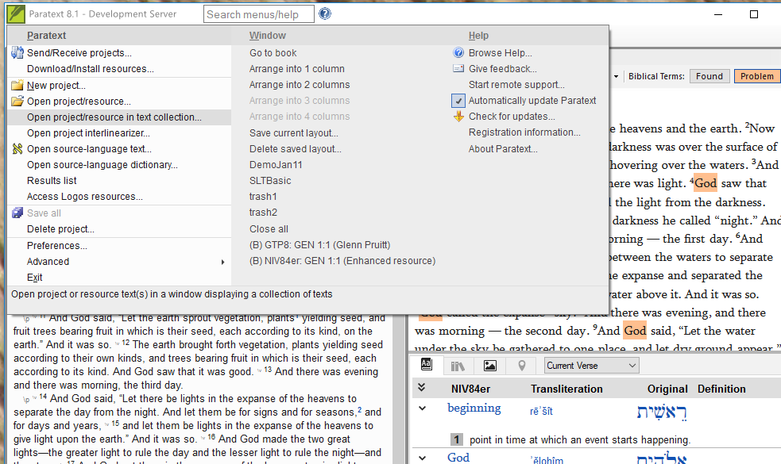
Megamenus
This is the right size

Slide 21
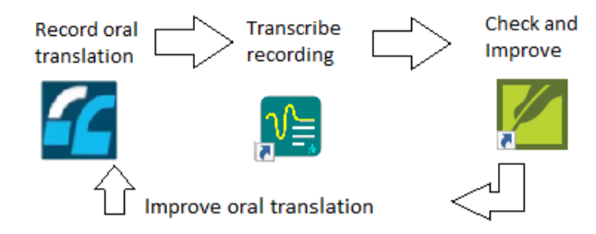
Transcriber: v1 released

Slide 22
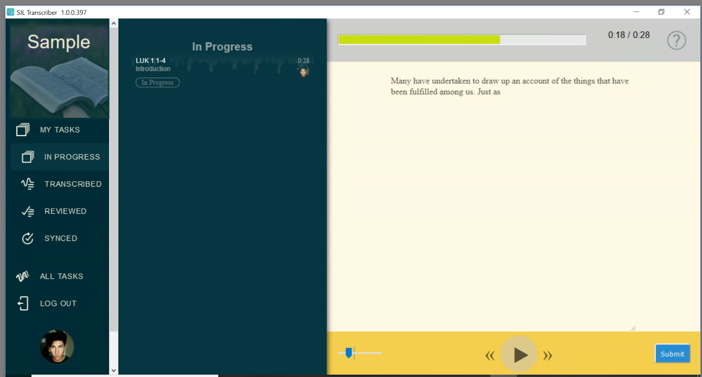

Slide 23
SAB/RAB/DAB
Major accomplishments
Audio: playback speed, convert audio format, extract audio by verse range
Video: thumbnail, stream/embedded, fullscreen, Bible Slideshow Videos
Analytics: Firebase, Amplitude, S3 Digest, FCBH/S3 send on connect
Other Features: Messaging, History, Bk/Ch/Vs selector
Android SDK: Compile: Android 9.0 (Pie), Min: Ice Cream Sandwich (4.0)
iOS Template app supporting "most" (a lot more) of the Android features

Slide 24
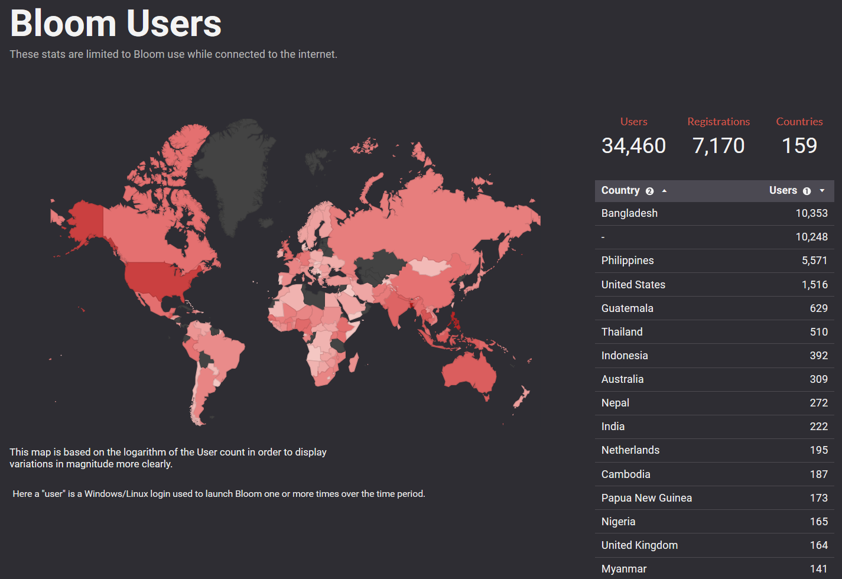

Slide 25
Bloom in 2018: Four releases
4.0: Bloom Reader
4.1: Paste Image Credits
4.2: Motion Books
4.3: Sign Language Books (experimental)
4.4, 4.5: Book Boost competition: $100k +$50k
Books for the Blind
Bloom Enterprise system

Slide 26
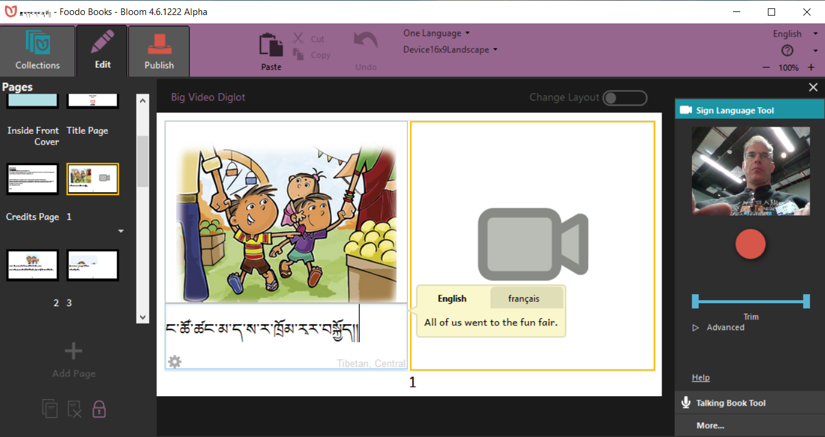

Slide 27
Keyman
Version 10 free on Windows, MacOS, Android, IOS, Web, mobile web
Version 11 (beta) also supports Linux
Fully open source

Slide 28
Other work
Scripture forge (online community Scripture checking): major rework, no release.
Glyssen (scripts for multi-voice scripture recording): Paratext 8 support
HearThis (record Scripture): option to display labels on navigation buttons
Transcelerator (translate comprehension questions): Scripture Forge support, draft French and Spanish localizations.
Scriptoria (cloud code for SAB deployment): lots of work, no release
Story Producer app (translate Animated Bible stories on Android): import from existing translation and audio
FieldWorks: 64-bit support, text charting enhancements, patchable installer, Paratext 8 support.
Language Forge (community dictionary building online): Send/Receive comments with FLEx.

Slide 29
Other work
WeSay (low computer skill dictionary building): configure to use gloss or defn for meaning
SayMore X (language documentation): new implementation, cross-platform, no recording yet.
Phonology Assistant: Find Speech Analyzer for slow playback
Bloom reader: rewrite, may make IOS feasible
Pathway (publishing from FLEx): support FLEx 9; HTML output more mobile friendly

Slide 30
Future focus: work continues on
ScriptureForge
Bloom
Keyman
Paratext
Render?
Transcriber?
Saymore-X?
LanguageForge?

