Slide 1
Accessing Language Resources
WSTech, SIL International
Modified for LTCT 2019

Slide 2
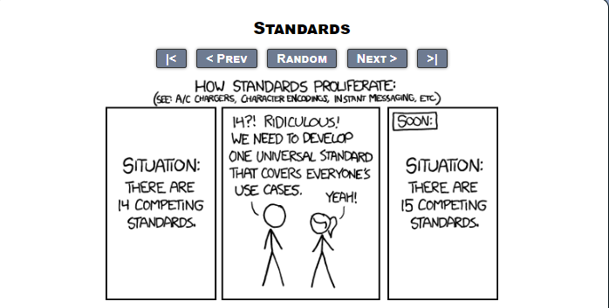
Standards

Slide 3
Language Tag
An identifier for languages
All languages should have one
It's that simple
But it's not!
Notes:
When search for info and seeing some text. It would be nice to be identify it s language
Cannot use langu name, new unique

Slide 4
Language
By Language
ISO 639
Use ISO 639-1 two-letter code if one exists
Use ISO 639-3 three-letter code otherwise
Examples:
English: en
Kiswahili swh
Notes:
2 letter code for major langs only
Ethnologue code ->ISO 639-3
Q??

Slide 5
Find a Book
Search for: en
⠠⠊⠝ ⠞⠓⠑ ⠃⠑⠛⠊⠝⠝⠊⠝⠛ ⠺⠁⠎ ⠞⠓⠑ ⠺⠕⠗⠙ ⠁⠝⠙ ⠞⠓⠑ ⠺⠕⠗⠙ ⠺⠁⠎ ⠺⠊⠞⠓ ⠠⠛⠕⠙ ⠁⠝⠙ ⠞⠓⠑ ⠺⠕⠗⠙ ⠺⠁⠎ ⠠⠛⠕⠙
Notes:
You asked for English. You got English. But it isn't exactly what you asked for. This is English in Braille. I bet you were expecting English in Latin. So a tag for a language isn't really that helpful on its own when trying to find language resources. (BTW It says: In the beginning was the word and the word was with God and the word was God)

Slide 6
Orthography Tag!
Orthography is language + script
ISO 15924
Examples:
English: en-Latn
Braille English: en-Brai
Akha Latin: ahk-Latn
Akha Burmese script: ahk-Mymr
Akha Thai script: ahk-Thai
Notes:
Language -> orthgography tag
Language + script (4 chars)

Slide 7
Same or Different?
Does en = en-Brai?
What is the default script for a language?
Which of the Akha scripts does ahk give us?
How does a computer know?
Likely Subtags:
en = en-Latn
ahk = ahk-Latn
Notes:
Done? Well sort of
What are the defaults?

Slide 8
Regional Variation
Region tag from ISO 3166-1-alpha2
Is en-US same as en-GB? How should we honor the honourable differences in spelling? Which one is en?
en = en-Latn-US
en-GB = en-Latn-GB
ahk = ahk-Latn-MM
ahk-Mymr = ahk-Mymr-MM
ahk-Thai = ahk-Thai-TH
ahk-TH = ahk-Latn-TH
Notes:
Role of region or country?
2 letter code
Trivial, for most cases, but it can be ahiry.
Region is important for various info

Slide 9
All Kinds of Variants
Language Variants - dialects
Orthography Variants
Script Variants - fonipa IPA, implies Latn
Private Use Variants
-x-whatever-you-want
-x-audio
Try to minimise variants
Notes:
Need to add something for various stnadards.
Variants have to be registered with IETF unless they are private us
Registration process. (IETF) language type specification

Slide 10
Tag Structure
Best Common Practice (BCP) 47
how the Tag Structure works
Industry Standard and IETF run
lng-Scrp-RE-variants-e-xtensions
Notes:
Everything you ever wanted to know about the structure of a language tag is in BCP 47. It's basically an internet standard. The -e- here is a general namespace which can be anything with a single letter. -x- is reserved for the Private Use extension. Other namespaces are: -t- for transliterations schemes, -u- for CLDR parameterising.
RCF = Request for Comments.

Slide 11
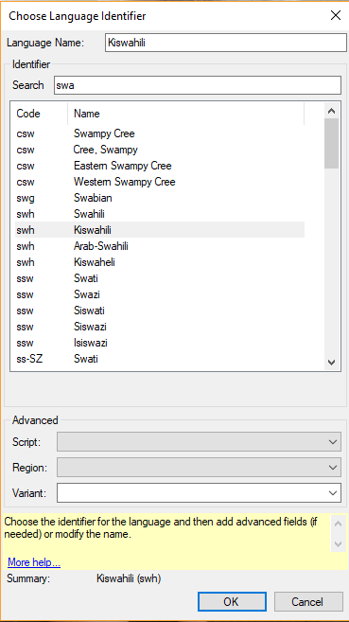
Paratext
How does it play out in Paratext?

Slide 12
Tag Wisely
Only include the elements you need to distinguish
Drop region if there is no variation
Drop script if there is no variation
Agree on defaults
Many under-differentiated tags and bad tags
Notes:
There are many bad tags out there. This whole language tagging thing is confusing and so we need to be able to deal with bad tags and work not to create bad tags ourselves.

Slide 13
Precision Tagging
An Example:
en-NZ-fonipa-x-hasctknp-soc534011-nssec2
New Zealand English as spoken by someone from New Plymouth, who is a railway worker and has a degree, written in IPA.
Notes:
An example of unwise tagging. But you really can be pretty precise if you want to be. Each of these private use variants are from a different official ontology. SInce people ask: HASC (Hierarchical Administrative Subdivision Codes) Taranaki-New Plymouth (http://www.statoids.com/ynz.html). Standard Occupation Codes (BSI) 53-4011 Locomotive Engineers (https://www.bls.gov/soc/2018/soc_2018.htm). National Statistics (UK) Socio-Economic Classification level 2 is lower managerial and professional occupations (https://en.wikipedia.org/wiki/National_Statistics_Socio-economic_Classification ).

Slide 14
Tagging Change
What happens if an orthography changes? Do you want to record the change or are you dumping the old?
Create variants for both orthographies:
blt = blt-Tavt-VN
blt-Laoo = blt-Laoo-LA
Then in 2013
blt = blt-Tavt-VN
blt-Laoo = blt-Laoo-LA-x-2013
blt-Laoo-x-1977 = blt-Laoo-LA-x-1977
Notes:
This is where it gets complicated.
What about changes like changes to orthography

Slide 15
Stable Tagging
Tagging to minimise change
Tag with a maximal tag
Also note the date when you tagged
Part of Metadata (along with langtag)
Allow for revisions
Notes:
What about archiving? Keeping track is not easily
A maximal tag is one containing lng-Script-RE and perhaps necessary variants as specified in the likely subtags mapping.
Very often a language tag is part of a wider collection of metadata. This often includes a metadata editing date, which is sufficient therefore to track a date when the language tag was correct.

Slide 16
Locale Information
Notes:
What stuff can be identified

Slide 17
What is Locale Information
Accessed by language tag
General Orthography information:
collation, number systems, times, dates, punctuation and currency
Key Terms
Language names, scripts, regions
Resources
Fonts, Keyboards, Mappings, Spell Checking
Notes:
All this is held by language tag, done for major languages mostly

Slide 18
How is it Stored?
Common Locale Data Repository (CLDR)
https://unicode.org/cldr
Locale Data Markup Language (LDML)
https://unicode.org/reports/tr35/tr35.html
SIL Locale Data Repository (SLDR)
https://github.com/silnrsi/sldr
LDML SIL Namespace extensions
https://goo.gl/pUKcS6
Notes:
"How" includes "Where".
LDMl = XML format for the exchange of structured locale data.
SLDR = extension of CLDR
ROD = Registry of dialects

Slide 19
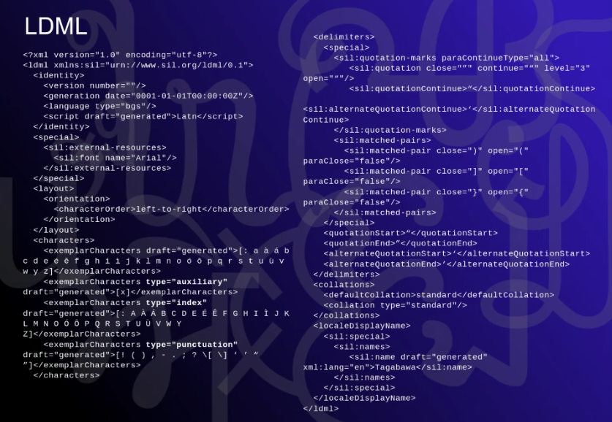
Notes:
What doe it look like.

Slide 20
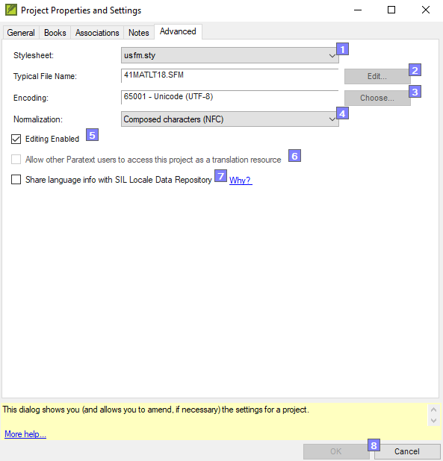
How does this play out in Paratext?

Slide 21
ScriptSource
http://scriptsource.org
Information by writing system
Form for submitting character exemplars
Phonological mapping (graphemes and phonemes)
http://scriptsource.org/phon
Fonts, Keyboards, Mappings, etc. available
Notes:
One stop shop about orthography or how a lang is written.

Slide 22
Key Resources
Keyboard Layouts
Keyman source (.kmn) or .kmp or whatever
LDML keyboard layout specification
Notes:
Even keyboard mapping
Even CLDR into this.
Getting payback from industry for the info we are gathering.

Slide 23
Fonts - http://scripts.sil.org/SILFontList
Charis, Doulos, Gentium, Andika - http://software.sil.org/lcgfonts/
New release coming (v6))
Alkalami - https://software.sil.org/alkalami/
Arabic - North Africa
Awami - https://software.sil.org/awami/
Arabic Nastaliq; Collision avoidance; Graphite only.
Harmattan - https://software.sil.org/harmattan/
Arabic - West Africa
Notes:
Here are just some of the 30+ fonts the NRSI produces. The left column is new stuff and the right column is the current status on existing stuff.

Slide 24
Spell Checking
Integration into LibreOffice
oxttools
Hunspell
Agglutinating languages
Are prefix/suffix constraints important?
Vowel Harmony
Notes:
Hunspell currently has suffix sequence constraints and prefix sequence constraints but it has no way of expressing constraints between prefixes and suffixes.

Slide 25
Questions?

