Slide 1
SayMore
Language Documentation

Slide 2
Why would you want to use SayMore?
Language documentation
Managing language data (audio/video) any language project.
Great way to organize your language files and the metadata (the data about the data).
SIL International
Notes:
Language documentation – collecting data on endangered languages before they die
Language development – developing a language for a community to use it

Slide 3
Learning Outcomes
Incomes?
Create a new SayMore project
Add a person to a project
Add audio file
Transcribe an audio file
Archive data to REAP
Export transcription to FLEx
Learner
Practitioner
Trainer
Expert

Slide 4
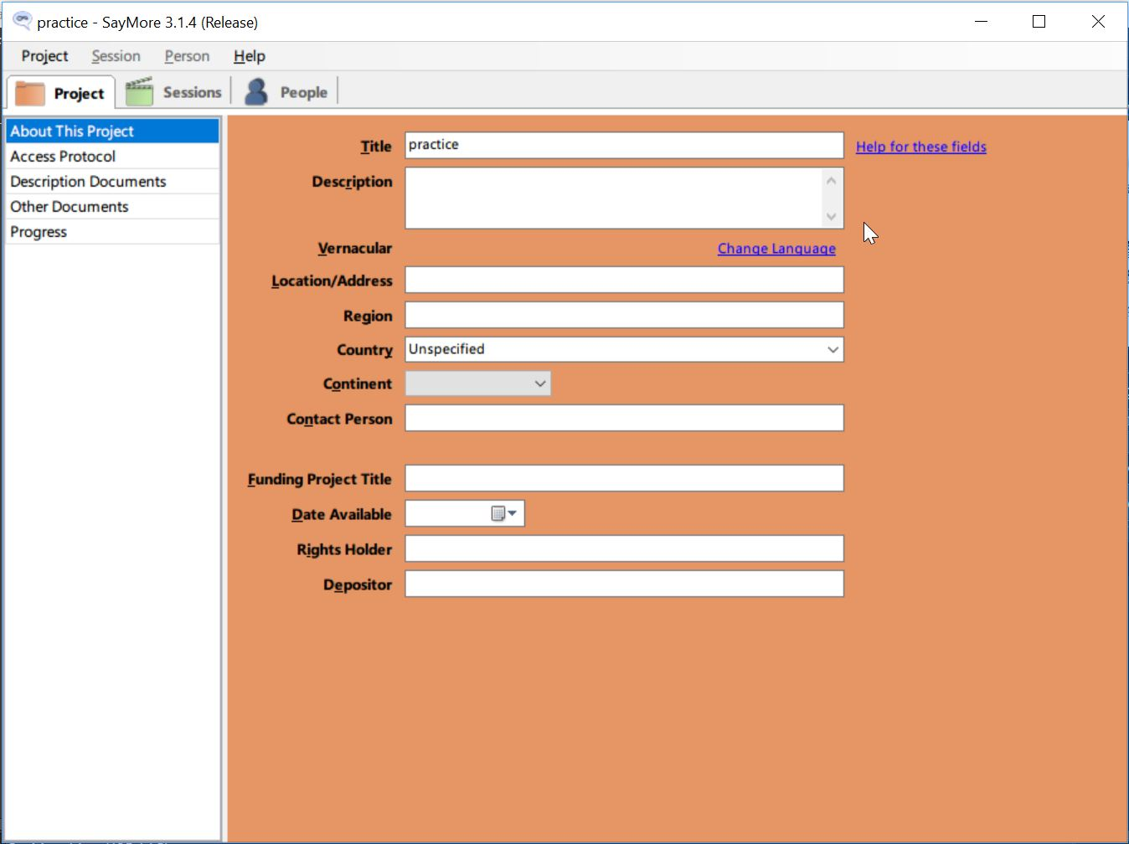
What’s Where?
Project – Session - People
SIL International

Slide 5
SayMore practice
In pairs, work though the simplified practice topic in the SayMore help.
Run SayMore
Help > Help
Click “A simplified practice topic”

Slide 6
Prerequisites
One or more *.wav files of someone speaking.
Documents that you can use for informed consent (PDF file is recommended.)
Picture of a person (optional).
A microphone you can use to record yourself.
An appropriate keyboard so you can type transcriptions (optional, depending on the writing system).
See SayMore sync folder for examples
SIL International

Slide 7
What you will do (in 37 steps!)
Steps 1-13
Create a new project
Add a person (photo, consent form – step 9 rename (on toolbar), consent)
Associate wav file for a session
Steps 14-
Annotate a file
Careful speech (step 16) (if you have another native speaker)
Oral translation (steps 19-20) (skip if your recording is English)
Manual segmentation (step 33) contributors
Step 36: Archive (use REAP not IDMI)
but don’t actually archive, cancel!
Step 37: Export a transcribed text file to FLEx

