Slide 1
HearThis
By John Thompson
Updated by Kent Schroeder

Slide 2
What is HearThis?
Easy to train/use software for recording audio Scriptures and preparing the recordings for loading onto various hardware devices for publishing

Slide 3
What is HearThis Android?
Easy to train/use software for recording audio Scriptures on an Android device (phone or tablet)
Exchanges data with HearThis desktop for publishing and merging

Slide 4
What are strengths of HearThis?
Designed for use by translation team or affiliated local users, not highly trained recordists
Readers with limited skills can keep trying, in private, until satisfied with the results.
Low cost
Pulls data directly from Paratext and/or the Digital Bible Library

Slide 5
What are the weaknesses?
Some loss of fluency reading one sentence at a time
No professional help with studio, mic, whatever
BUT
Early and often allows audio to feed back into translation process
Early access and community involvement

Slide 6
What does HearThis Android add?
More devices to use for recording
Sync allows multiple people to work on recording at the same time
But It can’t do the whole job…no import or publishing except by sync with desktop

Slide 7
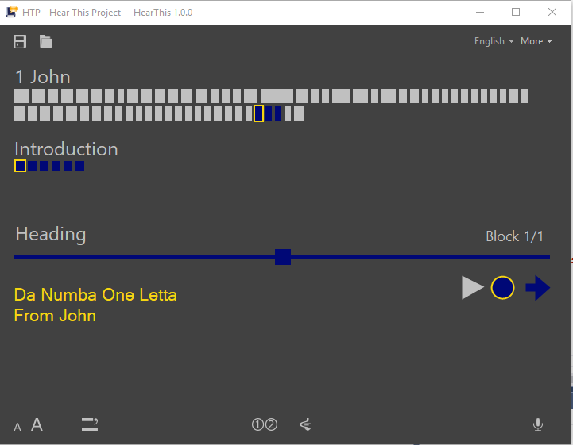
Learning Task 1
Demo of how to create a scripture recording using HearThis.

Slide 8
Learning Task
Work in Pairs
Create a new HearThis project
Record a portion of Scripture
Start HearThis Android and sync
Record more Scripture using HearThis Android
Sync again
Notes:
If I have time to practice, might add demo of publishing end result to megavoice

