Slide 1
Welcome to Scripture Forge
https://scriptureforge.org/
Notes:
Everything about Scripture Forge is found on this link here.

Slide 2
What is Scripture Forge?
Scripture Forge is a web tool to facilitate online community Scripture checking.
Notes:
I did try to setup a language project but it failed to complete for some reason. I even tried deleting it but that didn’t work. I wrote to support so I am hoping they will get back to me on that.

Slide 3
Learning Objectives
By the end of the lesson, participants will:
Know what Scripture forge is all about and does.
Accept an invitation and/or create a SF account.
Navigate different parts of Scripture Forge.
Answer checking questions and make comments.
Export data in USX format to Scripture Forge.
Export Scropture Forge comments and notes in XML format and display them in ParaTExt.
Setup Scripture Forge project if time allows.

Slide 4
Features of Scripture Forge
Enables you to get feedback on translation accuracy.
Enables you to get scripture drafts in front of native speakers easily.
Scripture Forge can import text from ParaTExt.

Slide 5
Features of Scripture Forge…
Facilitate Scripture checking online.
Answers and comments can be imported back to ParaTExt as notes.
You control how users interact with the text.

Slide 6
Features of Scripture Forge…
Create checking questions and invite members via email to give feedback.
You can easily register yourself as a new user (can even sign in with Google).
You can be easily invited to collaborate in a project.
Notes:
Signing in with Google is faster and you won’t have to keep tract of a new password

Slide 7
ParaTExt - SF Collaboration
Text is exported from ParaTExt in USX format and imported to Scripture Forge.
Display the text in SF and interact with it.
Create checking questions and invite others to respond to them.
Notes:
Create your

Slide 8
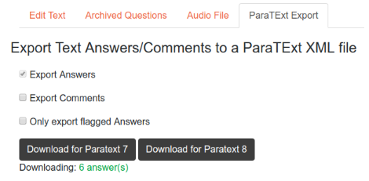
Exporting comments/Notes

Slide 9
ParaTExt - SF Collaboration
Download in XML format and put in the right project folder in ParaTExt.
Restart ParaTExt and see the answers/Comments attached to the first verse of the first chapter.
Notes:
You will see the notes flag in the beginning of the chapter.

Slide 10
Learning Task 1
Accept Invitations to use Scripture Forge.
View questions and responses on John.
Add some questions.
Answer some questions.
Add some comments.
Observe and Export the comments to ParaTExt.
View/Display the notes/comments in Paratext.
Notes:
Signing in with Google is faster and you won’t have to keep tract of a new password

Slide 11
Key take away
When everyone plays their part in getting Scripture translated and into the right hands, everyone benefits. It’s the power of collaboration that gets Scripture checking done faster and better.

Slide 12
Key take away
Technology brings Scripture checking to the masses, in a positive environment that focuses participants on the task and works wherever they are. On the tablet, phone or web, Scripture Forge is there!

Slide 13
Learning Task 2 (Assignment)
Read the tutorial and:
Create a checking Project
Import text from ParaTExt
Add some questions
Invite others to collaborate with you.
Export comments and notes to ParaTExt.
Display the notes and comments in ParaTExt.
Notes:
Signing in with Google is faster and you won’t have to keep tract of a new password

Slide 14
What Questions do you have?

Slide 15
Thank you!

