Slide 1
Paratext 8 – interlinearizer Presentation
2019 LANGUAGE TECHNOLOGY CONSULTANT TRAINING (LTCT)
MARCH 17 2019
Cicc-rUIRU
BY JEREMIAH OKUMU

Slide 2
What is Paratext interlinearizer?
In interlinear text, the verses of a project are aligned with a line of "glosses". These glosses are usually a translation into another language.
The project interlinearizer settings requires two texts: a target text ("text to interlinearize") and a model text ("model text for interlinearization").
The interlinearizer analyses the model text and automatically generates statistically-guessed glosses for the target text.
These glosses serve as the starting point for a new translation or a revision of an existing translation.

Slide 3
Interlinearizer products
The project interlinearizer can be used to create any of the following:
A revision/adaptation in the same or closely related language as an existing project. The project interlinearizer creates the revision/adaptation by consistently applying orthographic changes to the model text.
A formal back-translation project. In a formal back-translation project, paratext gives statistically-guessed glosses from the model text for the target text. Then someone who understands the languages of both the model text and the target language carefully checks and revises the guessed glosses. This process of translation is most suited to languages which are closely related.
An informal back-translation. In an informal back-translation, paratext uses a model project in a language you understand well to provide an approximate translation of a project which is written in a language you are unfamiliar with. An informal back-translation is useful for helping you begin to identify key words and phrases in the unfamiliar language project.

Slide 4
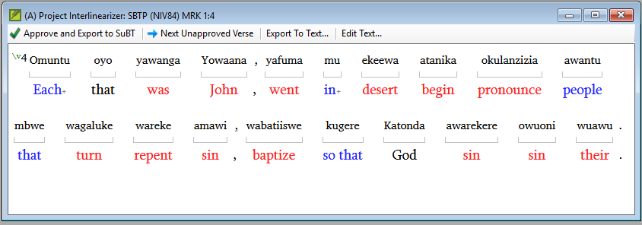
Interlinearizer Displays in paratext
The different colours of the glosses indicates the following:
Red | The computer guessed the gloss.
Black | The user approved this specific gloss for this specific word in this verse.
Blue | The user approved this specific gloss for this word in some other verse but has not yet specifically approved this gloss for this word in this verse.
Blue+ | The user approved this specific gloss in some other verse but there are also other possible glosses that have been approved in other verses.

Slide 5
What YOU CAN DO IN interlinearizer
For any word in the target text, you can:
Approve a gloss which was generated by paratext
Modify the gloss
Supply a new gloss
Ignore the word
You can also create and gloss phrases, or break a glossed phrase into individual words. Paratext will gather information about the choices you make and will help you maintain consistency for common words and phrases.
Break the word into morphemes and gloss the individual morphemes. In paratext 8.0 (and later), you can break a word into morphemes in more than one way and to specify infixes as a part of word morphology.

Slide 6
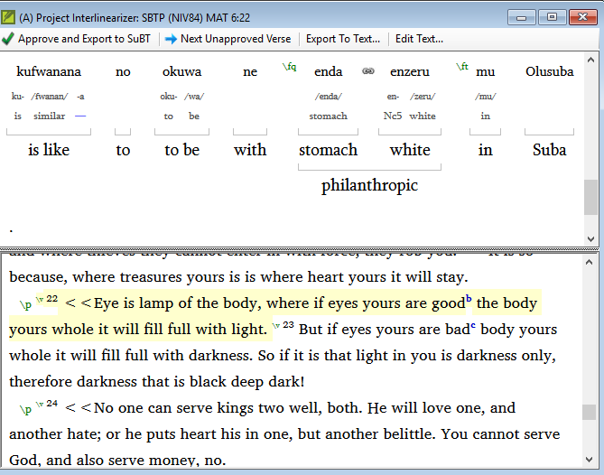
Interlinearizer Displays in paratext
The project interlinearizer can display up to five lines:
The text from the project.
Morphemes (word parses).
Glosses of morphemes.
Glosses of words
Glosses of phrases.
The interlinearizer window can also display the export pane (click on “export text pane”)

