Slide 1
Growth Plans
Kent Schroeder
LTCT 2020

Slide 2
Objectives
What is a growth plan?
Why the growth plan?
What does the plan look like?
How to fill in the growth plan?
Fill in the growth plan.
Meet with your mentor to review your growth plan.

Slide 3
What is a growth plan?
Action Plan
Defines target competency
Helps you evaluate your current competency
Sets goals
Helps you plan activities to reach competencies and grow professionally
Notes:
A growth plan is “the process of creating an action plan based on awareness, values, reflection, goal-setting and planning for development within the context of a career, education, relationship or for self-improvement

Slide 4
Why Smartsheet growth plan?
One plan for all
More levels (5 of them)
Can send notifications
Can create custom reports
Can see the person’s level quickly
Allows for more than one mentor
Does not need to be tie to a yearly schedule
Notes:
It gives a focus path/plan to develop professionally in LT. It also helps measure what skills and knowledge and attitudes you have availabity to contribute to the work.

Slide 5
Why the new growth plan?
Notes:
Where you are
Process
Where you want to be

Slide 6
What does the plan look like?
Target Competencies
Assessment Criteria (overall goal)
Suggested Growth Activities
Current target and progress
Planned Growth Activities & Events
Expected Completion
Mentored by

Slide 7
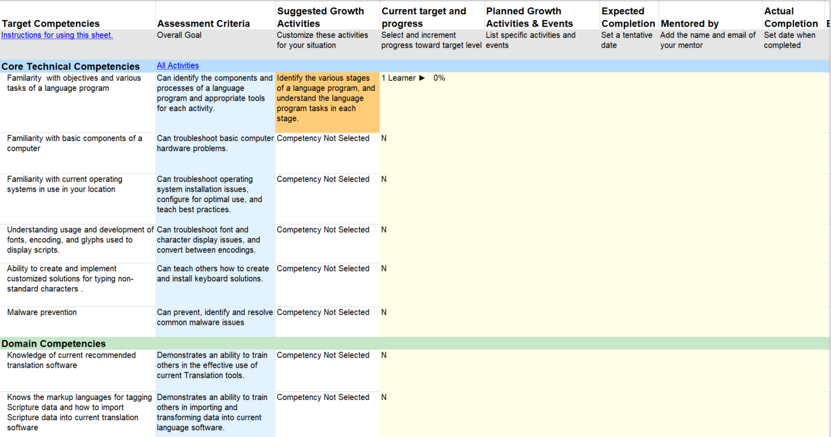
What does the plan look like?

Slide 8
What does the plan look like?
Current Target and Progress
Learner
Practitioner
Trainer
Expert
Show Source English Growth Activities file

Slide 9
What does the plan look like?
Competencies categories
Common Technical (6)
Domain (18)
Practical (6)
Consultant (4)
Professional (3)
Education (1)

Slide 10
What does the plan look like?
Core Technical Competency
Language programs
Basics components of a computer
Operating Systems
Fonts and Encoding
Keyboards
Malware

Slide 11
What does the plan look like?
Domain Competency
Translation Tools
Scripture Markup
Lexical Tools
Lexical Markup
Lexical Import
Morphological Parsing
Phonology Tools
Lang Documentation
Instrument Analysis
Data Conversion
S/W Development
Archiving & Copyright
Academic Publication
Publication
Collaboration
Literacy Tools
Digital Vitality
Custom

Slide 12
What does the plan look like?
Practical Competency
Teaching Skill
Problem Solving
Responsive Feedback
LWC
English
Structure of Local Languages

Slide 13
What does the plan look like?
Consultant Competency
Consulting
Lang, Culture & Teamwork
Formal Mentoring
Technology for Consulting

Slide 14
What does the plan look like?
Professional Competency
Networking
Professional Representation
Entity Participation and Advocacy

Slide 15
What does the plan look like?
Education Competency (only 1)
Linguistics
Translation
Literacy or MLE
Scripture Engagement
Others

Slide 16
How the plan works?
Five Levels
Must reach that level in all categories
Senior consultant level

Slide 17
How to fill in the plan?
Give a self assessment in the Current target and progress column
Put your potential activities in the Plan Growth Activities & Events and Expected Completion columns

Slide 18
Review the growth plan
Sign-up for a session with Kent or Frans or David to review your plan
Please update your growth plan before your review session.
Review your growth plan with Kent or Frans or David at appointed time.
Implement your plan

Slide 19
Questions?
Notes:
19

