Slide 1
Paratext 9 Project Plan
Notes:
So there is a Paratext 7.5 server and a Paratext 8.0 server
Kent & Doug Higby probably get a request from Cameroon every so often when I am in search of a Paratext license for someone

Slide 2
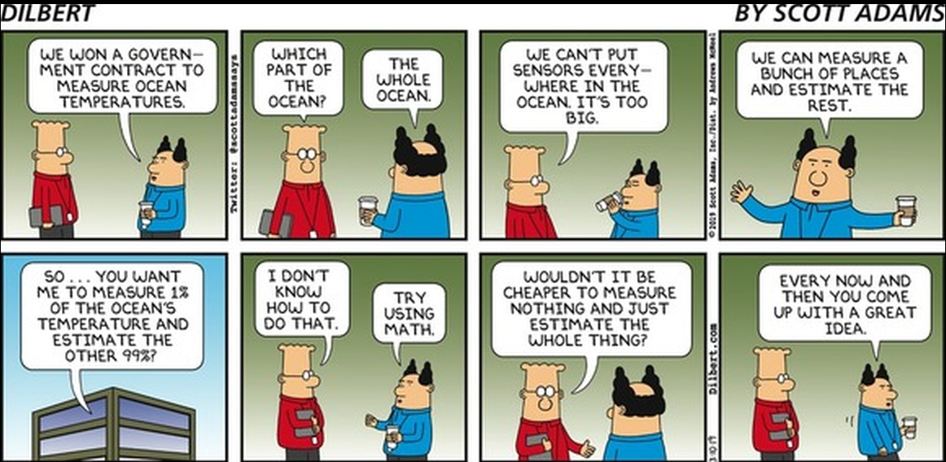

Slide 3
Learning Outcomes
Create a project plan from a base plan
Modify a project plan
Configure task settings
Assign automatic checks to stages
Assign tasks and checks to team members.
Mark individual tasks as completed.
Generate progress charts

Slide 4
Project Plan - Overview
Prerequisites
Setting up a plan (administrator)
Using a plan (administrator)
Using a plan (translator)
View progress

Slide 5
Project Plan Prerequistes
Notes:
So there is a Paratext 7.5 server and a Paratext 8.0 server
Kent & Doug Higby probably get a request from Cameroon every so often when I am in search of a Paratext license for someone

Slide 6
First things to consider
Must select the base plan to start from
Must agree on the plan to use
Must have review basic inventory setup
Remove all book permissions from User Permission dialog box.
Set start date and expected completion date in registry
Does the plan need to be localized?

Slide 7
Basic inventories
Review character inventory
Review punctuation inventory
Review scripture reference settings
Review language settings
Review quotation rules
Review number settings

Slide 8
Basic inventories
Demo character inventory
Demo punctuation inventory
Demo scripture reference settings

Slide 9
Project Plan Setting up a plan
Notes:
So there is a Paratext 7.5 server and a Paratext 8.0 server
Kent & Doug Higby probably get a request from Cameroon every so often when I am in search of a Paratext license for someone

Slide 10
Setting up the project plan
Setting project scope
Creating a project plan
Modifying a project plan
Configuring task settings
Assigning checks to stages
Marking Progress to date

Slide 11
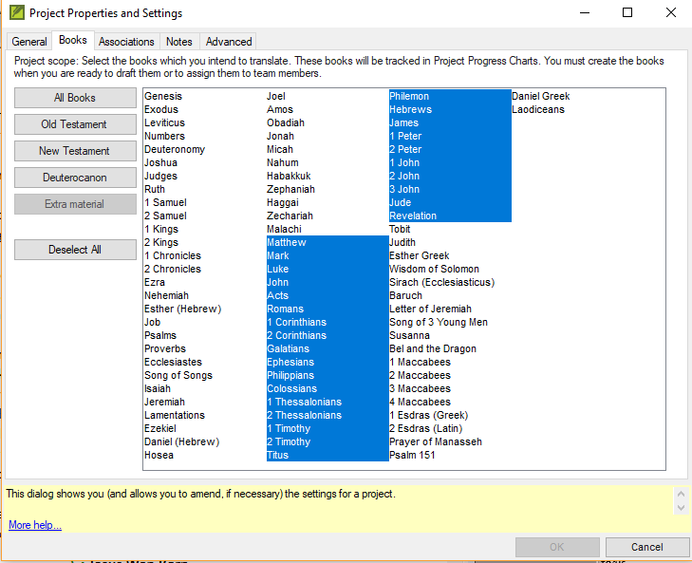
Setting project scope
Notes:
Project progress is calculated based on the total number of verses in the books that are included in the project scope. Therefore, the project scope cannot include books without verses (for example, a glossary) even though you intend to include that book in your project.

Slide 12
Creating a project plan
Selecting a base plan and applying it to project
In the Project Settings menu, click Project Plan
Click Manage Plans
Select a base plan
Click Copy Plan
Click OK

Slide 13
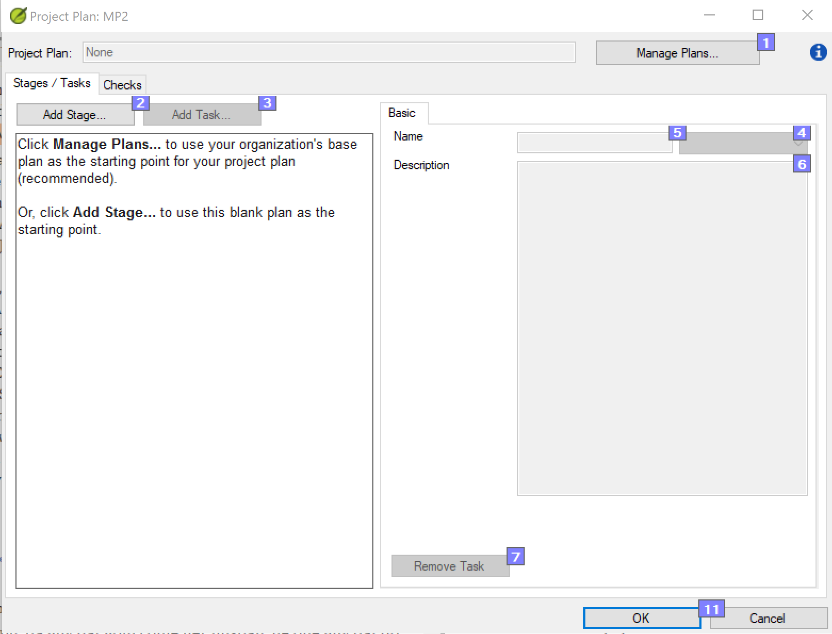
Creating a project plan
Demo creating a project
Notes:
If you add, reorder, or remove stages or tasks, a hyphen followed by the short name of your project is added at the end of the Project Plan name.

Slide 14
Modifying a project plan
Reorder tasks
Add tasks
Delete tasks
Combine tasks
Notes:
If you modify a project plan, a hyphen followed by the short name of your project is added at the end of the Project Plan name.

Slide 15
Modifying a project plan
Reorder tasks
Tasks can be moved earlier or later in a stage
Tasks can be moved to different stage
Tasks should be placed where they must be completed
Add tasks
Delete tasks
Combine tasks

Slide 16
Modifying a project plan
Reorder tasks
Add tasks
Select preceding task
Click Add task button
Give the task a name and description
Delete tasks
Combine tasks

Slide 17
Modifying a project plan
Reorder tasks
Add tasks
Delete tasks
Select task and click on Delete icon or Remove task button
No undo function
Can cancel if you delete the wrong task
Combine tasks

Slide 18
Modifying a project plan
Reorder tasks
Add tasks
Delete tasks
Combine tasks
Select the task you wish to edit
Edit the name and description
Delete the other task

Slide 19
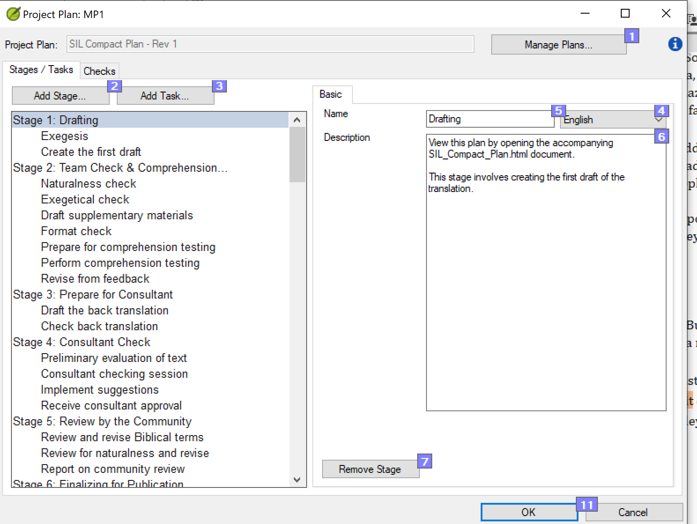
Modifying a project plan
Demo reordering a task
Demo adding a task
Demo deleting a task

Slide 20
Configuring task settings
Three task settings
Mark task as complete
When can this task start
Requires Editing

Slide 21
Configuring task settings
Three task settings
Mark task as complete
By chapter of a book
By entire book
By entire project
When can this task start
Requires Editing

Slide 22
Configuring task settings
Three task settings
Mark task as complete
When can this task start
Dependent tasks: After previous task is complete {for book}
Dependent tasks: After previous stage is complete {for book}
Independent tasks: Any time
Effects the task shown on the translator’s to do list
Requires Editing

Slide 23
Configuring task settings
Three task settings
Mark task as complete
When can this task start
Requires Editing
Project name
No

Slide 24
Configuring effort settings
Estimate how many verses the team can complete each day for this task.
Easiest books
Easy books
Moderate books
Difficult books

Slide 25
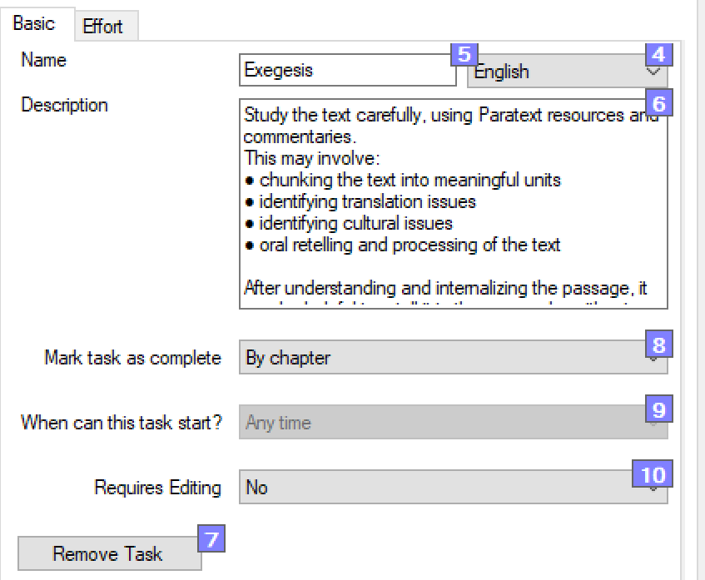
Configuring task settings
Demo configuring task settings

Slide 26
Assigning checks to stages
Automatic checks are set at the stage level
In Checks tab in the Project Plan dialog box
At least 20 checks available to you
There are five categories of checks: Basic, Spelling, Unresolved Notes, Back Translation and Other
Each Note tag will have a potential check

Slide 27
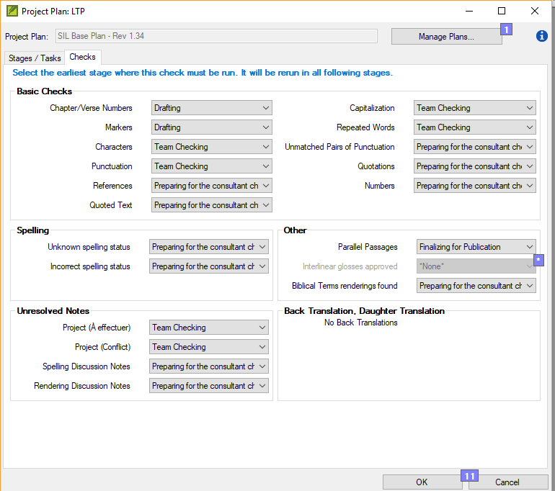
Assigning checks to stages

Slide 28
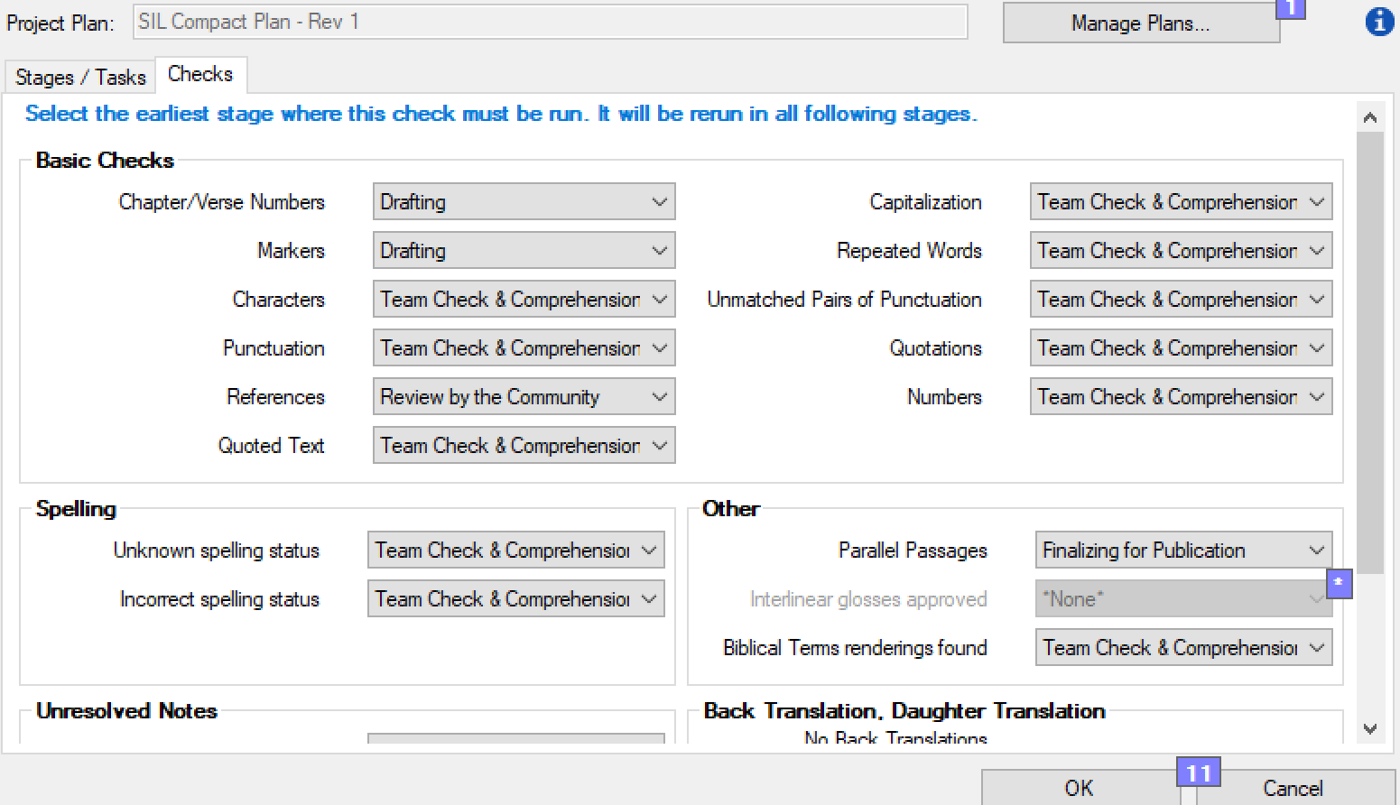
Assigning checks to stages
Demo

Slide 29
Marking progress to date
In the Assignment and Progress dialog box, select Stages Table
Check off stages completed
But automatic checks won’t let you proceed

Slide 30
Marking progress to date
The Solution
First take a screenshot of your check
Temporarily turn off automated checks
Use the Stages Table to mark the completed stages for existing books
Turn the automated checks back on.

Slide 31
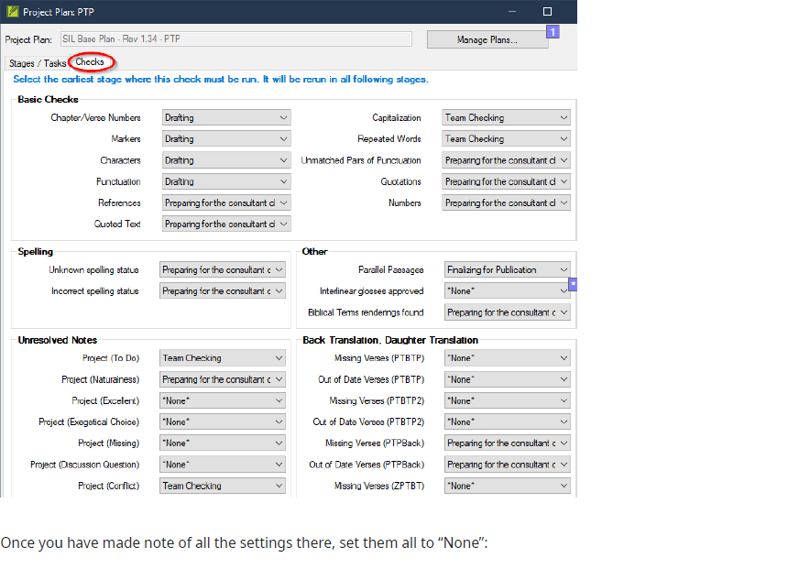
Marking progress to date

Slide 32
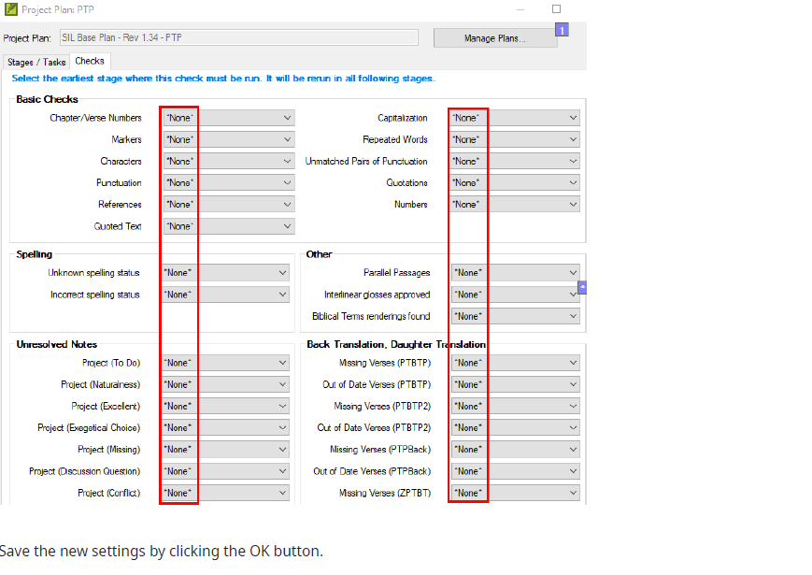
Marking progress to date

Slide 33
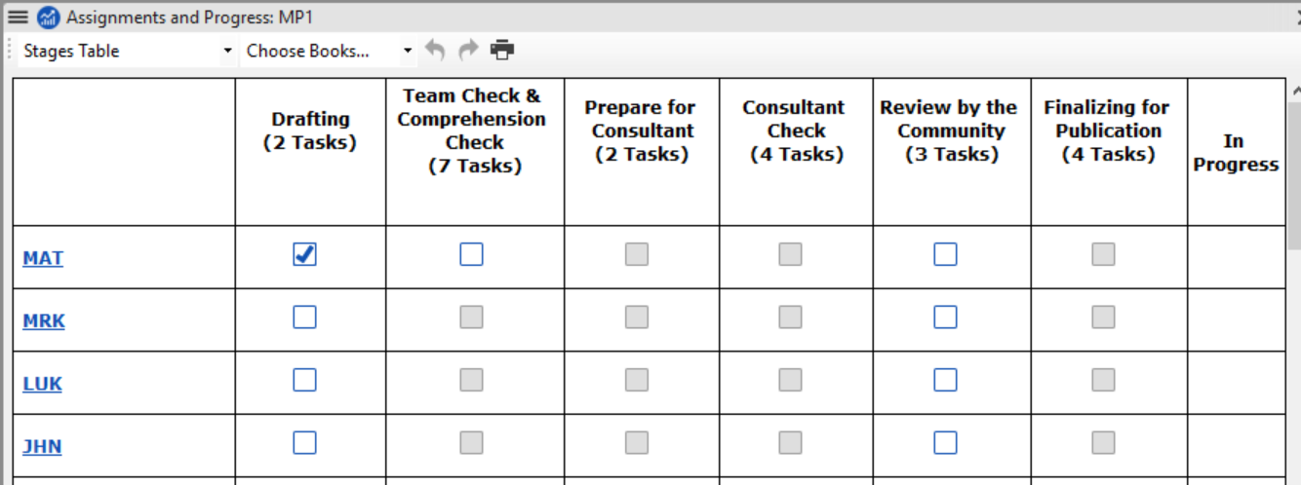
Marking progress to date

Slide 34
Marking progress to date

Slide 35
Your Turn
Apply SIL Compact Base plan to your project and save it.
Move tasks to a new location in same stage
Move tasks to new location in different stage
Add new tasks
Delete a task
Combine two tasks into one task
Update description for task
Change task features

Slide 36
Your Turn
Change stage for a basic check
Change stage for other checks.
Assign tasks for two books to the team.
Assign task to yourself and another task to your partner for the first draft.
Mark tasks as completed.

Slide 37
Using the Project Plan
What do we do next?
Are we there yet?
Notes:
So there is a Paratext 7.5 server and a Paratext 8.0 server
Kent & Doug Higby probably get a request from Cameroon every so often when I am in search of a Paratext license for someone

Slide 38
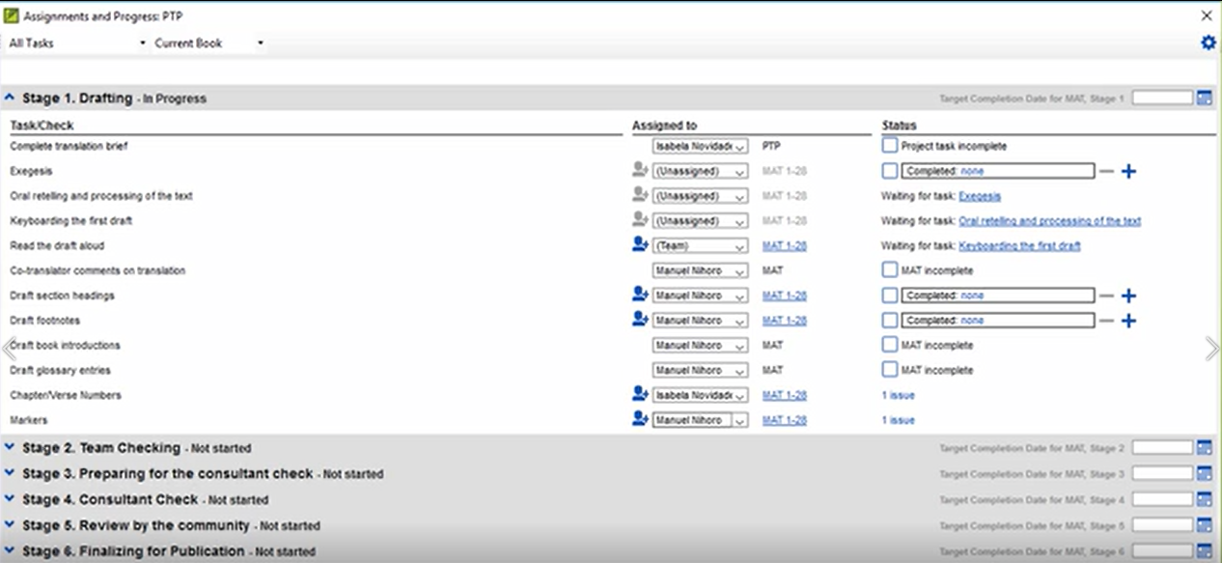
Assigning tasks to the team
For administrator to do, first choose a book
In the Assignment and Progress dialog box, there are three columns:
Task/Check
Assigned to
Status

Slide 39
Assigning tasks to the team
In the Assigned to column, there are options to select:
Unassigned
One team member
(Team)
Assign whole book or range of chapters

Slide 40
Assigning tasks to the team

Slide 41
Assigning tasks to the team
There are three kinds of activity for the translators to do
Editing the text
Resolving issues
Marking progress

Slide 42
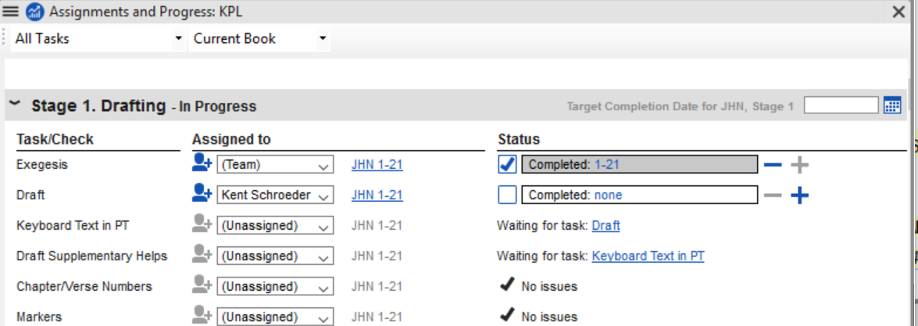
Getting Info on Task
Assignments and Progress dialog box
Hover over the task you want information on
The description for the task is displayed

Slide 43
Marking tasks as completed
Check the Status column
Set the checkbox to mark book as completed
Click the number range to mark a range of chapters as completed
Click plus sign to mark next chapter as completed

Slide 44
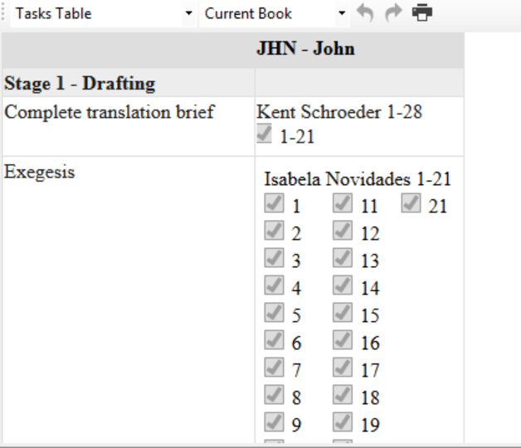
Task Table
To see the completion status for tasks by current book, assigned books or by range of books

Slide 45
Checking My Tasks
Notes:
If there are incomplete tasks or checks that are assigned to you in other books, click a link at the lower edge of the dialog to display incomplete tasks or checks that are assigned to you in another book.

Slide 46
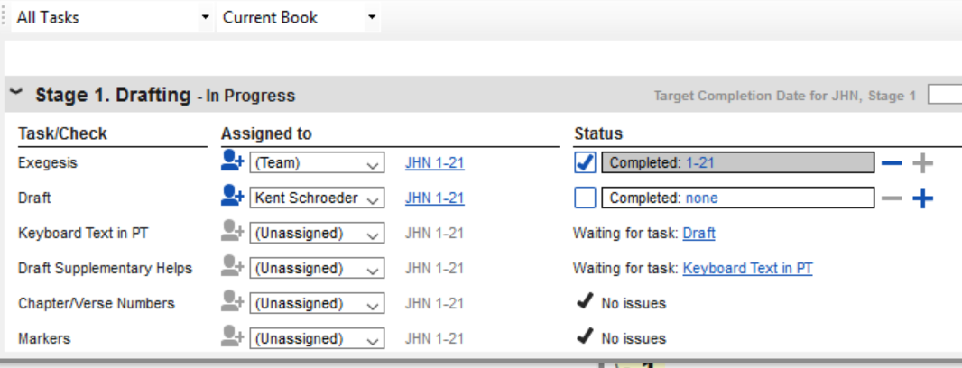
Checking All Tasks

Slide 47
Demo

Slide 48
Project Plan – View Progress
How are we doing?
Notes:
So there is a Paratext 7.5 server and a Paratext 8.0 server
Kent & Doug Higby probably get a request from Cameroon every so often when I am in search of a Paratext license for someone

Slide 49
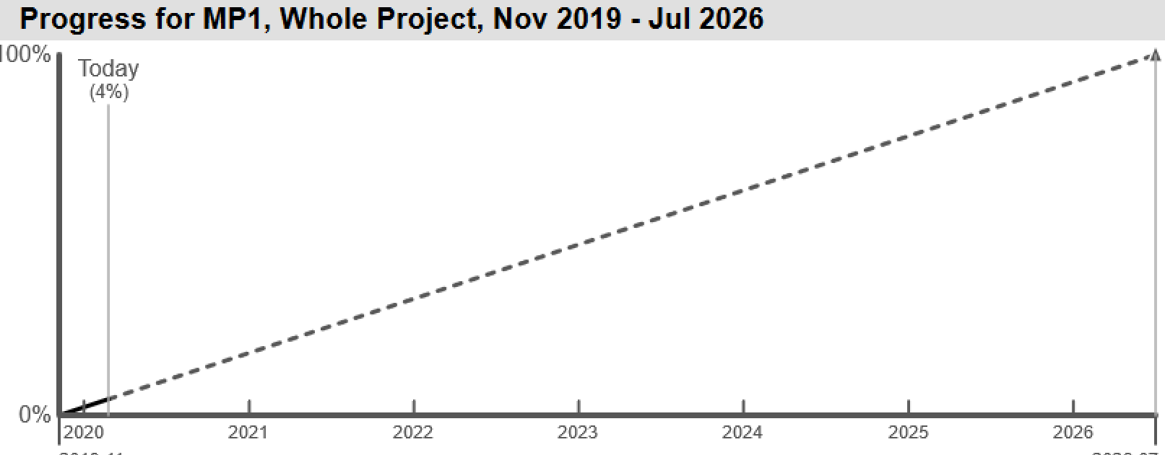
Charts and reports
Team Progress Report
By Book
By and Stage
Forecase Line Chart

Slide 50
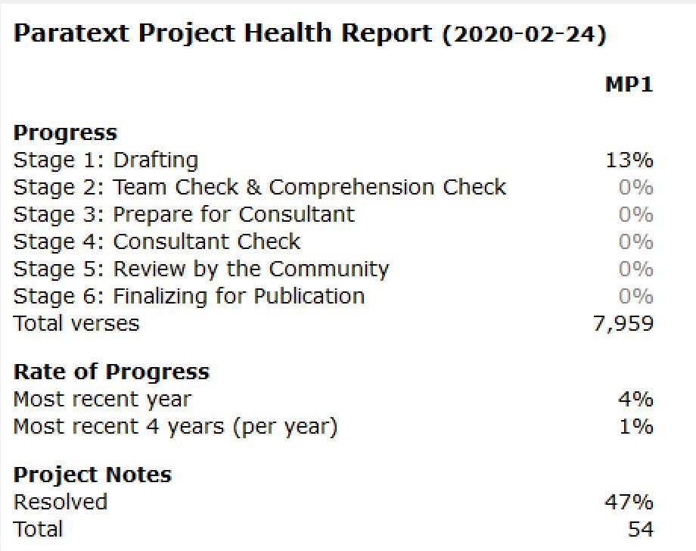
Charts and reports
Project Health Report

Slide 51
Demo

Slide 52
Notes
You need to do a Send/Receive after you have made changes to Assignments and Progress window, so that the other team members get the new editing permissions
The blue icon on the upper right hand corner indicates a project has a plan.
Having too many task set to “start anytime”.
Assigning global checks while others are drafting
Notes:
Having too many tasks set to “start anytime.” This setting gives flexibility when needed but also opens up the possibility of merge conflicts since tasks in more than stage and in more than one book can be given editing permissions at the same time.
Other problems related to causing conflicts such as assigning global checks such as Spelling and Biblical terms while others are drafting and revising.

Slide 53
How to make a base plan
Open the project that has a project plan that you wish to share as a base plan.
In the Project Plan window, shift-click Manage Plans
Make any other changes to the plan
Click Save as a Base Plan.
Give the plan a unique name.

Slide 54
How to distribute a base plan
Copy the project plan file in the StandardPlans subfolder in the MyParatextProjects folder to the computer that needs it in the StandardPlans subfolder.
The administrator for each project will need to choose the new base plan for their projects
Notes:
The base plan is an XMl in the _StandardPlans subfolder under the My Paratext 9 Projects folder,

Slide 55
Your Turn
Assign tasks for two books to the team.
Assign a task to yourself and another task to your partner for the first draft.
Mark tasks as completed.
Check the difference between My tasks and All tasks.
Review progress reports

Slide 56
Summary
A project plan is built upon an _______ plan.
To add a task to the plan, you select ______ task, click _______ button and give the task a name and __________.
You can mark a task as complete by chapter, by ______ or by _______.
Automatic checks are set at the _____ level.
You assigned tasks to a translator via the _________ and _______dialog box.
Notes:
You should demonstrate these in Paratext

Slide 57
Summary
A project plan is built upon an _______ plan.
To add a task to the plan, you select ______ task, click _______ button and give the task a name and __________.
You can mark a task as complete by chapter, by ______ or by _______.
Automatic checks are set at the _____ level.
You assigned tasks to a translator via the _________ and _______dialog box.
Answers: organizational, preceding, Add task, description, book, project, stages, assignments and progress.
Notes:
You should demonstrate these in Paratext

Slide 58
Summary
Tasks assigned to you are shown under _______
Mark individual tasks as completed for a variety of types of tasks (by _______, book or ______) from the _____ column.
Postpone checks by clicking to the ______ of the check.
Show the progress charts of your project using Project > _______ ______.
Notes:
You should demonstrate these in Paratext

Slide 59
Summary
Tasks assigned to you are shown under _______
Mark individual tasks as completed for a variety of types of tasks (by _______, book or ______) from the _____ column.
Postpone checks by clicking to the ______ of the check.
Show the progress charts of your project using Project > _______ ______.
Answers: my tasks, project, chapter, status, right, Progress Charts.
Notes:
You should demonstrate these in Paratext

