Slide 1
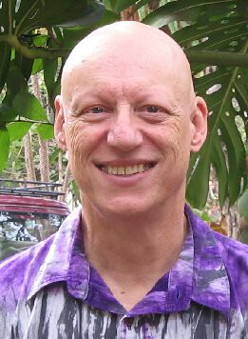
Paratext 9 UI
Kent Schroeder
SIL International
2020
Notes:
My name is Kent Schroeder. I am Language Technology Consultant for Africa Area.
I will be giving a basic overview of most of all the language software available to language development workers.

Slide 2
New Features of P9
Enhanced Resources
New UI
Simplified SIL Project Plan
USFM 3.0

Slide 3
Why is this important?
More screen space available
Ends the “ran command on wrong project” pain.
More options for managing windows
With floating windows can use second monitor
One open dialog

Slide 4
Learning Objectives
Be able to identify the new UI features of Paratext 9
Be able to use the new features of Paratext 9
Be able to show someone else how to use the new features of Paratext 9

Slide 5
What will we do?
Demo the following
New menu system
Search menu
Open dialog
Window framework
Window layouts

Slide 6
What will you do?
Your turn to do
New menu system
Search menu
Open dialog
Window framework
Window layouts

Slide 7
What will you do?
Show your mate what you have learn, each one taking a turn.

