Slide 2
REAP
Repository for
Electronic
Archiving and
Publishing
Notes:
A project mandated by SIL International, and sponsored under SIL Language Program Services

Slide 3
REAP is…
an online archiving system that:
Stores text, video, audio, images, and data
Preserves resources in electronic form over the long term
Indexes resources for easy searching and retrieval
Makes content available via intranet and internet

Slide 4
REAP is
a centralized archiving system,
that can be used remotely by your staff.

Slide 5
SIL Language & Culture Archives (LCA).
Over 60,000 volumes of Scripture, vernacular materials and academic papers.
Notes:
But in the past the Archives were safeguarding only a paper copy. In the last decade, the SIL Archive added electronic files, if the entity chose to send them to Dallas, but it was still not easy to search. In fact the database was not available except at Dallas. Now, all items are to be archived in REAP, both published and unpublished research, surveys, internal reports.

Slide 6
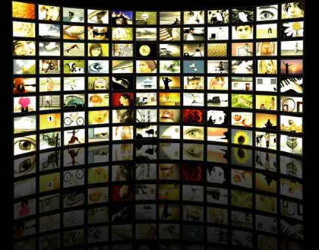
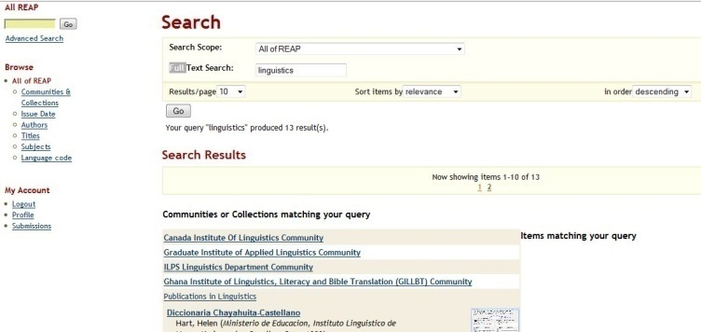
Compared with a hardcopy archive, a central, remotely accessible, electronic archive is:
REAP
easier to maintain
easier to search – for the entity & for others
easier to share
& has a longer life

Slide 7
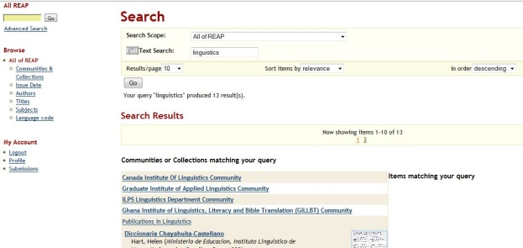
REAP lets us share our work with future generations
For more sustainable language development
For continuation of interrupted projects
For re-engagement with past work
For re-working older materials for new purposes.
REAP

Slide 8
Backup vs. Archiving: different goals
Backups are designed to facilitate rapid recovery from disasters like theft, looting, fire, data loss or data corruption, hard-disk failure, etc.
Archives should facilitate the preservation of stable materials that are deemed to have long term value.

Slide 9
What does REAP contain?
REAP is our language & culture knowledge repository, including translated works, Scripture, vernacular works, research, academic production, training materials, etc., both published and not published.
It does not contain finance data, personnel data or other. Only language and culture materials.
Notes:
9

Slide 10
What formats does REAP manage?
Archive formats are any electronic file and can include soft-copy, editable format, print-ready, web, video, audio, & photos.
Notes:
10

Slide 11
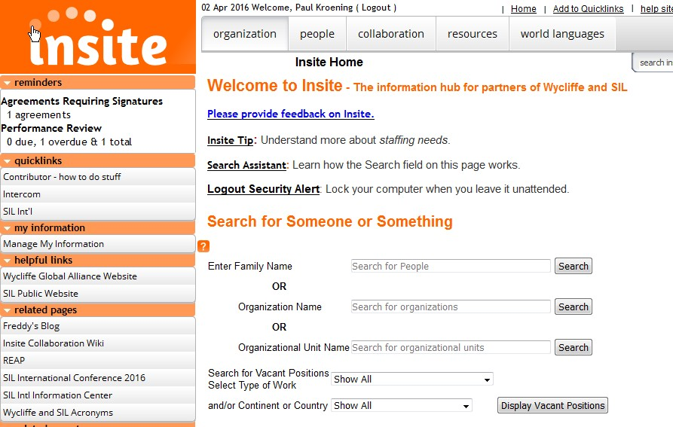
Notes:
Insite home

Slide 12
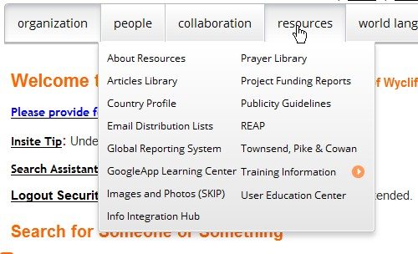
Notes:
From Resources, find REAP

Slide 13
Logon at: https://www.reap.insitehome.org/
Intro to REAP: https://www.wiki.insitehome.org/display/REAP/REAP
Help files at: https://www.wiki.insitehome.org/display/RH/Archiving+Procedures+and+Guidelines
Notes:
Also found here

Slide 14
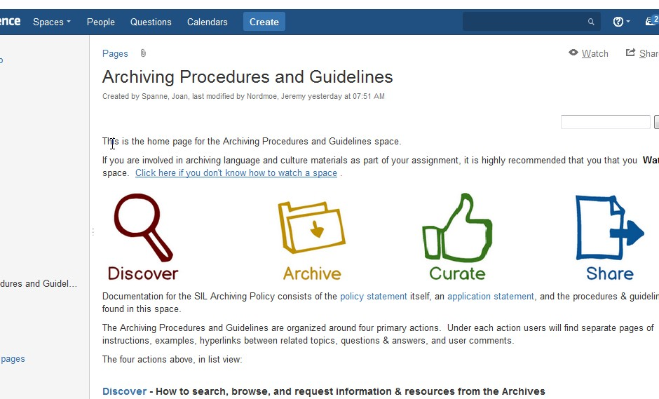
Notes:
This is the front of the new Help pages on Insite

Slide 15
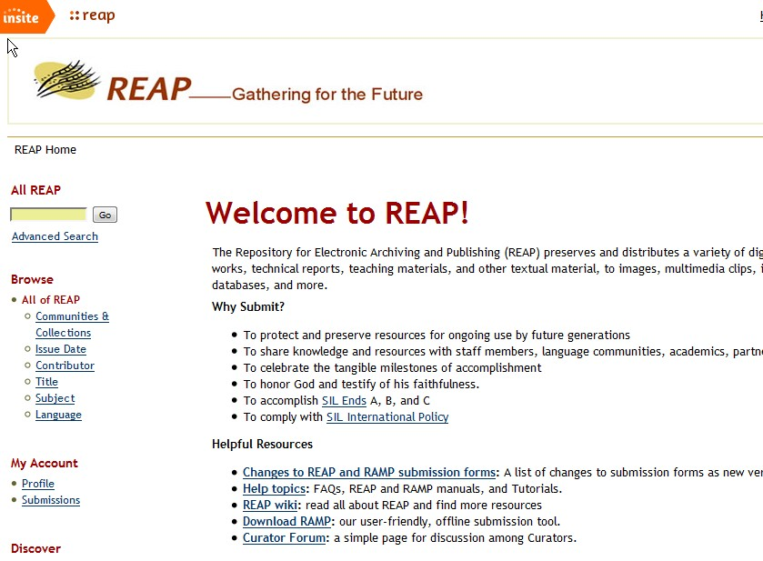
Notes:
Home page of REAP

Slide 16
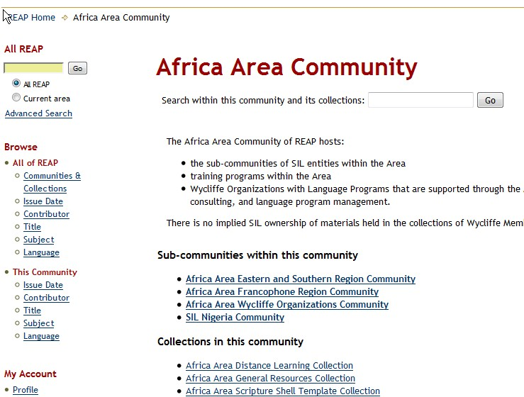
Notes:
Click Africa and see the three traditional regions or Areas, and Wycliffe Organizations separately

Slide 17
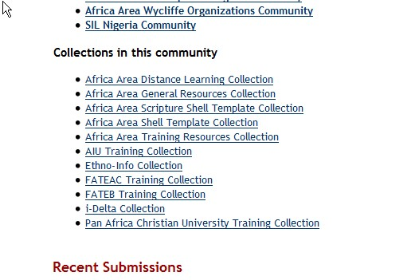
Notes:
With in Africa are also the Area training collections and Shell Templates

Slide 18
Notes:
Look at the Communities representing more or less the Areas

Slide 19
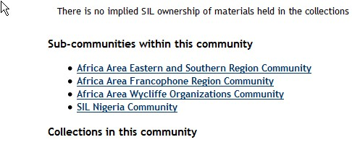
Notes:
Detail

Slide 20
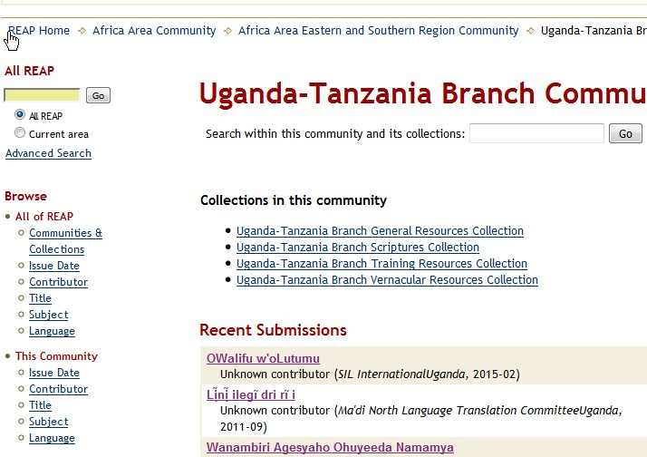
Notes:
One entity, all 4 of its Collections

Slide 21
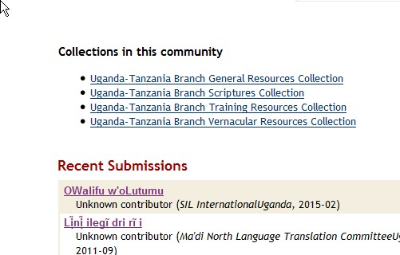
Notes:
Click on UTB and see it has 4 collections

Slide 22
Collections
Entity or WMO
Scripture
Vernacular Resources
General Resources
Collection
Training Materials
Sub-Community
Within each entity community, you will find four collections based on broad type: Scripture, Vernacular Resources, General Resources, and Training Materials.
Notes:
Collections are always these four with the possibility of adding one or more sensitive collections

Slide 23
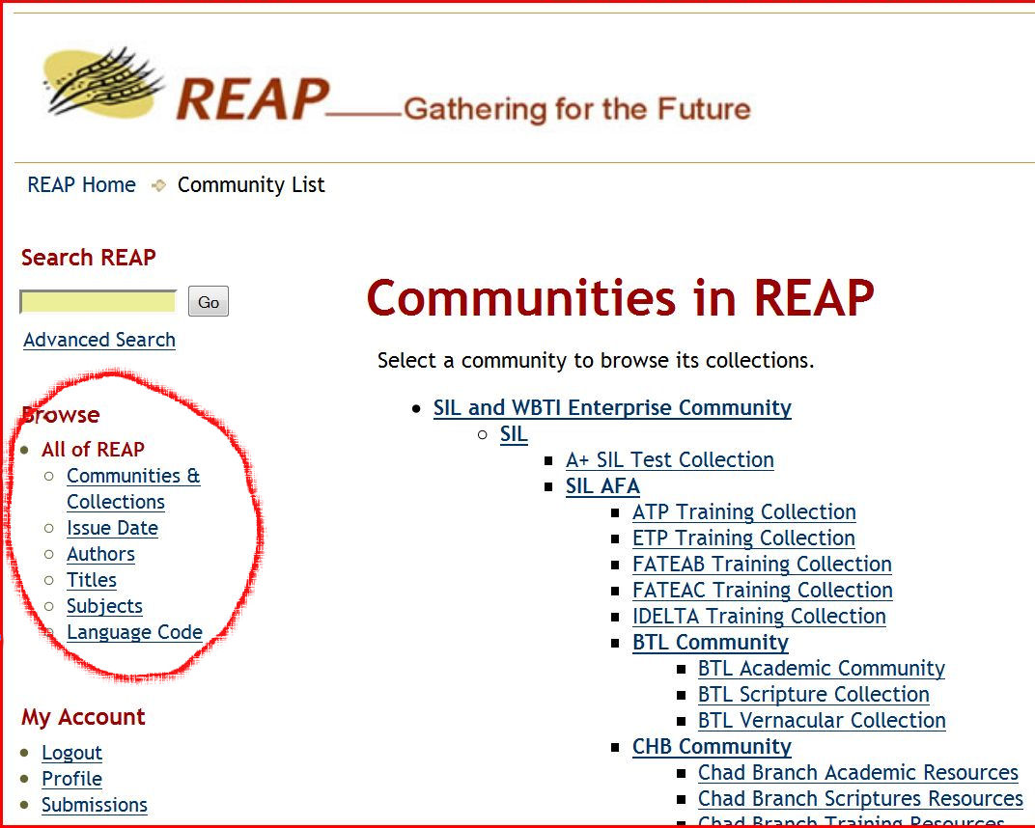
REAP Communities and Collections

Slide 24
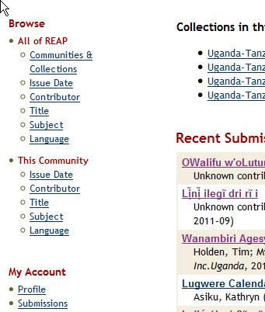
Notes:
Browsing, left sidebar: All of REAP, and the entity you are looking at

Slide 25
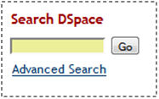
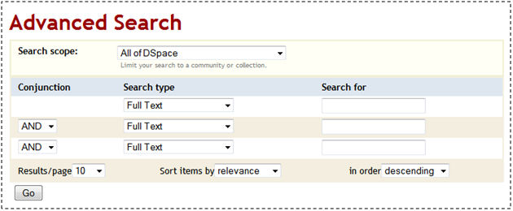
Searching in REAP

Slide 26
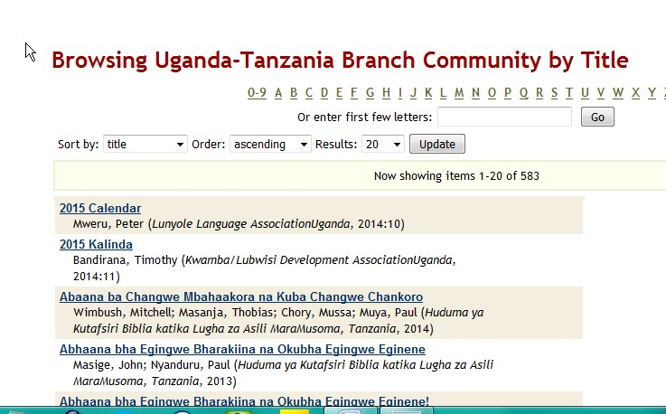
Notes:
Browse for title

Slide 27
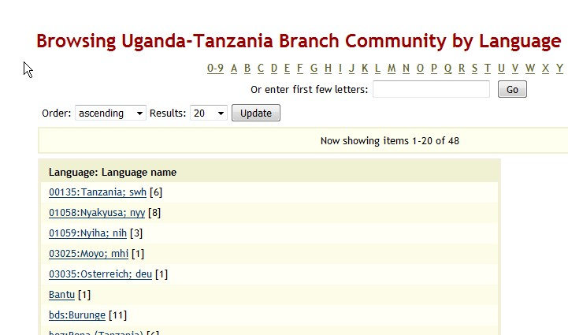
Notes:
Browse for language

Slide 28
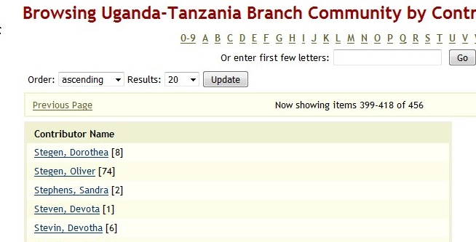
Notes:
Browse for contributor or author

Slide 29
Notes:
Look for one author

Slide 30
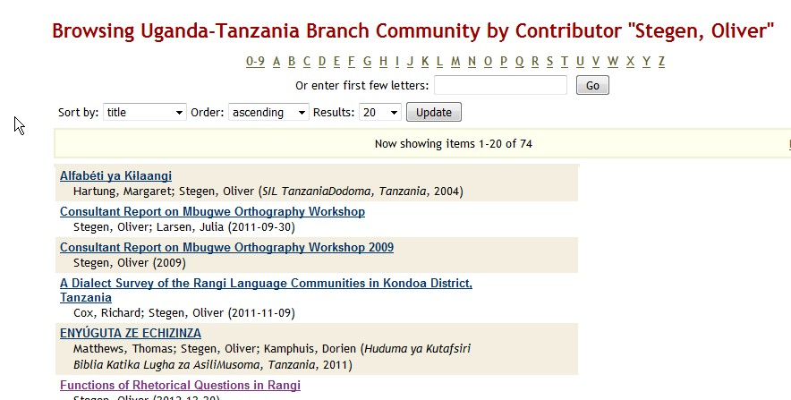
Notes:
Find all the items with the contributor’s name related to it. Click on the top item

Slide 31
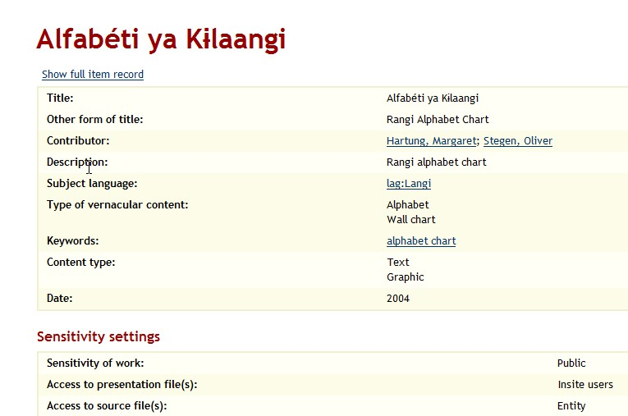
Notes:
Click on the top item and the entry loads. This is the summary view. Click full item to see all the metadata

Slide 32
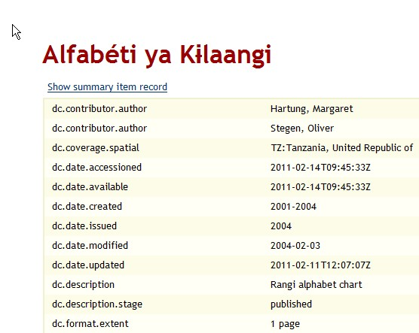
Notes:
This is the top part of the full view.

Slide 33
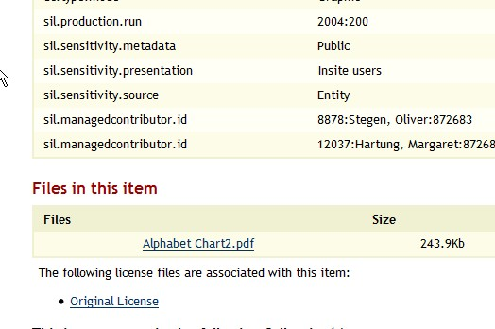
Notes:
Bottom of the entry gives the access sensitivity, set by the submitter, or by branch policy.

Slide 34
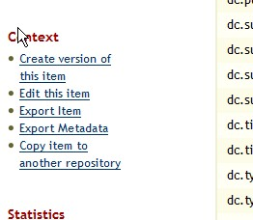
Notes:
Curators may edit the metadata. The edit link is found on the left sidebar.

Slide 35
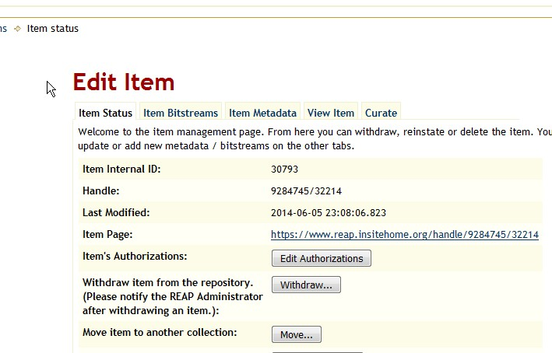
Notes:
This is the edit screen. Submitters can’t get here, only curators, approved by the entity and trained by REAP staff. Three places to edit. The access status of the bitstreams (content files), upload and delete new bitstreams, and additions and changes to metadata.

Slide 36
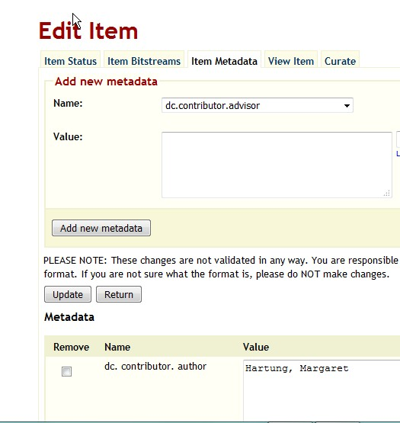
Notes:
This is the edit screen which the curator uses to add or change metadata.

Slide 37
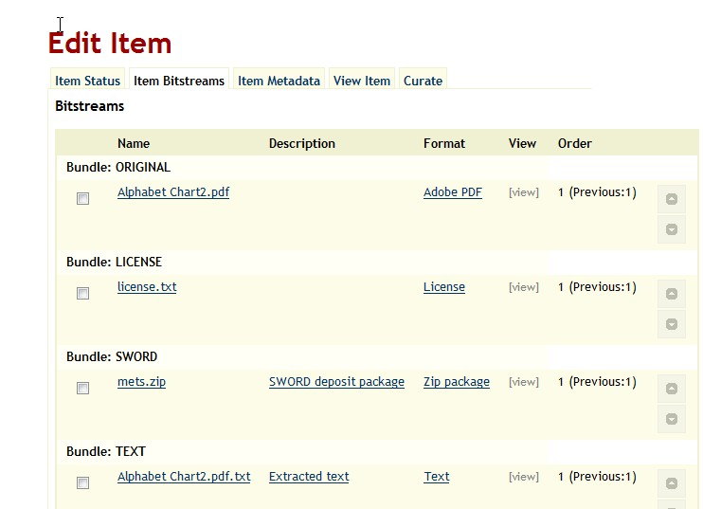
Notes:
This is the bitstream edit screen. To upload and delete new bitstreams, and additions and changes to metadata.

Slide 38
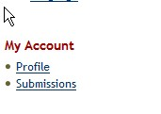
Notes:
On the left of any screen is a box called My Account containing for curators a “submissions” link.

Slide 39
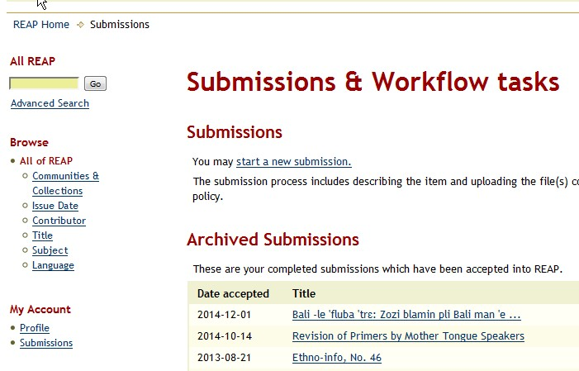
Notes:
The curators use the submissions screen to manage new entries which the curator is to edit and approve.

Slide 40
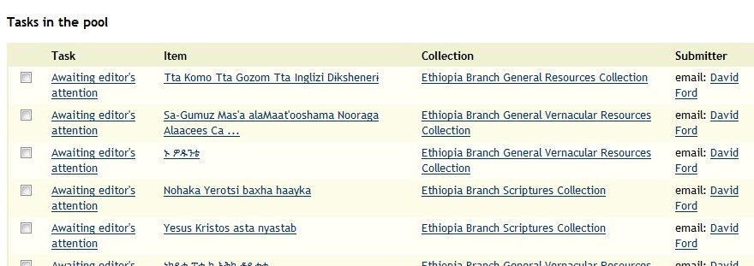
Notes:
In the “Pool” are all submissions which apply to a curator. I’m a curator for all of Africa, so my page may get long. I click on one or more of these and move them to my own Task bin.

Slide 41
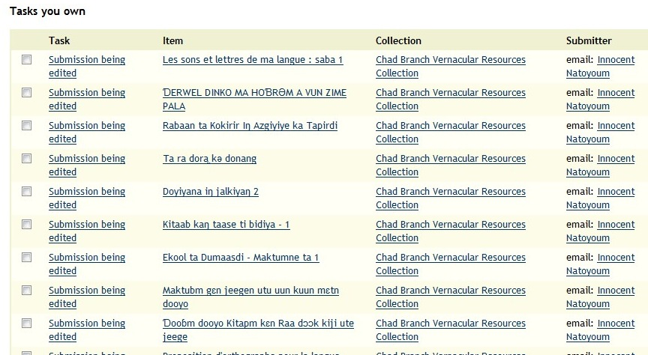
Notes:
Then the “Pool” changes to “tasks you own”, ones the curator has accepted to edit and approve into the system.

Slide 42
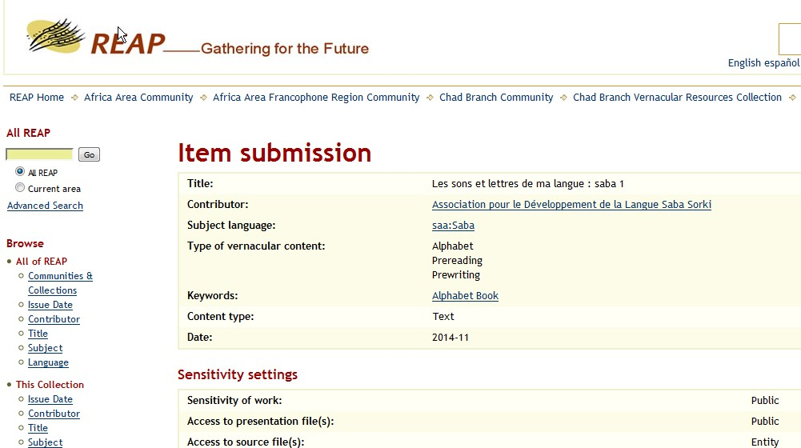
Notes:
Here is one item for submission.

Slide 43
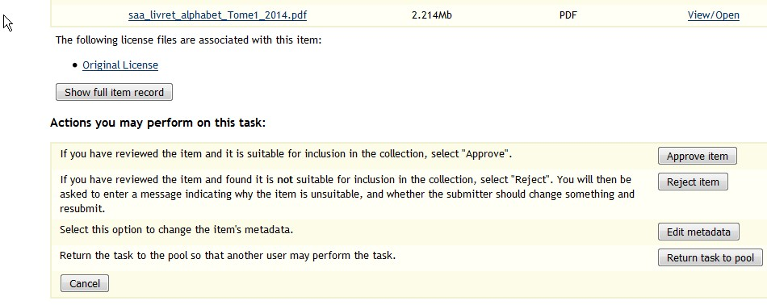
Notes:
Here is one item for submission. This is the bottom portion of that same screen. The curator clicks on “edit item” to start editing. If the curator finds that the item already exists in the Archives, he can reject it, or return it to the pool to ask advice of another curator.

Slide 44
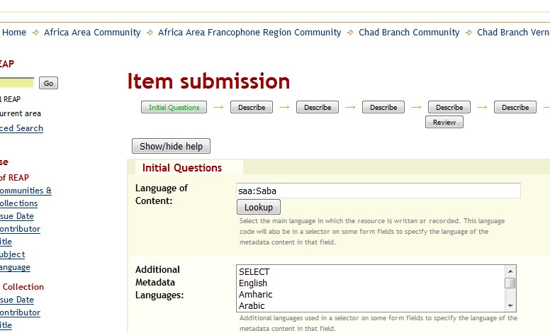
Notes:
This is what one page of the edit screen looks like. Beginning with the name of the language itself and its ISO code, and working down through all the metadata.

Slide 45
Notes:
One further function which the curator may need help with is on the left sidebar, exporting the metadata for an entire collection. This is a handy way to have a single spreadsheet view of all the holdings of the entity. I’ve left an entire sample file in your folder, but it looks like this.

Slide 46
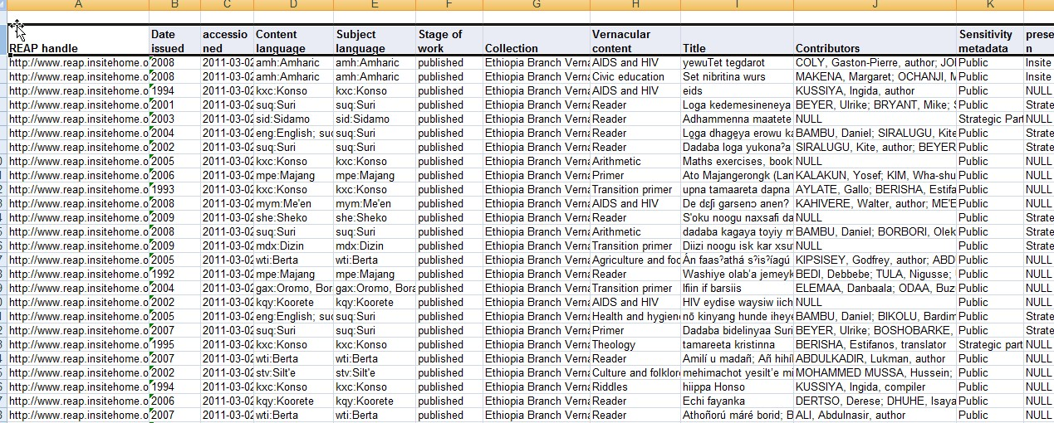
Notes:
It is an excel or libre office spreadsheet, containing as many columns as there are metadata fields in the REAP entry, so it can be quite wide. I have an instruction on how to turn the raw CSV file into this format which I’ll give you.

Slide 47
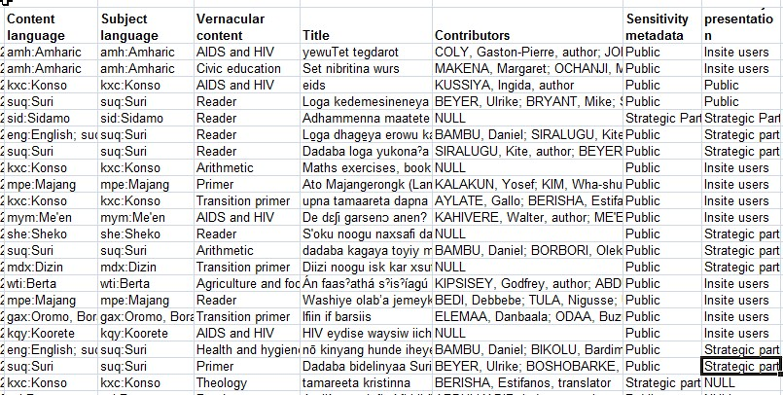
Notes:
But you can see that it contains in summary form all the information for the entire collection. This useful for the curator to print out from time to time to help the LP department know what is in the archives, what is not, and what the sensitivity settings are.

Slide 48
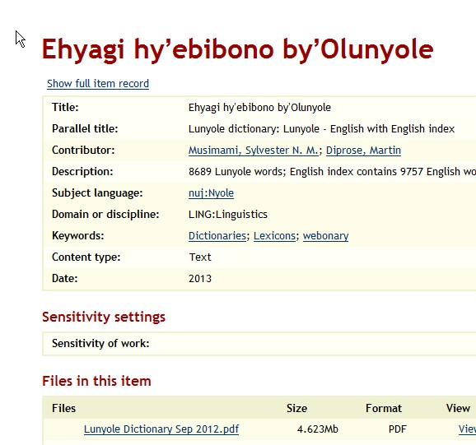
Notes:
One of the purposes of the electronic archives is having a repository centrally managed by the entity for publishing. Open one entry.

Slide 49
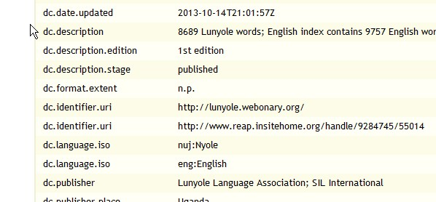
Notes:
At the bottom of the entry you can see the location of the entry in REAP, and also that it has been published to a website, in this case Webonary.

Slide 50
Notes:
in this case Webonary.

Slide 51
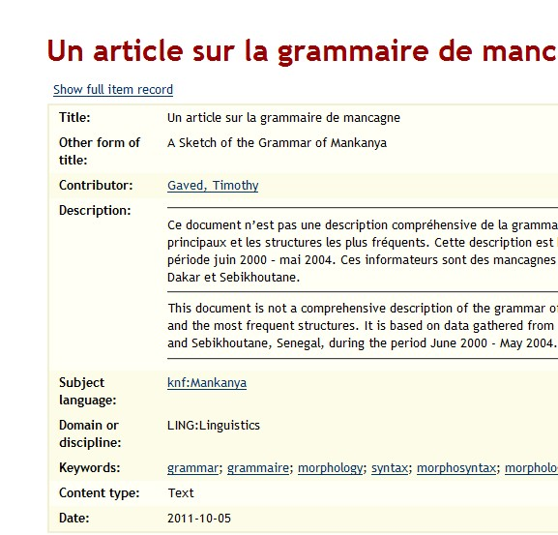
Notes:
Another possibility for direct publishing, that is, directly out of REAP, is for SIL.org. Here is an entry from Senegal Branch.

Slide 52
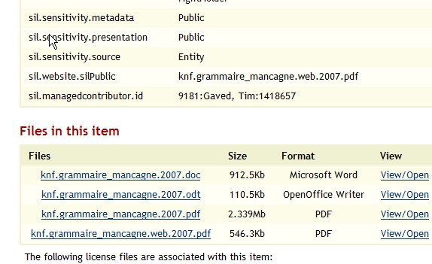
Notes:
At the bottom of the entry you see the content files. And above under sil.website.silpublic, note that one of the filenames from the content list below has been chosen by the submitter, the author, to be publicly displayed on SIL.org.

Slide 53
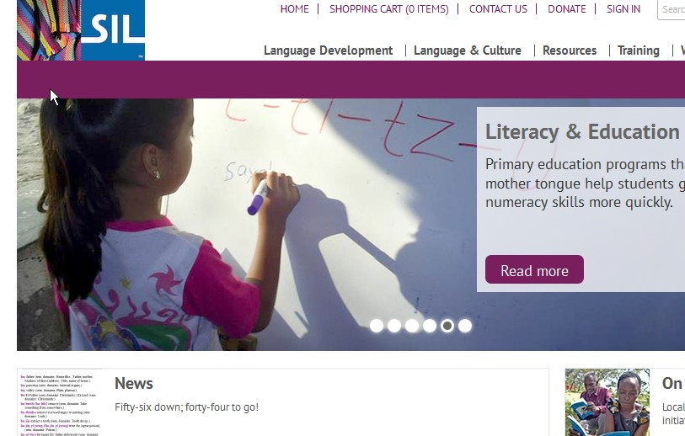
Notes:
Now if you go to SIL.org and click on resources.

Slide 54
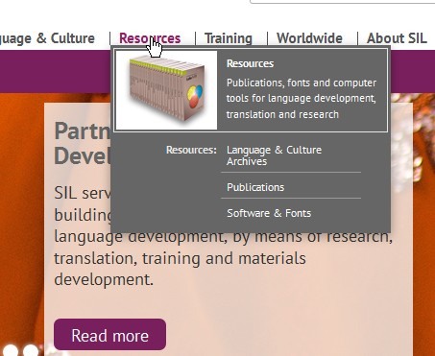
Notes:
Now if you go to SIL.org and click on resources. And one resource is the Language and Culture Archives.

Slide 55
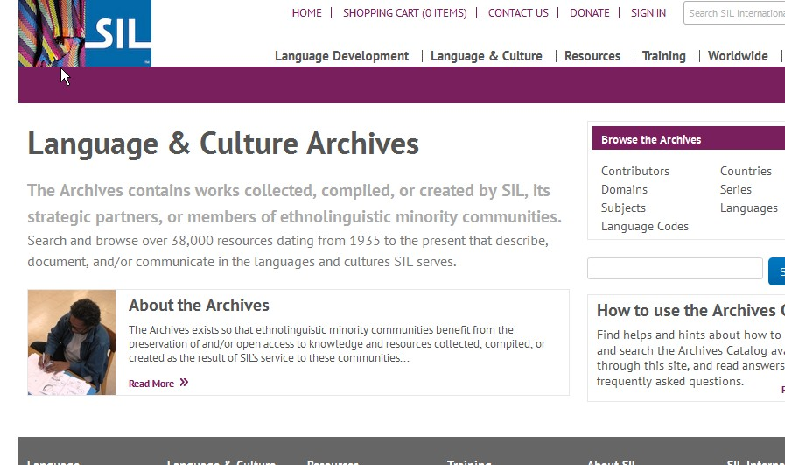
Notes:
Find contributor, and put in the name of our author

Slide 56
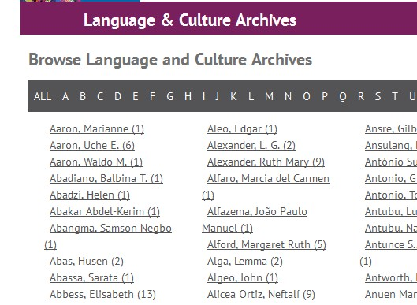
Notes:
Find contributor, and put in the name of our author

Slide 57
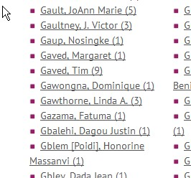
Notes:
Find contributor, and put in the name of our author

Slide 58
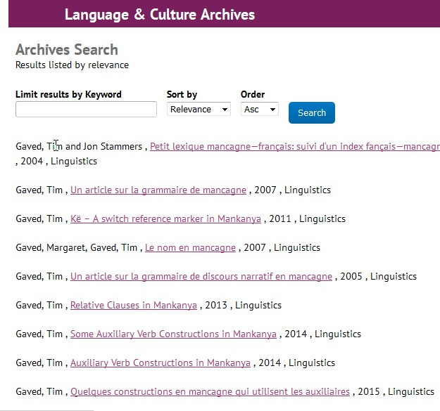
Notes:
Find contributor, and put in the name of our author, and here is the SIL Bibliography. This is the list of everything SIL knows about this author’s publications.

Slide 59
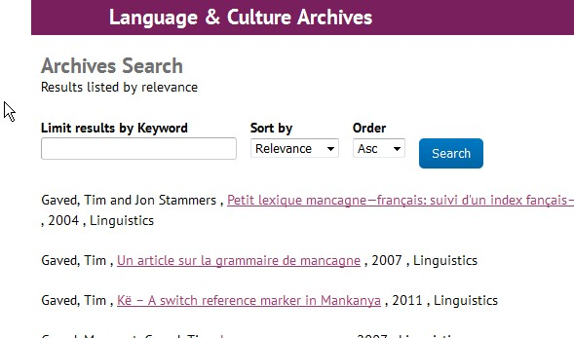
Notes:
The second on is the grammar article.

Slide 60
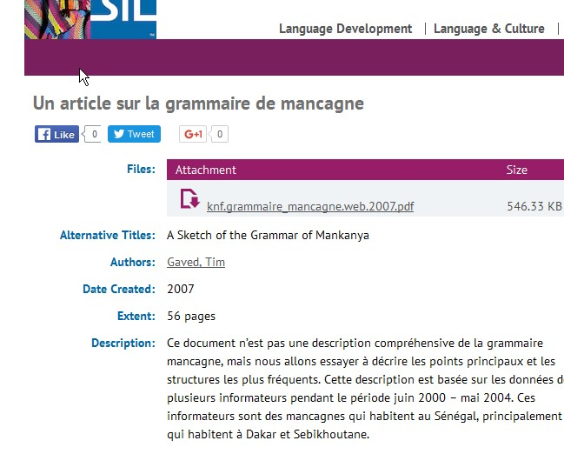
Notes:
And when you click on it, the SIL Bibliography entry is displayed for that work, including, in this case, a downloadable PDF of the work.

Slide 61
Notes:
This is fully automated through REAP and does not need to go through the SIL Content Board of editors. When the author submits the work to REAP, and checks that he wants it to be publicly displayed, then the curator checks it, it is sent to SIL.org within the recycle period of the server.

Slide 62
Notes:
This is the simplest way in which curators can assist entity staff to publish their articles, dictionaries, etc.

Slide 63
Notes:
This has been a brief overview of the screens about which curators and entity users of REAP may ask you for help. You can keep this presentation and use it as a reminder of the purposes of each of the pages. If your entity has a curator, work with the curator from time to time to learn more about the functionality of the Archives.

