Slide 2
REAP
Repository for
Electronic
Archiving and
Publishing
Notes:
A project under SIL Language Program Services

Slide 3
Getting items to REAP
Staff who have access to Insite may submit directly to Collections managed by their entity of assignment.

Slide 4
Getting items to REAP
Staff who have access to Insite may submit directly to Collections managed by their entity of assignment.
The intention is to give decision-making power about sensitivity and access to the author or editor as well as off-load the curator of submission duties.

Slide 5
Getting items to REAP
However, an entity may also decide to have submitting done only by the curator. This may be easier when internet access is poor. Or it may be simply an entity decision about asset management.
Notes:
Recommendations? Experiences?

Slide 6
Getting items to REAP
Staff who have an Insite login and password may submit directly to Collections managed by their entity of assignment.
Notes:
REAP was set up in such a way

Slide 7
Getting items to REAP
Staff who have an Insite login and password may submit directly to Collections managed by their entity of assignment.
Retired members or SIL staff without an assignment to the entity may not.
Notes:
This is a useful restriction because the idea behind Collections follows the SIL Intellectual Property Policy, that the entity is the managing authority for both published and unpublished materials.

Slide 8
Getting items to REAP
Retired members or SIL staff without an assignment to the entity may not.
But there are a few reasons to allocate access to former staff.
Retired staff still submitting materials.
Consultants with another branch who continue to have long-term responsibilities to the former branch.
Notes:
There may be other possibilities

Slide 9
Getting items to REAP
Retired staff still submitting materials.
Consultants with another branch who continue to have long-term responsibilities to the former branch.
These staff need to have an “affiliation”with the entity in order to continue to have access.
Notes:
On the other hand, this will probably not be worth the trouble for those who have a few or occasional items to submit or to edit. It will probably be simpler for that person to send items to the curator to submit or to add or change content files. In the end however, it is an entity decision.

Slide 10
Getting items to REAP
Submitters may enter items directly into the REAP interface. It is cumbersome but possible.
Notes:
I find this method clumsy and subject to errors and I do not recommend it unless the submitter is very familiar with the metadata choses for a given type of content.

Slide 11
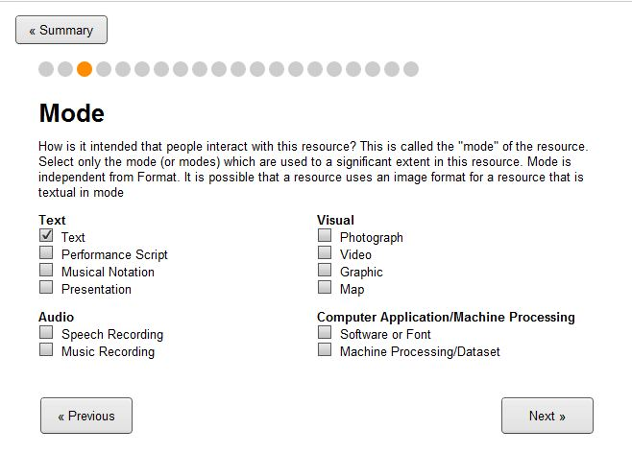
Getting things into REAP using RAMP
The Resource and Metadata Packager
Notes:
The method designed for submitters for all types of material is to use RAMP

Slide 12
Getting things into REAP using RAMP
The Resource and Metadata Packager
Advantages of using RAMP:
It is an offline tool, requiring no internet to use.
Notes:
The method designed for submitters for all types of material is to use RAMP

Slide 13
Getting things into REAP using RAMP
The Resource and Metadata Packager
Advantages of using RAMP:
It is an offline tool, requiring no internet to use.
It is hierarchial, so that as the submitter answers questions, metadata types no longer relevant to the entry are not seen.
Notes:
The method designed for submitters for all types of material is to use RAMP

Slide 14
After you submit the item…
The entity curator manages the input process to insure consistency and accuracy.
RAMP
REAP

Slide 15
Decisions curators make -
Does it belong in REAP?
Is the metadata accurate?
Can the files be opened correctly?
Are permissions set, and set according to entity guidelines?
REAP
Notes:
The curator answers these questions. Entities may have one or more curators. Few entities would need a full-time curator. UTB has one curator for Uganda and one for Tanzania. Each is a part-time position.

Slide 16
The submitter may:
Upload the completed RAMP package
RAMP
REAP
Notes:
The submitter may upload the completed RAMP package to the REAP server

Slide 17
The submitter may:
Upload the completed RAMP package
Or “export” it to give it to the entity curator to upload.
RAMP
REAP
Notes:
The submitter may upload the completed RAMP package to the REAP server. We’ll get into this more in a moment.

Slide 18
What’s inside a RAMP package?

Slide 19
The finished RAMP package contains:
all the bibliographic information
&
the content files
Notes:
This package is discrete, essentially a zip file containing the metadata in xml format, and the content files. There is no encoding.
Normally the RAMP package can be easily handled by the REAP server, even on quite terrible connections. It’s very robust and can take packages of up to 700 MB. This permits a wide variety of uploads including audio, typesetter files for entire Bibles, and even video.

Slide 20
What’s inside a RAMP package?
You have a sample called
SevenFuliiruScripturesongs0.ramp
Copy this filename to:
SevenFuliiruScripturesongs0.zip

Slide 21
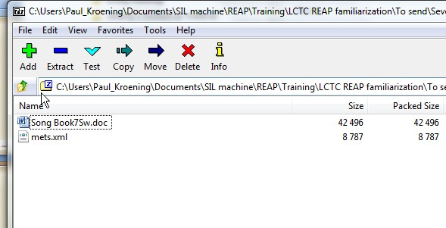
SevenFuliiruScripturesongs0.zip may be extracted to show the contents.
Notes:
You’ll see a content file, in this case a Word document. And the metadata file called mets.xml. This file is what the REAP server uses to build the REAP entry.

Slide 22
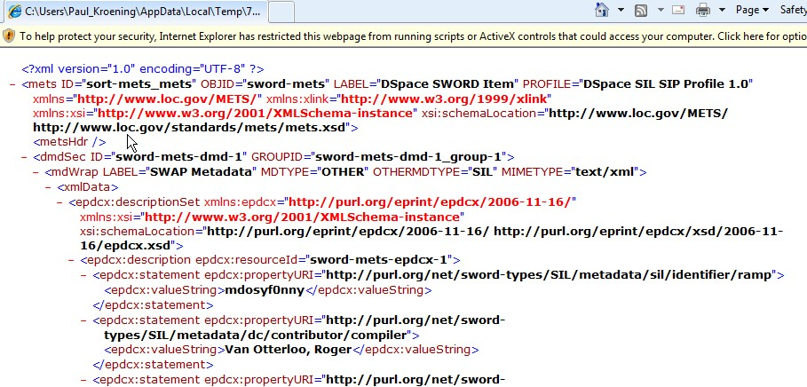
mets.xml may be displayed in a web browser to show the data fields which have been entered by the user and encoded to build entry in the REAP server
Notes:
You’ll see a content file, in this case a Word document. And the metadata file called mets.xml. This file is what the REAP server uses to build the REAP entry. You have this sample in your folder.

Slide 23
While it is possible to revise mets.xml data in an xml editor, it is almost never worth the trouble.
It is simpler and more reliable to re-do the RAMP package to correct data.
Notes:
As you’ll see, the RAMP package is easy to edit and revise to a new filename.
We mentioned before the size of the submission. Extremely large packages of a GB or more are best handled by sending to Dallas Archives via Dropbox to be uploaded. One method of initiating an entry which can be curated locally is to encourage submitters to build a RAMP package with only the small files of a set, and upload the large ones later. See demo.

Slide 24
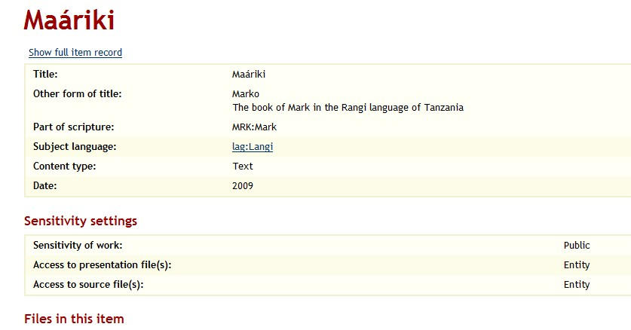
Sample: https://www.reap.insitehome.org/handle/ 9284745/35811
Notes:
One method of initiating an entry which can be curated locally is to encourage submitters to build a RAMP package with only the small files of a set, and upload the large ones later. In this sample from UTB, the [lag] Rangi St Mark, if we’d had only limited bandwidth, we could upload only a small file now and the larger files later.

Slide 25
Sample: https://www.reap.insitehome.org/handle/ 9284745/35811

Slide 26
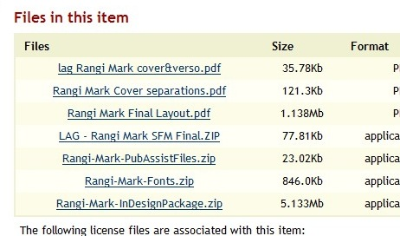
Sample: https://www.reap.insitehome.org/handle/ 9284745/35811
Notes:
One method of initiating an entry which can be curated locally is to encourage submitters to build a RAMP package with only the small files of a set, and upload the large ones later. In this sample from UTB, the [lag] Rangi St Mark, we might have started only with the SFM/Paratext zip file, and the cover and front matter pages only, two small files, and added the InDesign and other printable files later on.

Slide 27
Practice
make a RAMP package from the Johannes Merz’s sample.
this is already in REAP at: 60083, but make a new one to compare it.
export the package (Religionoffilm.ramp)
examine the contents

Slide 28
Technical questions to :
your entity REAP curator
Africa Area Curator Janell Nordmoe (Nairobi)
Janell_nordmoe@sil.org
Africa REAP Community of Practice Coordinator Ali Robinson (Jos) ali_robinson@sil.org
Paul Kroening (Nairobi) paul_kroening@sil.org
SIL Archives Director Jeremy Nordmoe (Nairobi) jeremy_nordmoe@sil.org
Notes:
Your REAP curator may know a great deal about archiving and relatively little about IT, file management, etc. This is where you can work together to improve entity language program processes.

