Slide 1
Teaching a Workshop
Kent Schroeder
SIL AFA

Slide 2
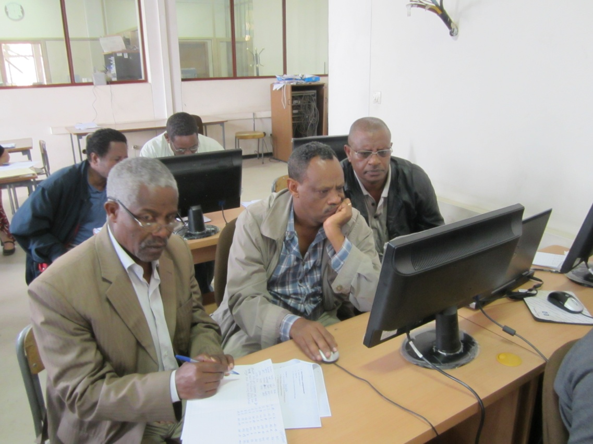
What usually initiates a software training workshop?
Notes:
Often it is provoked by a crisis
-Teams are already using the software but are failing in some way.
-It is thought that general training in the tool will help
--This is usually a “tool-focused” training
Sometimes it is initiated by a new version of software

Slide 3
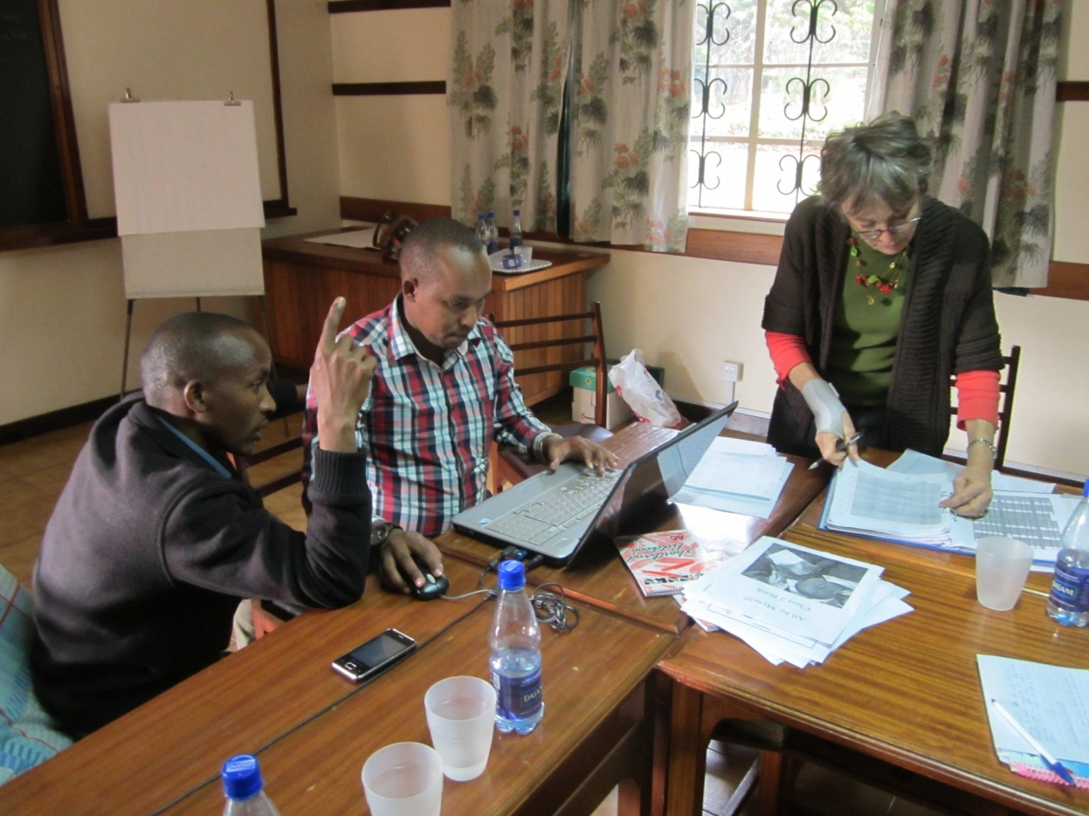
What should initiate a workshop?
Notes:
Strategic planning
--Language programs plan training at just the right time to equip teams to accomplish language program tasks.
Regular interval
--Technology pace of change is enough that you can assume that the technology you are using today will be new and improved this time next year.
--We have determined a pace of 1 week of training per team per year.

Slide 4
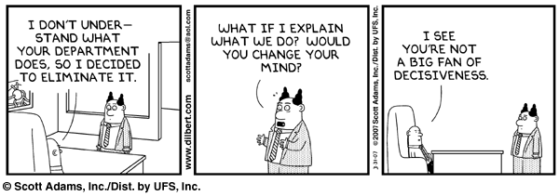
How can the language technology dept. help?
Notes:
We provide language technology training to improve the efficiency of language program tasks
But sometimes our tools accomplish those tasks in ways the project management has not thought of.
Our job is to know what features of the software will help accomplish which language program tasks.

Slide 5
Position yourself for successful training
Inform leadership of new language technology that will help their strategy
Learn what tasks the language programs want to accomplish
Measure the group's existing skills
Create learning objectives that align with the tasks
Notes:
Share the things that are available with the leadership in your area. See where the tools you have learned about can save time and effort
Don't accept a general answer. Be specific
Test, survey or query someone who understands the group

Slide 6
Learning Objectives
A learning objective is an explicit statement that clearly expresses what the student will be able to do after taking a course.
Create learning objectives that bridge the current skills to the desired outcomes
Customize for the audience

Slide 7
Samples of LOs
Be able to backup and restore a project in FLEx.
Be able to get a shell book from the Bloom library.
Be able to build a word list using MLE 4000 Word List in WeSay.
Be able to use the Biblical Terms tool to adapt proper names in Paratext

Slide 8
Writing Training Modules
Purpose
Learning Objectives
Learning Tasks
Connection
Content
Challenge
Changes
Notes:
Method 1:
Purpose
Learning Objectives
Learning Tasks
--Connection
--Content
--Challenge
--Change

Slide 9
Writing Training Modules
Introduction
Where are we?
Why is this important?
What will you do?
2. Demonstration
3. Exercises
4. Summary
Notes:
Method 2:
Introduction
--Where are we?
--Why is this important?
--What will you do?
Demonstration
Exercises
Summary

Slide 10
Task Oriented Learning
Creating a new collection of books
Keeping good records of your preparatory notes and comments
Collaborating with teams to receive their text and back translations and send comments
Taking notes during a checking session and sending it in a report afterwards
Bloom collection
Consultant notes project
Send and Receive
Using notes
Notes:
In a recent workshop on Paratext 7 for Consultants, we made a strong effort to focus only on the task that Bible translation consultants would specifically deal with. Here is an example of task orient learning objectives. Please look at these and discuss how they compare to the topics you might normally expect from a Paratext workshop. What is “Doing effective exegetical preparation for a consultant checking session”?

Slide 11
Planning a Workshop
How will the cost be covered?
How far in advance should it be planned
Rule of thumb - One week of tech training per project per year
Basic planning information
Notes:
1. Date:
2. Place:
3. Workshop Title:
4. Objectives:
5. Target Audience:
6. Prerequisites:
7. Programs used:
8. Length:
9. Leaders to contact:
10. Resource people to contact:
11. Training materials exist?

Slide 12
Training Pitfalls
Don’t put people of varying levels in the same course.
Don’t cover more than they can handle
Don’t do menu-based instruction
Don’t forget to specify prerequisites.

Slide 13
Training Pitfalls
Don’t fail to supply electronic documentation
Don't fail to provide concrete exercises with sample data
Don't forget to specify hardware/software requirements in
advance

Slide 14
Assignment
Plan a workshop for the coming year. Use the Workshop Planning Form
Notes:
1. Date:
2. Place:
3. Workshop Title:
4. Objectives:
5. Target Audience:
6. Prerequisites:
7. Programs used:
8. Length:
9. Leaders to contact:
10. Resource people to contact:
11. Training materials exist?

