Slide 1
Glyssen
LTCT 2017 Nairobi
Outilingua 2017, Ouaga

Slide 2
GLYSSEN TECHNOLOGIE DE LA LANGUE
Producing a high-quality dramatized Scripture recording just got easier.
http://software.sil.org/glyssen/

Slide 3
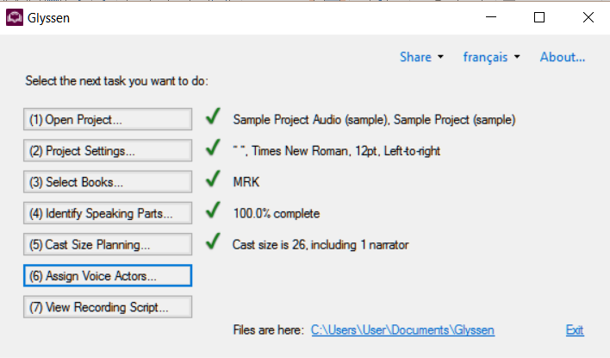
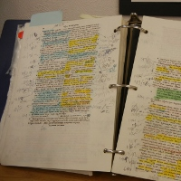
Paratext – Glyssen - Script
Glyssen starts with a translated scripture text (exported from Paratext as DBL).
Glyssen
Script

Slide 4
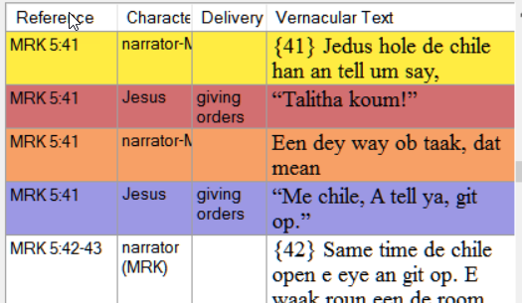
Who says what part?
Glyssen finds all the places where direct speech is marked by quotation marks, et for 95 % of cases can automatically determine who is speaking.

Slide 5
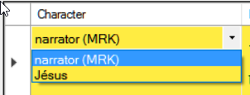
Who says what part?
Text that is not direct speech is assigned to the book narrator.
For verses where there is direct speech from more than one individual, Glyssen prompts the user to choose from a list of expected speakers in that verse.

Slide 6
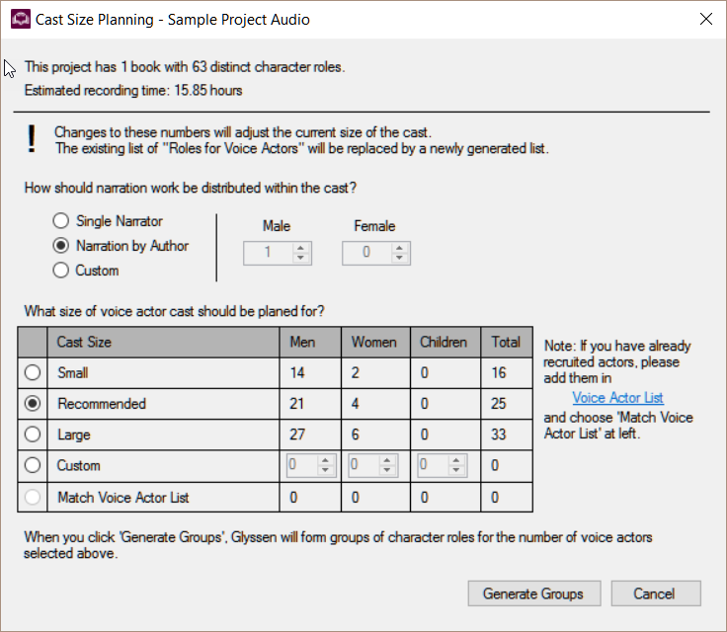
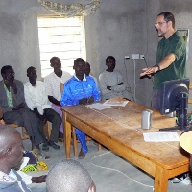
Cast Planning, Role Assignments
Glyssen helps you select an appropriate list of actors for the project.
1 livre 63 acteurs
15.85 heures

Slide 7
When to use Glyssen ?
If you wish to do audio recording as a naturalness check of the translation, use HearThis to quickly produce a single-voice recording.

Slide 8
If you wish to invest in publishing a single or multi-voice recording for long-term use, wait until the text has been consultant checked and then utilize either HearThis or Glyssen in your recording project plans.

Slide 9
Questions ? Comment ?
http://software.sil.org/glyssen/

