Slide 1
Notes
in
ParaTExt 8

Slide 2
Who? To whom? What for? When?
Experiences and uses for Project notes
During drafting – the translator is uncertain and wants to return to consider options (note or bookmark for self)
During internal or external review – a reviewer comments on the translation
At any time – ask the consultant a question
Prior to checking sessions – consultant asks questions or highlights issues to cover
After a checking session – for reporting or for the consultant to use when working in other projects
At any time – bookmarks (for the next session, this is where I/we start)
Other uses ?
Return to Menu

Slide 3
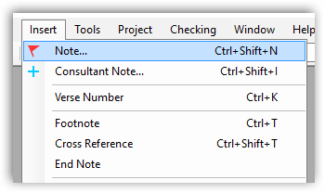
How?
Inserting project notes
Using the Insert menu
or
Right click on word/phrase
OR Control+Shift+N
Return to Menu

Slide 4
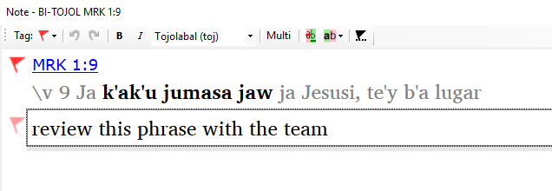
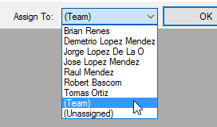
What? To whom?
Writing a comment and assigning it
Type in your comment or question
Assign the note
Notes:
End of this slide – exercise – each person insert a note in COPYICAP

Slide 5
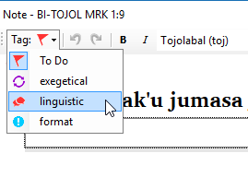
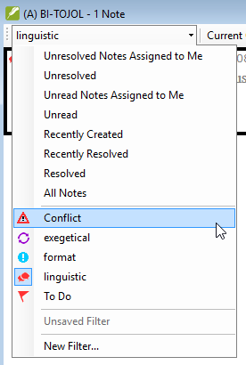
What for?
Using project tags to describe the content
Custom tags become default filters
Return to Menu

Slide 6
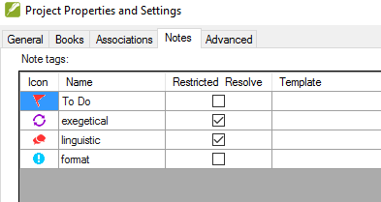
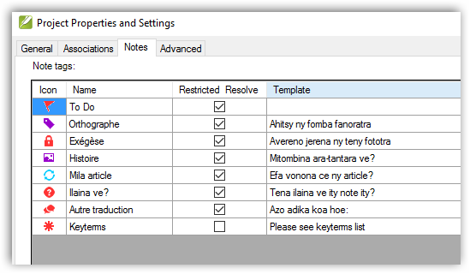
Adding new Note Tags
Administrator defines the project tags - specific to each project
Return to Menu
Notes:
Show them where under Project Properties and Settings, Notes tab (for COPYICAP)

Slide 7
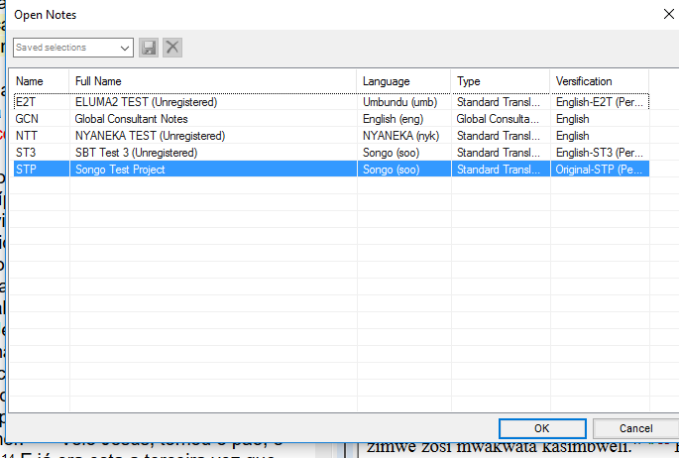
Where? Searching notes
Return to Menu

Slide 8
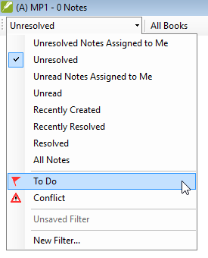
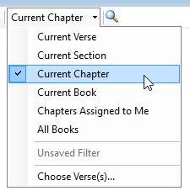
Filtering project notes
Return to Menu

Slide 9
PRACTICE
Please have a look at what notes are there in COPYICAP
Use File, Open Notes, Filter on All Books
First see All Notes
Then look at Unresolved Notes

Slide 10
Creating and saving a Filter for notes
Return to Menu

Slide 11
Saving a Filter in notes window:
Menu File > Open notes…, choose any project(s), start filtering
Return to Menu

Slide 12
Saving a Filter in notes window:
Menu File > Open notes…, choose any project(s), start filtering
Return to Menu

Slide 13
Saving a Filter in notes window.
Once your filter is ready, give it a name and save it:
Return to Menu

Slide 14
NOW YOU DO IT!
First, do a S+R to the internet, team member A, then member B, then member A
Make a new filter for the COPYICAP project
Make a filter for notes written by your partner
Notes:
NOTE TO SELF – you may have to do an initial example, find a note written by Ada Vultur – then they do the practice

Slide 15
New features in ParaTExt 8
Return to Menu

Slide 16
Filtering notes in ParaTExt 8
Return to Menu

Slide 17
Filtering project notes in ParaTExt 8: Notes Assigned to Me
Return to Menu

Slide 18
Filtering project notes in ParaTExt 8: Conflict Notes
Return to Menu

Slide 19
Train translators to use Notes Window
Return to Menu

Slide 20
Using Notes window with Vernacular
How to have vernacular and resources and Notes together
Save the windows combination
Opening all notes
The colours of notes (red, grey, yellow background)
Filtering by text in notes
Resolving Notes (including restricted resolve)
Notes:
Describe how most translators operate – VISUALLY - so they miss notes in footnotes
General principle: The person making the note should resolve the note EXCEPT where otherwise agreed.

Slide 21
Resolving Conflict notes in ParaTExt 8
Return to Menu

Slide 22
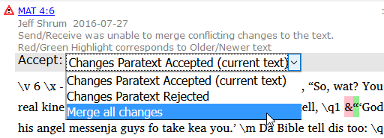
Resolving Conflict notes in ParaTExt 8 – easy fix
Easy replace or merge of changes from conflicts
Return to Menu

Slide 23
YOUR TURN!
Create a conflict. Agree to change the same verse somewhere in Matthew in COPYICAP with your partner. Both do a S+R.
Locate the conflict, and together, resolve it.

Slide 24
New types of notes in ParaTExt 8
Return to Menu

Slide 25
Note types in ParaTExt 8
Project notes
Consultant notes
Conflict notes
Biblical term (rendering discussion) notes
Word list (spelling discussion) notes
Return to Menu

Slide 26
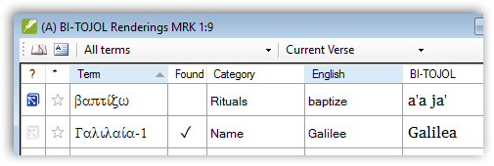
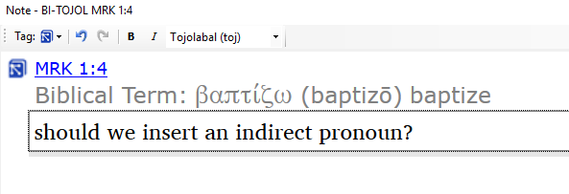
Biblical term notes
Return to Menu
Notes:
Show an example of this from COPYGIRY - by using Biblical Terms Discussion Notes filter

Slide 27
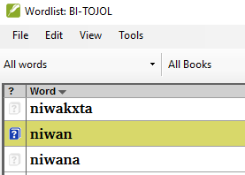
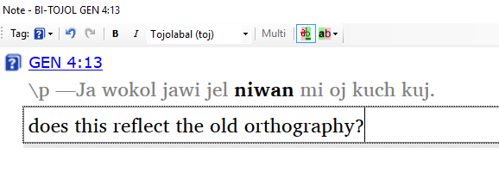
Word list notes – Spelling discussion notes
Return to Menu

Slide 28
GIVE IT A GO!
Using COPYICAP, bring up Biblical Terms Tool (under the Tools menu.)
Make a note next to a Biblical Term
Then open the Word List.
Make a note against one of the words
Notes:
You could show them COPYDIG just before they do this

Slide 29
Attaching notes to the text in ParaTExt 8
Return to Menu

Slide 30
Attaching notes in ParaTExt 8
How many have seen something like this?
Return to Menu

Slide 31
In ParaTExt 8, the note is kept attached to the original location
Only when the text is drastically changed, the note jumps to the beginning of the verse.
Return to Menu

Slide 32
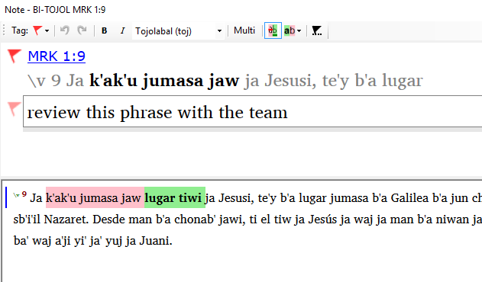
Reattaching a note
Return to Menu

Slide 33
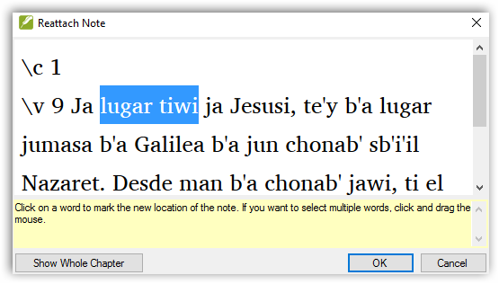
Reattaching a note
Return to Menu

Slide 34
Reattaching a note
Return to Menu

Slide 35
Notes in the project planning in ParaTExt 8
Return to Menu

Slide 36
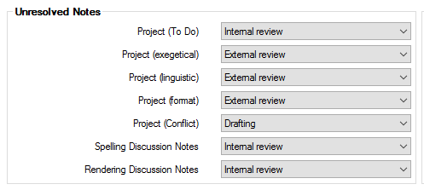
Project tags in project progress planning
Return to Menu

Slide 37
Consultant notes in ParaTExt 8
Return to Menu

Slide 38
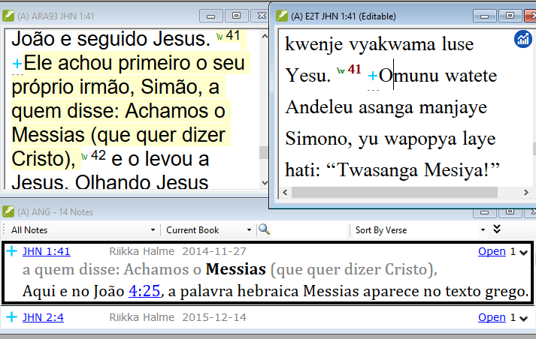
Consultant notes: a separate project not restricted to one project
Return to Menu

Slide 39
Showing consultant notes
Return to Menu

Slide 40
Registration of consultant notes not needed
Consultant notes are projects that need to be migrated
Return to Menu
Notes:
Show my JMCLY notes in ACTS, in COPYICAP, and explain how I created the consultant notes project.
New project, type of project, consultant notes
Ask them to display JMCLY – all notes in ACTS

Slide 41
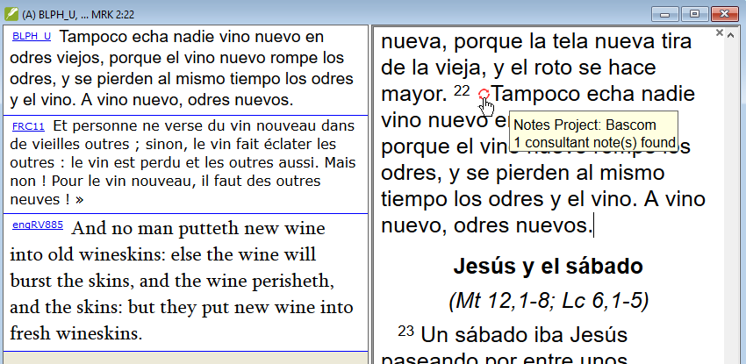
New in ParaTExt 8: View or insert consultant notes in “text collection” context window
Return to Menu

Slide 42
Tips and Tricks
Return to Menu

Slide 43
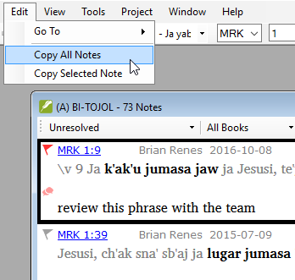
Tip # 1 – copying filtered notes
Filter notes, then
go to Edit… Copy … notes
Return to Menu

Slide 44
Tip # 2 – quick links to references
Scripture reference links
Or with scripture reference settings
Return to Menu

Slide 45
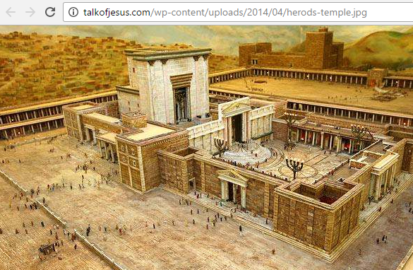
Tip # 3 – quick links to references
Links to web pages
http://talkofjesus.com/wp-content/uploads/2014/04/herods-temple.jpg
Return to Menu

Slide 46
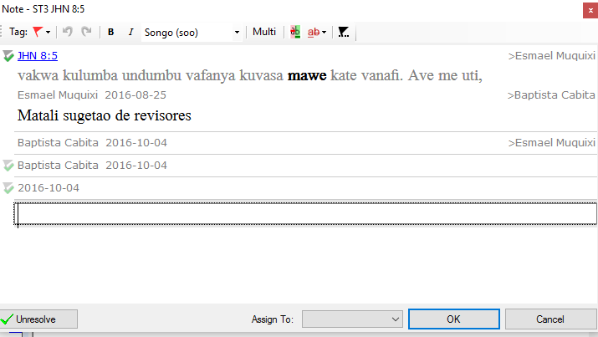
Tip # 4 – comparing text before and after inserting a note
Return to Menu

Slide 47
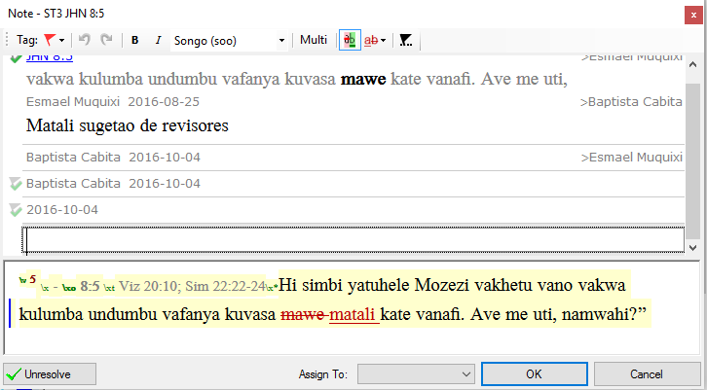
Tip # 4 – comparing text before and after inserting a note
Return to Menu

Slide 48
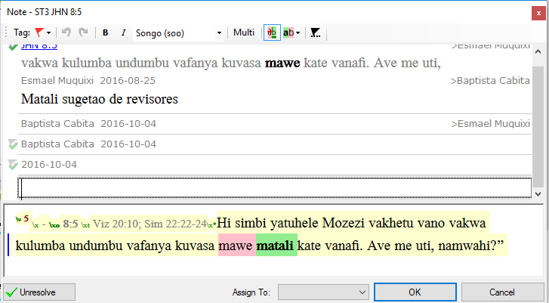
Tip # 4 – comparing text before and after inserting a note
Return to Menu

Slide 49
Summary
All project notes will transfer with the ParaTExt 8 project
Consultant notes are projects and must migrate separately
New note types (Biblical terms notes and Word list notes) do not appear in the notes window
It is important to know how to use filters
Project plans can include note resolution goals
Project plans can assign supervision of note progress
Return to Menu

Slide 50
TRY THESE OUT
Managing notes:
Creating different tags for notes Menu Project > Project Properties and Settings > Notes
Menu File > Open notes > Filtering notes
Creating and saving a filter
Resolving Conflict notes in ParaTExt 8
New types of notes in ParaTExt 8
Attaching notes to the text in ParaTExt 8
Notes in Project plans in ParaTExt 8
Consultant notes:
Viewing Consultant notes in any project or resource
Creating/Migrating a Consultant notes project and inserting & Viewing Consultant notes

Slide 51
Questions
Return to Menu

