Slide 1
ParaTExt Spell Checking
THURSDAY MARCH 30, 2017

Slide 2
Spell-Checking Overview
The Word List is the primary method for spell checking your translation
for much more detail, read the Spell-Checking Manual
This is not something to tackle in final checking – but all through the project

Slide 3
Why is spelling important?
What do you think?
Spelling mistakes and variation diminish peoples’ confidence in the other aspects of your translation.
Translations in LWCs generally have few spelling mistakes
People should be drawn to the message, not the mistakes.
Notes:
Found under checking menu – show them in Paratext

Slide 4
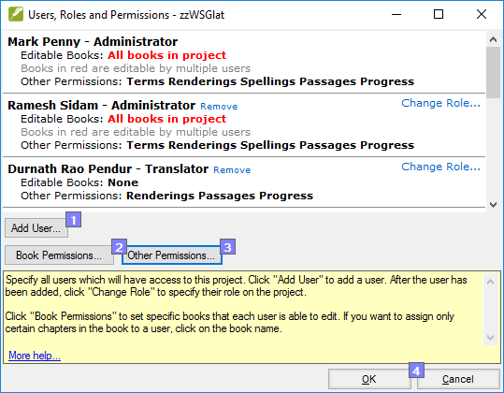
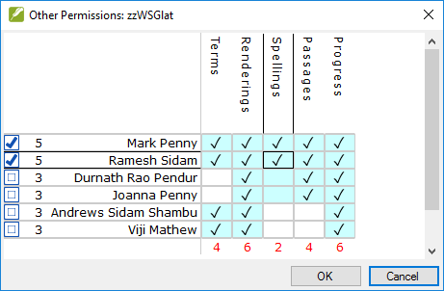
Setting Permissions to edit Spelling Status:

Slide 5
Accessing Word List
3 ways to access –
Tools, WordList
Control-W hotkey
right mouse click on word in your project, Wordlist - takes you directly to that word in the Wordlist
Notes:
Found under checking menu – show them in Paratext

Slide 6
Word List Overview
What should be done, and in what order?
Open the Wordlist and do the following:
1. Approve spelling of frequent words
2. Check the words Paratext thinks are wrong
3. Check similarly spelled words
Notes:
Found under checking menu – show them in Paratext

Slide 7
1. Approve frequent words
Click in the window of your project, to make it the active window.
From the Tools menu, select Wordlist...
From the Wordlist Tools menu select Approve Spelling of Common Words...
Adjust the number of occurrences that must be present. The spelling status for any word with that amount of occurrences (and more) will be marked as correct. Paratext will alert you to the number of word status changes made by this procedure.

Slide 8
Global -vs- Local Checking
Takes a significant amount of time
Extremely efficient (massive impact)
Risky if done hurriedly
Need above-average skill to do it well
Not done very often (once per book)
Batch processing mode
Quick to fix mistakes in context
Not as efficient (inconsistent impact)
Lower risk (local scope)
Can easily be done by anyone
Tends to be done multiple times a day
Real-time maintenance modeS

Slide 9
Pre-requisites for effective global spell-checking
Character inventory has been set up correctly
Have the authoritative copy of the project (s/r to collect latest text)
Ideally others stop working while global spell-checking is in progress
Permission to edit ALL the books that are being checked & fixed
Permission to edit the Spelling Status of words (this is NEW!)
Notes:
In my experience, this global checking only happens in final checking. It should be happening from time to time during the project’s ongoing life.

Slide 10
Best Practice? - depends on who you ask!
It is always best to fix spelling mistakes as they happen (while editing in context).
I agree, but...
That’s not always practical, or the most time-effective way. It can also distract the translator from the main task at hand (esp. w.r.t. naturalness and flow).
Another issue is that it is all too easy to mark a word as being correct when seen in isolation (even in an appropriate context), but then you later realize that it is actually wrong when you see it in the context of other words which look remarkably similar.

Slide 11
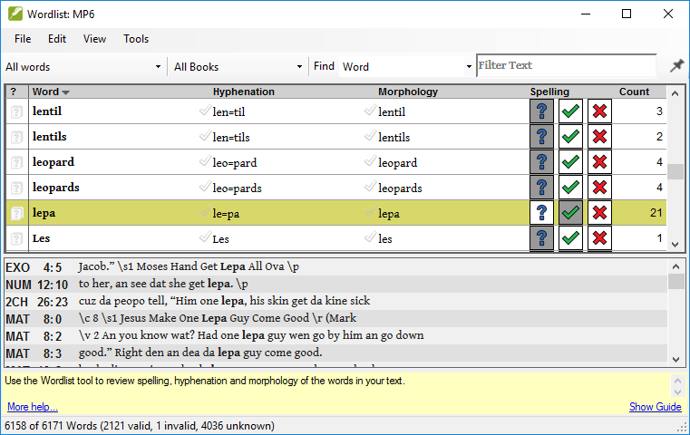
Tools > Wordlist… (Ctrl+W)

Slide 12
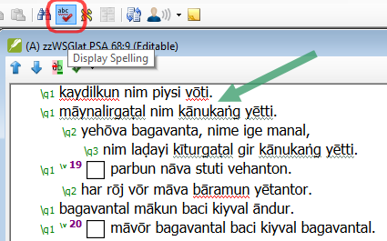
Strategies (both are needed)
Global:
First ensure that the Character Inventory setup is done. Then check that you have set the scope (filter books).
Then perform these steps… (details will follow)
Find Incorrectly Joined or Split Words
Find Similar Words
All Checks (let Paratext highlight all the suspicious words)
Local:
Turn on the Display Spelling setting. Then...
Right-click on a word to fix.

Slide 13
Alternative method
Translators or advisors/consultants who DO NOT HAVE editing permissions make SUGGESTED spelling changes in the Word List;
Translator must then review and apply the correction.
Notes:
I have used this method for some time with a number of projects.
The main reason for doing so is translators not being able to effectively use the word list for themselves.
Much more training is needed, just on the Word List.

Slide 14
What NOT TO DO
Translators go down the list, in alphabetical order, marking word after word as spelled correctly.
Generally, this results in words that are incorrect being marked as correct.
It is also extremely boring, and so the translator loses concentration quickly.
Notes:
Illustrate with CNT

Slide 15
2. Check mispelt words
Click in the window of your project, to make it the active window.
From the Tools menu, select Wordlist...
From the Wordlist Tools menu, select Spell Check…
Choose Single Character Typos initially
Notes:
My preference is to use the various Spell check options one by one.

Slide 16
PRACTICE
Working with COPYICAP, approve frequently spelled words.
Then run Word List, Tools, Spell Check, Single Character Typos
Tick what is correct, accept Paratext suggested changes when correct, or click X, make correction

Slide 17
3. Checking similar words
Click in the window of your project, to make it the active window.
From the Tools menu, select Wordlist...
From the Wordlist Tools menu, select Find Similar Words…

Slide 18
3. Checking similar words
The first box is for letters that sound alike, where translators may be using one or the other to spell the same word.
For example, “s” and “z”, or l and r (in many Bantu languages)
DEMONSTRATE long and short vowels in OT of zzHABNJM
Notes:
Yaakani and Yakani
Yaazieli and Yazieli

Slide 19
3. Checking similar words
Need to use your knowledge of the language, so as to know what should be put in as similar sounds.
Example – Chonyi (CNT) - the underlined v and the ordinary v. OR ng’/ng’m/ng
Example 2 - COPYDIGO - á and a, ó and o
Notes:
Use Paratext 7.6 and CNT project
Example 2 in Paratext 8

Slide 20
3. Use of Ignore Diacritics
Particularly productive in a complicated Nilotic language like Aringa (Paratext 7.6)
See the word for God – adroŋa, capitalized, uncapitalized, etc.

Slide 21
Similar Words - PRACTICE
Make your active window EPP2, then produce a word list
Use the letters o/ou in Tools, Find Similar Words in Word List
Then enter the apostrophe into Letters to Ignore, and see if there are any errors. Correct them.
Notes:
Mourning shld be morning
Apostrophe - should find isnt and isn’t wasnt and wasn’t

Slide 22
Incorrect Word breaks
Wordlist, Tools, Incorrectly Joined or Split Words
DEMONSTRATE with zzHABNJM
PRACTICE - run this same check on COPYICAP, then click on Show All Combinations
Notes:
Big issue for new orthographies, when word breaks are difficult to define, as the language has only recently been written.

Slide 23
Spell-Checking – in Text Window (Local Checking)
for more detail, read the Spell-Checking Manual
PRACTICE click on Checking, Display Spelling (COPYICAP)
Words which are incorrect or which are considered suspicious will have a wavy red underline. Words for which Paratext does not have enough information to consider correct, incorrect, or suspicious will have a wavy grey underline.
Notes:
Found under checking menu – show them in Paratext

Slide 24
Overview of Word List
Explain various menu items – File, Edit, View, Tools
Filters – All Words, Unknown, Incorrect and Unknown
Range filter (Bible, NT, OT, Gospels, Current Book, etc)
Extreme right – filter for any string
Notes:
You should demonstrate these in Paratext

Slide 25
PRACTICE – setting Range Filter
DEMONSTRATE Make a filter for Johannine material in COPYICAP
PRACTICE In COPYICAP, make a filter for the Gospels

Slide 26
Capitalization
DEMONSTRATE with Hema ra Mkpwutano (Tent of Meeting) in COPYDIGO
Use of search for phrase, Match Case unticked, then remove from list capitalized phrase, to assess situation
Translators should be aware that capitalizing any word or phrase means they have to check for consistency.
Use Tools, Missing Capitals in Word List

Slide 27
PRACTICE
USING COPYICAP Bring up the WordList, then run the check, Tools, SpellCheck, then choose Missing Capitals.

Slide 28
Plan and Word List
Show LT17 – Plan – Checks –
currently Spell Check at Stage 3. Preparing for the Con. Check
Should be in Stage 2. Team Checking
A reminder of the close relationship between Plan and various Checks (Spell Check, Basic Checks)

Slide 29
Relationship of WL with Names
Possible to mark all Names in Bibl Terms list as correctly spelled, once they are correct (use zzHABNJM)
Tools, Biblical Terms, use filter Names
In Bibl Terms, Tools, Mark Renderings as Correctly Spelled
All these words now marked in WordList as correctly spelled

Slide 30
Any questions ?

