Slide 1
Comparing & contrasting Parallel texts
ParaTExt 8
Notes:
I’m excited to share with you this afternoon the great improvements that have been made in version 8 to the Parallel Passages check. Firstly, how many people have actually used the tool. Not just demonstrated it but used it. You see I have demonstrated it for over 10 years now and I have used it with two teams. One with and earlier version (probably 7.3) and one this year with 7.6. wow what a difference!

Slide 2
1000s of parallel texts in NT
What are Parallel texts?
Same event told by different people
A quote from the OT
A quote from another book NT
Why are we comparing and contrasting them?
Make them the same when they are the same in the source text
Keep the differences (most of the time)
Wisdom to know the difference!

Slide 3
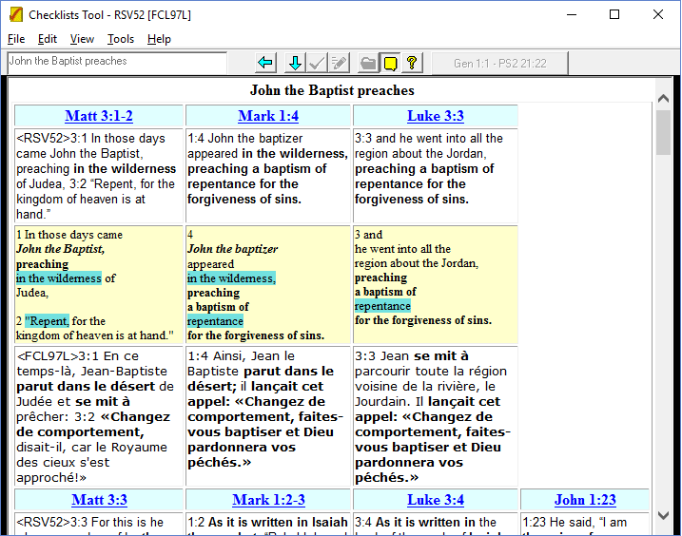
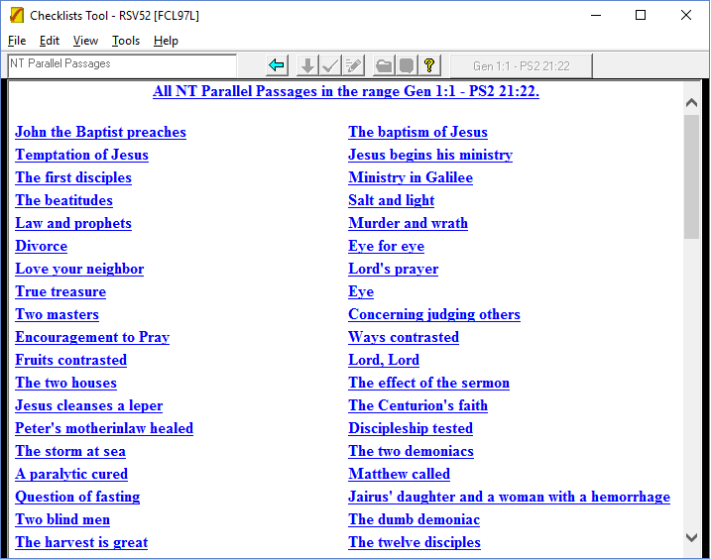
ParaTExt 6
Limited set of 132 parallel passages (Synoptic Gospels)
Notes:
When I started demonstrating ParaTExt 6 – the task was so much simpler.
132 parallel passages.

Slide 4
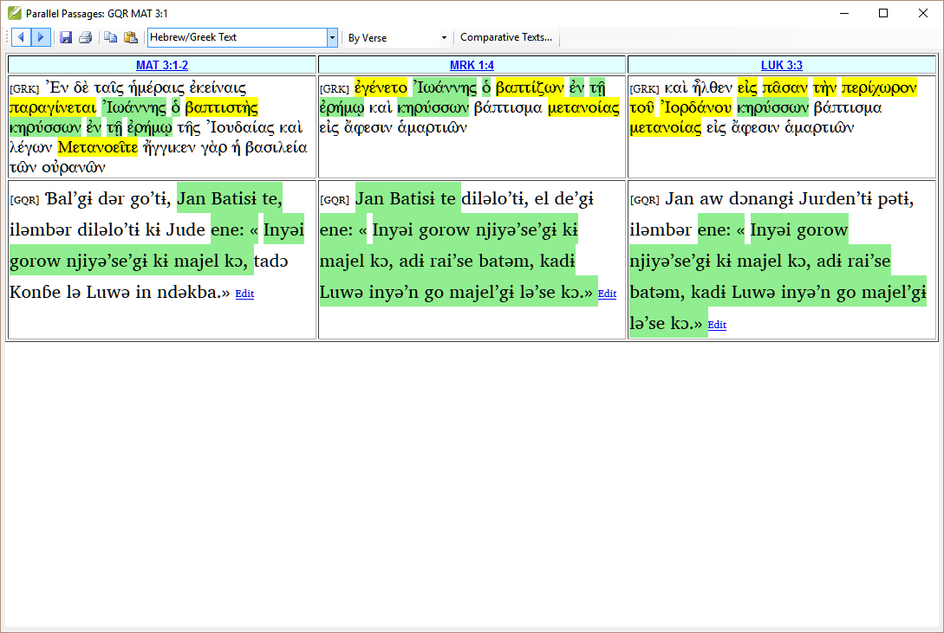
ParaTExt 7 – verse by verse!
Broaden out – stepped through one at a time
How do you find them
What if you double-clicked and missed one!
Notes:
Lost in a sea of passages!
If double-clicked you missed one, but which one?
If you didn’t write down where you were, had no idea.
Have you done all 132 passages?

Slide 5
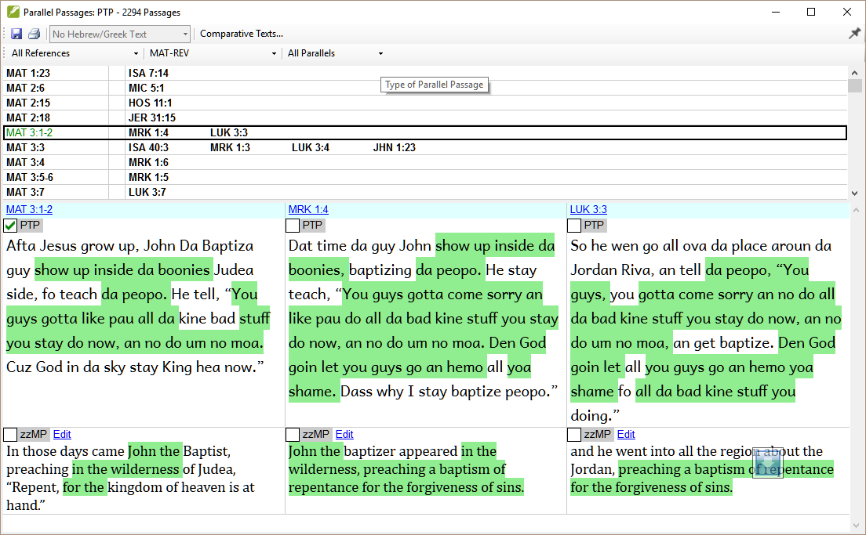
ParaTExt 8
Thousands, but …
List to keep track
Filters (inc Synoptics
Shows if changed

Slide 6
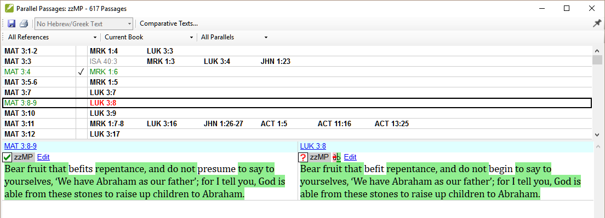
ParaTExt 8

Slide 7
Objectives
Use the Parallel passages tool to compare and contrast texts
Interpret the green shading in the texts and yellow in source text
Edit the text to make any corrections
Keep track of the passages that have been already checked
Identify any changes made after marking complete
View a parallel passage while translating (if appropriate)
Make sure Parallel Passages check is in your plan.
Notes:
So what are we going to do this afternoon
We will focus on the Parallel passages tool …
But we will also cover viewing the passage while we translate. Not always a good idea …
Finally we will make sure that the parallel passage tool is on your plan.
Open you eHO and Paratext 8 and let’s get started. Firstly, I will demonstrate for you and then get you to do some learning tasks.
You will want to load Paratext and put the eHO in a narrow window to the side so you can follow what we are doing.

