Slide 1
S
O
F
T
W
O
T
S
H
A
P
N
S
R
Part 2
E
LTCT 2017
Notes:
Kent says I can do anything – 30 minutes = 6 x 5 minutes
56 software packages (some duplicates on 26 slides)
Choose some to focus on then give an overview of some of the others.

Slide 2
Overview
Adapt It 6.8.2 (Paratext 8)
Anki
Logos
SayMore
HearThis/Glyssen
Pathway
Meld
Greenshot
XlingPaper

Slide 3
Copy from mobilelite
Adapt It
Anki

Slide 4
Adapt It
Adapt It 6.8.1 (December 2016)
Bug fixes
Compatible with Paratext 8
Doesn’t work when both Paratext 7 and Paratext 8 installed
In response to my bug report they are now working on 6.8.2

Slide 5
Let’s test the new installer
Install Adapt It
Install Git using the downloaded file (not the Internet)
Adapt_It_WX_6_8_2_Unicode (6).exe
Git-2.12.0-64-bit.exe
rdwrtp7.exe.config (copy to program files (x86)\Paratext 8
Write-up any bugs!
https://adapt-it.org/

Slide 6
T
U
R
Y
O
R
N

Slide 7
Adapt It data files
Paratext projects files
Restore the 2 Paratext 7 projects
Copy the Adapt It project to
…\Documents\Adapt It Unicode Work
Launch Paratext, open the project
Write-up any bugs

Slide 8
?
What is the administrator’s password?
CORRECT! It isn’t meant to be hard for geeks!
Admin
LPDT
INCORRECTE That’s for the French equivalent TW.
Notes:
We are using 7.5 and are waiting for the next version. What will it be?

Slide 9
Logos
New Version 7
Purchase for $0

Slide 10
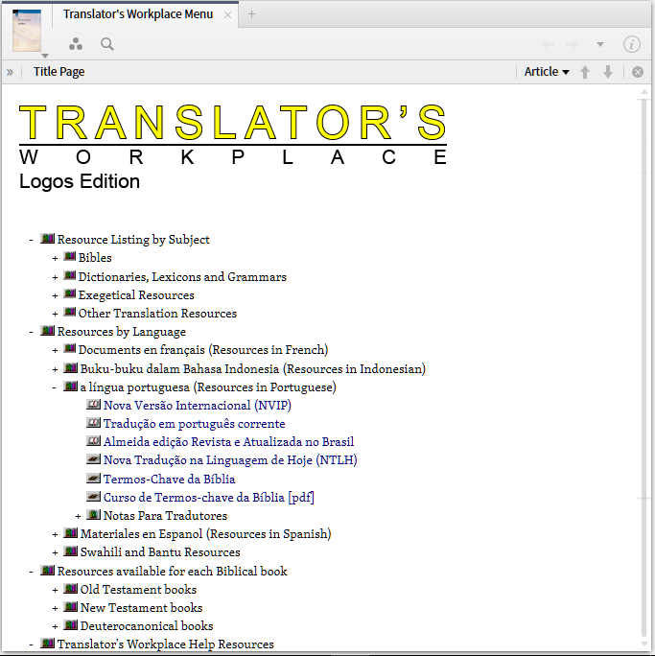
Logos
Updates
Major update (1GB!)
Scan USB resources folder
Translator’s Workplace Menu

Slide 11
Logos tutorial
Great Logos tutorial - Jonah
LT271 Study the Bible with Logos: Jonah 1
30 lessons (videos from the Internet)
Learn Logos but suggests extra resources

Slide 12
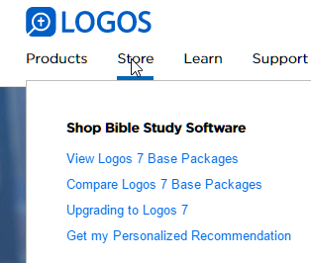
?
How much do you pay for Logos 7 upgrade?
CORRECT! It is a free upgrade but you buy it from the store.
$0
$50
INCORRECTE That’s for the full version.
Notes:
Go online to Logos, log in, go to the store, upgrading to Logos 7, scroll down, click get it Free
and purchase the free update for $0

Slide 13
Anki
Great for learning anything not just a language (flash card program)
Spaced repetition
Recall (not review)
Rereading not helpful
Questioning more effective
Create your own cards even better

Slide 14
T
U
R
Y
O
R
N

Slide 15
Learning task 1 Install Anki
Install Anki program
Install decks (double-click)
LTCT Topics
RegEx

Slide 16
Learning task 2 Use Anki
Study the two sample decks
Add your own cards
Click on deck
Click on Browse
Click on deck to left
Click on Add
Fill in front and back
Click Add

Slide 17
HearThis
Two different installations
Paratext 7
Paratext 8
New version this week!
HearThis (http://software.sil.org/hearthis/)
Glyssen (http://software.sil.org/glyssen/)

Slide 18
FLEx audio writing system
Watch video (3+ minutes)

Slide 19
FLEx audio writing system
(audio writing system video)

Slide 20
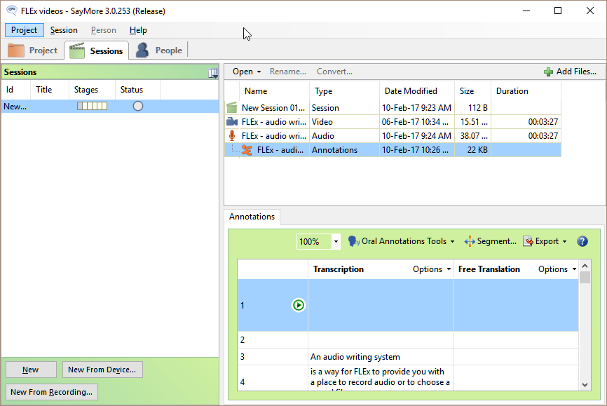
SayMore
Organise audio/video data
Transcribe texts

Slide 21
XLingPaper
Complicated but powerful way writing complex documents
Grammar papers, phonology papers
Edit English and French together in one source file
Export to PDF and Web
XLIngPaper (http://www.xlingpaper.org/)

Slide 22
Training materials
Paratext (English and French)
FLEx (English) in progress
Bloom (Eng French) in progress
Reformatting using XLingPaper

Slide 23
Pathway
For printing from FLEx or Paratext
Need to match the version with FLEx and/or Paratext
Version for FLEx 8.3 not yet released
“Nightly version” available
http://software.sil.org/pathway/

Slide 24
Useful tools
Meld - useful comparison tool
Sync
GreenShot (screen shots for training materials)

Slide 25
Questions? Need More Information?

