Slide 1
Comparing & Contrasting Parallel texts
Notes:
I’m excited to share with you this afternoon the great improvements that have been made in version 8 to the Parallel Passages check. Firstly, how many people have actually used the tool. Not just demonstrated it but used it. You see I have demonstrated it for over 10 years now and I have used it with two teams. One with and earlier version (probably 7.3) and one this year with 7.6. wow what a difference!

Slide 2
Comparing & Contrasting Parallel texts
Same or different?
Notes:
I’m excited to share with you this afternoon the great improvements that have been made in version 8 to the Parallel Passages check. Firstly, how many people have actually used the tool. Not just demonstrated it but used it. You see I have demonstrated it for over 10 years now and I have used it with two teams. One with and earlier version (probably 7.3) and one this year with 7.6. wow what a difference!

Slide 3
1000s of parallel texts in NT
What are Parallel texts?
Same event told by different people
A quote from the OT
A quote from another book NT

Slide 4
1000s of parallel texts in NT
Why are we comparing and contrasting them?
Make them the same when they are the same in the source text
Keep the differences (most of the time)
Wisdom to know the difference!
It is the meaning not the form!

Slide 5
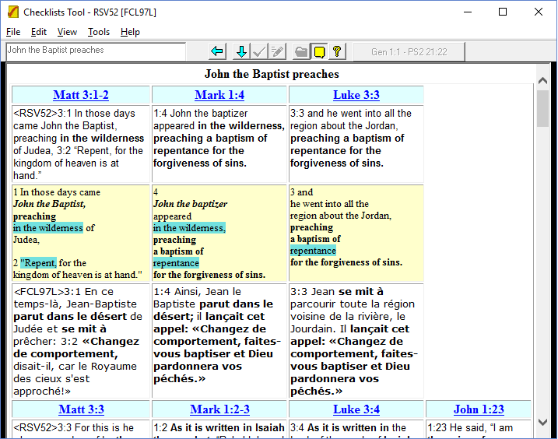
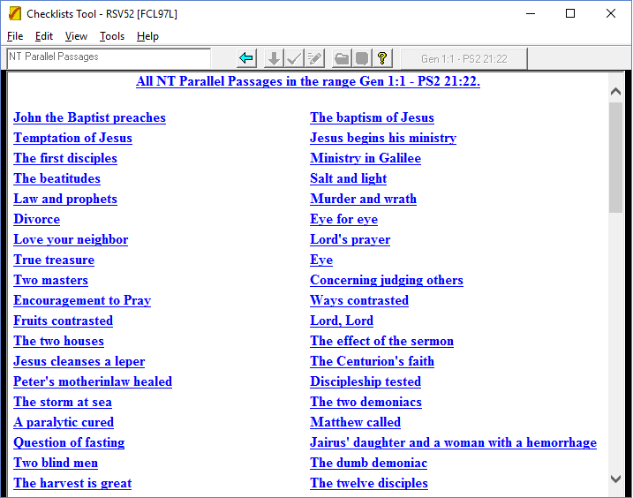
ParaTExt 6
Limited set of 132 parallel passages (Synoptic Gospels)
Notes:
When I started demonstrating ParaTExt 6 – the task was so much simpler.
132 parallel passages.

Slide 6
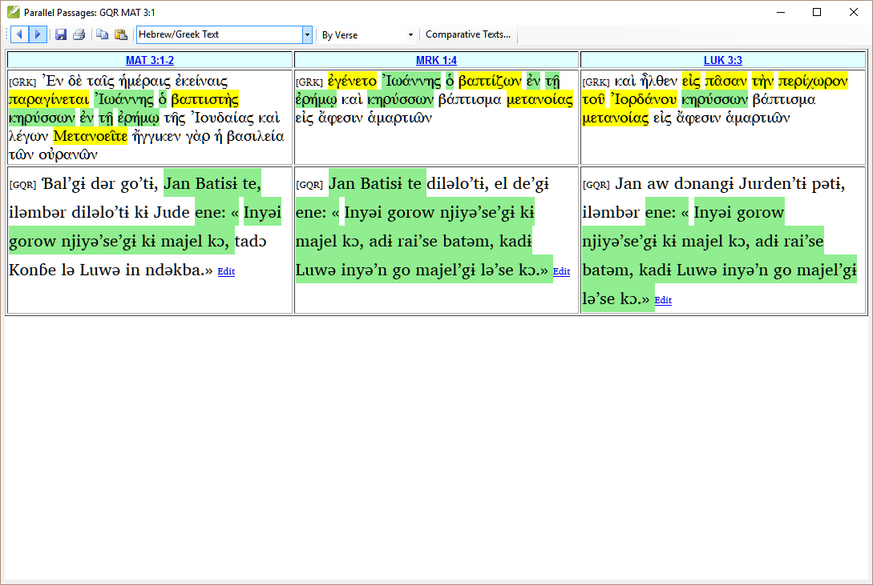
ParaTExt 7 – verse by verse!
Broaden out – stepped through one at a time
How do you find them
What if you double-clicked and missed one!
Notes:
Lost in a sea of passages!
If double-clicked you missed one, but which one?
If you didn’t write down where you were, had no idea.
Have you done all 132 passages?

Slide 7
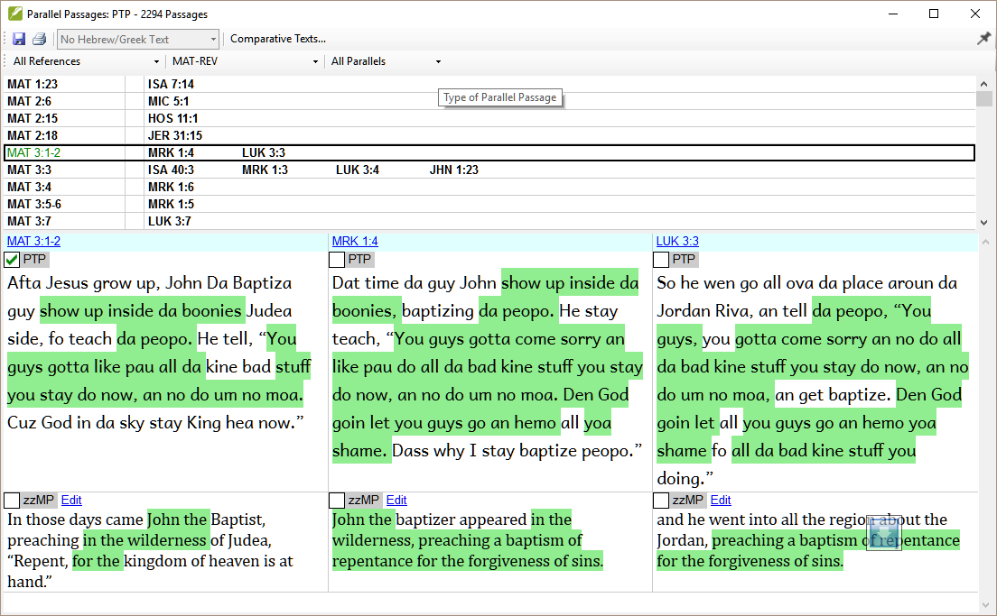
ParaTExt 8
Notes:
Thousands, but … list to keep track
Filters (inc Synoptics
Shows if changed

Slide 8
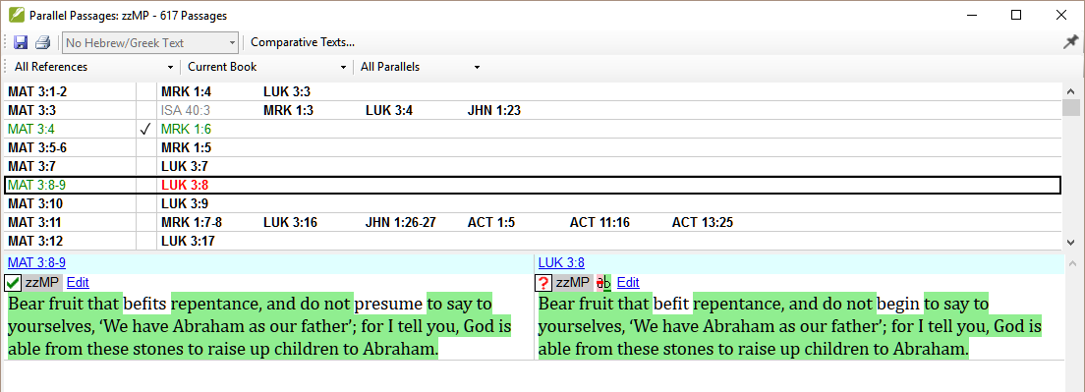
ParaTExt 8

Slide 9
Learning objectives (outcomes)
Use the Parallel passages tool to compare and contrast texts
Interpret the green shading in the texts and yellow in source text
Edit the text to make any corrections
Keep track of the passages that have been already checked
Identify any changes made after marking as complete
Notes:
So what are we going to do this afternoon
We will focus on the Parallel passages tool …
But we will also cover viewing the passage while we translate. Not always a good idea …
Finally we will make sure that the parallel passage tool is on your plan.
Open you eHO and Paratext 8 and let’s get started. Firstly, I will demonstrate for you and then get you to do some learning tasks.
You will want to load Paratext and put the eHO in a narrow window to the side so you can follow what we are doing.

Slide 10
Objectives (outcomes)
View a parallel passage while translating (if appropriate)
Notes:
So what are we going to do this afternoon
We will focus on the Parallel passages tool …
But we will also cover viewing the passage while we translate. Not always a good idea …
Finally we will make sure that the parallel passage tool is on your plan.
Open you eHO and Paratext 8 and let’s get started. Firstly, I will demonstrate for you and then get you to do some learning tasks.
You will want to load Paratext and put the eHO in a narrow window to the side so you can follow what we are doing.

Slide 11
Learning incomes?
Use the Parallel passages tool to compare and contrast texts
Interpret the green shading in the texts and yellow in source text
Edit the text to make any corrections
Keep track of the passages that have been already checked
Identify any changes made after marking as complete
Learner
Practitioner
Trainer
Expert
Notes:
So what are we going to do this afternoon
We will focus on the Parallel passages tool …
But we will also cover viewing the passage while we translate. Not always a good idea …
Finally we will make sure that the parallel passage tool is on your plan.
Open you eHO and Paratext 8 and let’s get started. Firstly, I will demonstrate for you and then get you to do some learning tasks.
You will want to load Paratext and put the eHO in a narrow window to the side so you can follow what we are doing.

Slide 12
Learning incomes?
View a parallel passage while translating (if appropriate)
Learner
Practitioner
Trainer
Expert
Notes:
So what are we going to do this afternoon
We will focus on the Parallel passages tool …
But we will also cover viewing the passage while we translate. Not always a good idea …
Finally we will make sure that the parallel passage tool is on your plan.
Open you eHO and Paratext 8 and let’s get started. Firstly, I will demonstrate for you and then get you to do some learning tasks.
You will want to load Paratext and put the eHO in a narrow window to the side so you can follow what we are doing.

Slide 13
Demonstration

Slide 14
Summary
Use the ________ ___________ tool to compare and contrast parallel texts.
The green shading in the texts means _____________and yellow shading in source texts means that ____________________.
Edit the text to make any necessary corrections
Ensure that what is ______ in the source is the same in your texts
What is different in the source is the __________ in your text where possible
Use the _______________ to keep track of the passages that have been already been checked.
Answers: Parallel Passages; two or more words are identical; same root word used; same; different; checkboxes; red; ?; lower: second, quick reference, scroll.

Slide 15
Summary
You can identify any changes have been made after marking a parallel text as checked from the _____ (coloured) references in the top pane and the ____________ in the ___________ pane.
It is generally not good practice to follow the first gospel passage when translating the ____ gospel passage. But it is good to follow either an OT quotation or a third gospel.
You can use a ________ window and/or _____ groups to view passages in separate windows while translating.
Answers: Parallel Passages; two or more words are identical; same root word used; same; different; checkboxes; red; ?; lower: second, quick reference, scroll.

