Slide 1
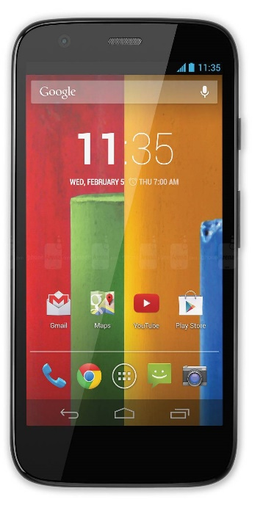
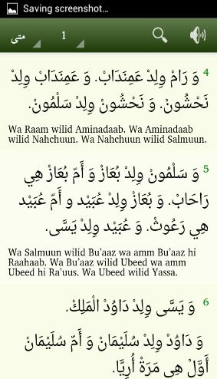
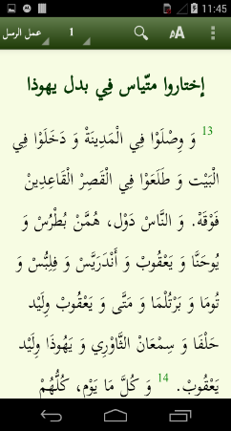
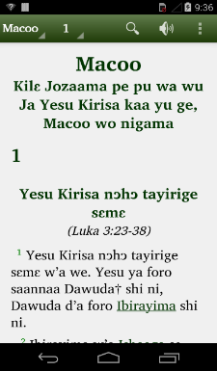
Scripture App Builder
SAB

Slide 2
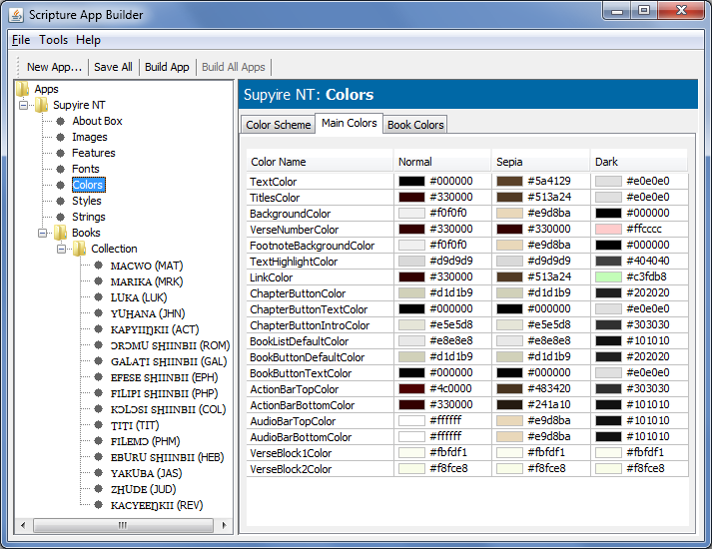
Introducing Scripture App Builder
What does Scripture App Builder do?
«Yawutuu wo saan we w’a se nimɛ ge, mii wu wa wɛ? Wèe ya wu wɔrɔ ɲa, na wèe yaha Kilɛ-nɔhɔ ke na, na ba di ba wu pɛlɛ.»
\p
\v 3 Ba saannaa Hɛrɔdi ya yee logo wɛ, a l’i wu ɲaha wɔ fo xuuni, na fara Zheruzalɛmu shɛɛn bɛɛri na.
\v 4 A Hɛrɔdi di saraya ɲaha shɔɔnrivɛɛ ɲuŋɔfɛɛ†, ni saliya karamɔgɔlɔɔ† pu bɛɛri
di ba wu pɛlɛ.»
\p
\v 3 Ba saannaa Hɛrɔdi ya yee logo wɛ, a l’i wu ɲaha wɔ fo xuuni, na fara Zheruzalɛmu shɛɛn bɛɛri na.
\v 4 A Hɛrɔdi di saraya ɲaha shɔɔnrivɛɛ ɲuŋɔfɛɛ†, ni saliya karamɔgɔlɔɔ† pu bɛɛri pinnɛ, na pu yege na: «Kirisa wemu wu ɲɛ Saan ni Izirayɛli† wo Shɔvɔɔ wu ge,
\c 2
\s Wɔrɔɔ cɛvɛɛ ya pa na yìri Kilɛ-nɔhɔ na
\p
\v 1 Yesu ya se Zhude fiige ki ni, Bɛtilɛhɛmu ni, saannaa Hɛrɔdi† caŋa ɲii ni. Wu nizexhɔgɔ ki na, a wɔrɔɔ cɛvɛɛ pii di ba na yìri Kilɛ-nɔhɔ na, na nɔ Zheruzalɛmu ni.
\v 2 A p’i yegeŋɛ pye na: «Yawutuu wo saan we w’a se nimɛ ge, mii wu wa wɛ?
ParaTExt Files
APK
(Android app
installation file)
Fonts
Icons
Audio Files

Slide 3
Objectives (Wednesday)
Ensure Scripture App Builder and dependant software is installed.
Create a simple scripture app (text only).
Review creating apps with other features.
Create complex apps with newer features (multiple translations, borders, share app).
Notes:
Last year it took all of the first week to install. This year much easier by copying the SDK folder from someone else (but very large)
Create simple,

Slide 4
Objectives (Friday)
Build a scripture app with synchronised audio (aeneas).
Distributing audio files with apk or external folder
Project: Build an app for a language from your branch.
Notes:
Project – can be anything, if you don’t have something then can use the samples provided.

Slide 5
Learning Task 1 Ensure SAB installed
Please ensure the software is installed prior to the class.
Under Tools, Settings, Build settings,
Untick build offline before do first app.
(Then tick it after finished first app.)
Check location of SDK.
Verify Aeneas installation.
Notes:
Run SAB, what version are you running = 3.2
Review on Friday but then jump to

Slide 6
How much do you remember?
Last year Darcie did 15 sessions
This year we have 4 sessions
Notes:
Play Emma video

Slide 7
How much do you remember?
Notes:
Play Emma video

Slide 8
Learning Task 2 Create a simple scripture app
Demonstrate starting the New app… wizard.
Create an app for the Mwgahavul Bible using the data in the folder LTCT2017\Data\SAB\Mwgahavul-Bible

Slide 9
Learning Task 3 Create a complex app
Create a variety of complex apps, with one or more of the following:
content menu for the four gospels
(Content menu node – add images …)
Using Mwgahavul-Bible
splash screen (images node – splash screen…)
expiry (app node)

Slide 10
Learning Task 3 Create a complex app
Create a variety of complex apps, with one or more of the following:
multiple translations of Mark
Add book to book collection (p 24)
Use Mwgahavul-Bible and Margi
border
Images node, border (p 28)
share your app
Features node, sharing (p 43)

Slide 11
Learning Task 3 Create a complex app
add your own icon (undocumented?)
images node
App Icon for Android,
Android asset studio link,
Foreground image (at left)
Choose the file on your computer
Download arrow
Unzip file
Add Icon images

Slide 12
Ticket out the door
Write on a piece of paper:
What 2 things did you learn this morning?
What 1 question do you have?

Slide 13
Learning Task 4 Anki time
Add cards to your deck
Use the deck to revise earlier cards

Slide 14
Learning Task 6 Build an app with synchronised audio using Aeneas
Watch the demonstration
(See instructions “Using aeneas for Audio-Text Synchronization”)
Build an app of Chadian Arabic for the book of James
Audio synchronisation using Aeneas. (page 9)
Synchronize by clicking on the book name
Fine tune (page 11)

Slide 15
Learning Task 7 Distributing audio files
Distributing audio files with apk or external folder
With APK easier installation but too large
(default)
External folder
(audio note, audio source)

Slide 16
Learning Task 8 Project
Build an app for a language from your OU (organisational unit).

Slide 17
Learning Task 9 Anki time
Add cards to your deck
Use the deck to revise earlier cards

Slide 19
How much do you remember?
Emma
Notes:
Play Emma video

Slide 20
Videos:
Romantic Dinner

Slide 21
Videos:
German Navy

Slide 22
Videos:
OMINI KNOWEST (Mark Angel Comedy) (Episode 59)

Slide 23
Videos:
Cat herders

Slide 24
Videos:
Emma
Romantic Dinner
German Navy
OMINI KNOWEST (Mark Angel Comedy) (Episode 59)
Cat herders

