Slide 1
SOURCE LANGUAGE TOOLS
Paratext 7.6
Source Language Text Window
Source Language Search Tool
Source Language Dictionary

Slide 2
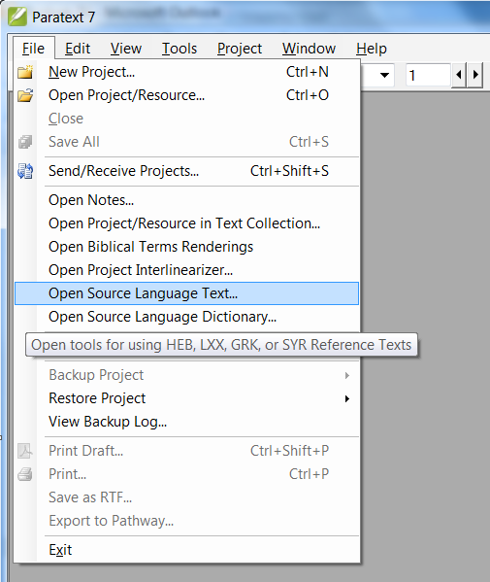
A Source Language Text window can be opened in two ways:
Using the File menu
Using the toolbar; look for the icon with the golden “aleph”:
Return to Menu

Slide 3
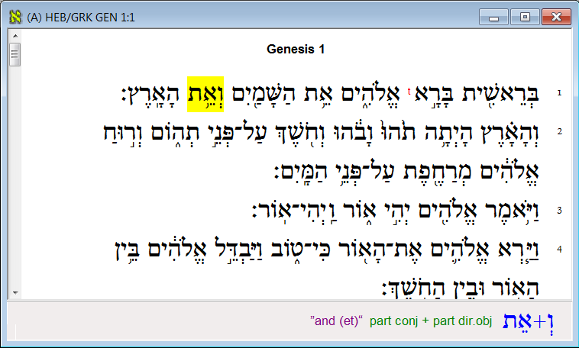
The default view shows the Hebrew/Greek texts only.
The analytical data is visible in the status bar.
Return to Menu

Slide 4
When mouse cursor hovers over a word, the analytical info in the status bar is updated automatically.
Return to Menu

Slide 5
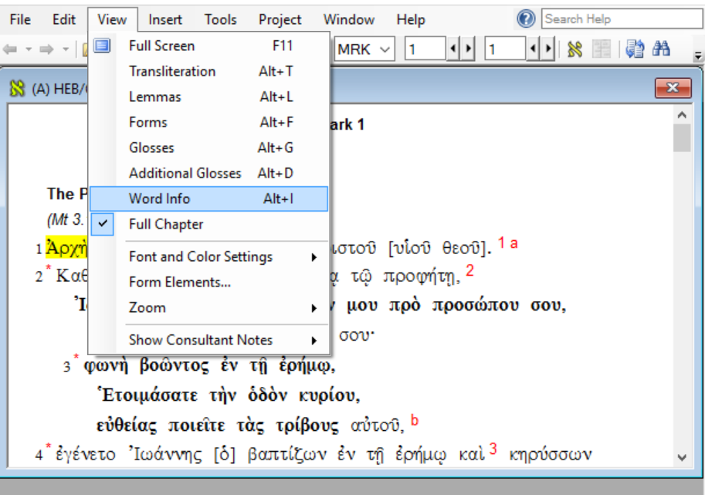
To Hide the analytical info in the status bar click on the view menu and uncheck Word Info.
Analytical info is no longer displayed
Return to Menu

Slide 6
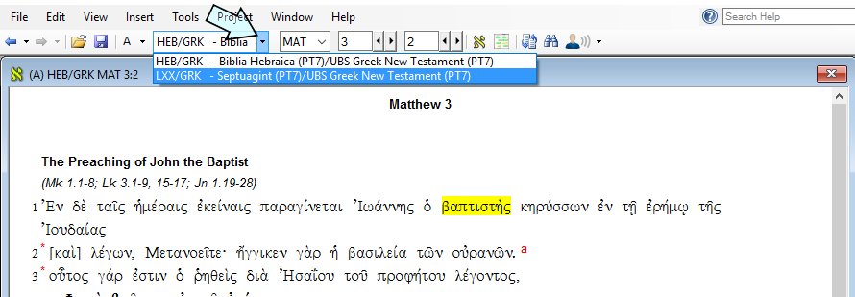
You have a choice of canons: HEB/GRK or LXX/GRK. Hebrew/Greek is the default, if you wish to use the LXX then click on the drop down arrow to the right of HEB/GRK –Biblia on the tool bar and select LXX/GRK Septuagint
Then select your canon:
HEB/GRK
LXX/GRK
Return to Menu

Slide 7
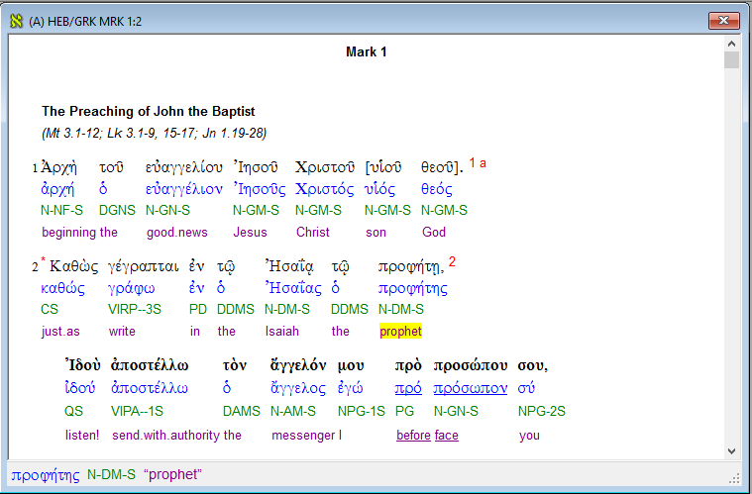
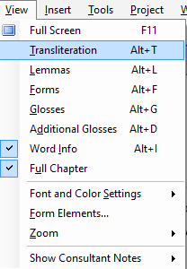
Use the View menu to have the text displayed in an interlinear format, with transliteration, lemmas, forms, and glosses. The status bar with its word information can be hidden as described earlier.
Return to Menu

Slide 8
If the mouse cursor hovers over a morphological form (which is in an very abbreviated form called Friberg tags used by many scholars), a tooltip appears giving a form that is more easily understood for those not familiar with the Friberg system..
Return to Menu

Slide 9
If you click on any of the red superscripts in the Greek text, a popup window will appear with background information on the source text, depending on what is available, such as the critical apparatus, cross-references, etc.
Press Escape or the X on the pop up to close this window again.
Return to Menu

Slide 10
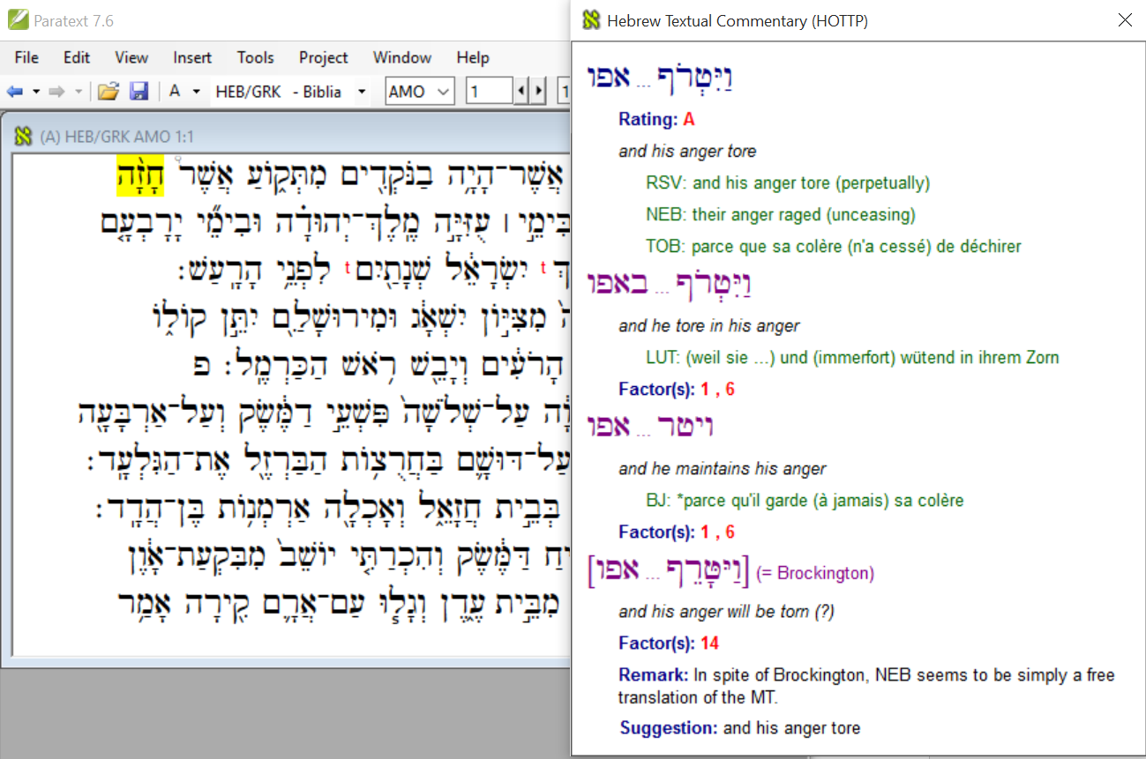
Example of clicking on red superscript “t’s” in the Hebrew text to access more information about the text. Clicking on the red t’s opens the Hebrew Textual Commentary (HOTTP)
Press Escape or the X on the popup to close this window again.
Return to Menu

Slide 11
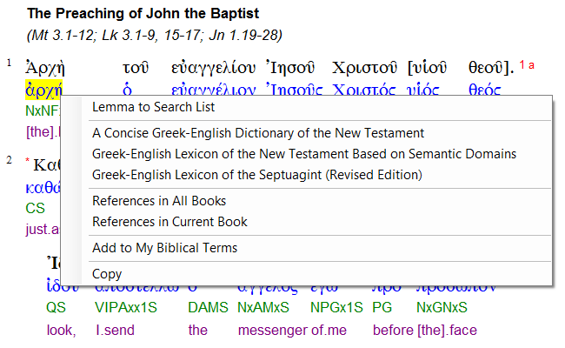
If you right click on a Greek lemma, a context-sensitive popup menu will appear with options such as:
Include in a Search List or advanced search
Look up in one of three dictionaries
List all occurrences in all books
List all occurrences in the current book
Add to custom list of Biblical Terms
Copy to clipboard
Return to Menu

Slide 12
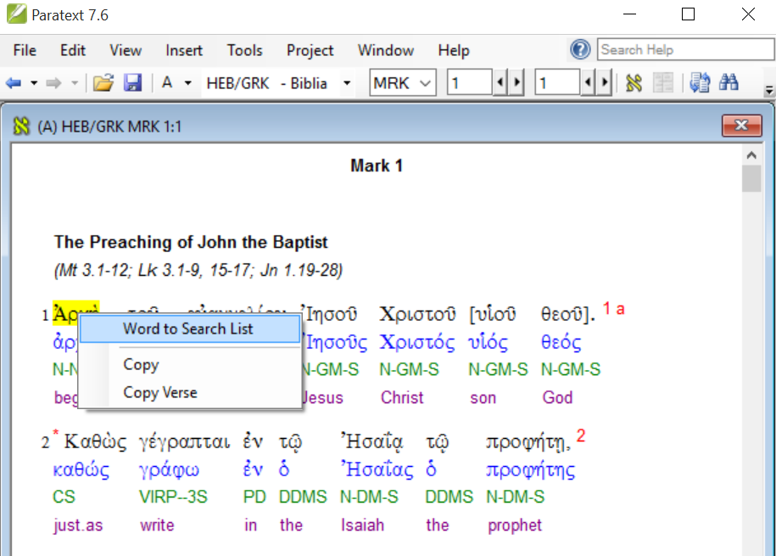
If you right click on a Greek surface form, a shorter context-sensitive popup menu will appear with options such as:
Include word in a Search List
Copy (word) to clipboard
Copy verse to clipboard
Return to Menu

Slide 13
Note that if you do not use the interlinear view, an intermediate popup menu will appear first, prompting you to choose whether you want this action to apply to:
The word with its morphological form as it occurs in this verse
The lemma, regardless of its morphological form in this verse
Any word with this morphological form
The gloss
Return to Menu

Slide 14
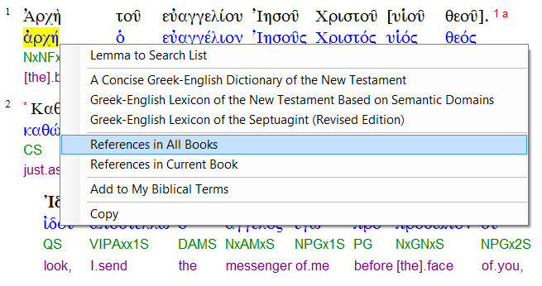
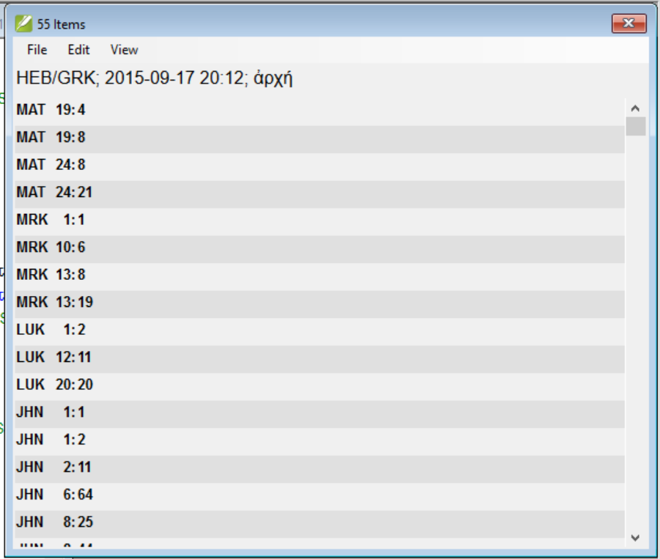
If you click on References in All Books, or References in Current Book a list of verses where lemma occurs, will be displayed.
Return to Menu

Slide 15
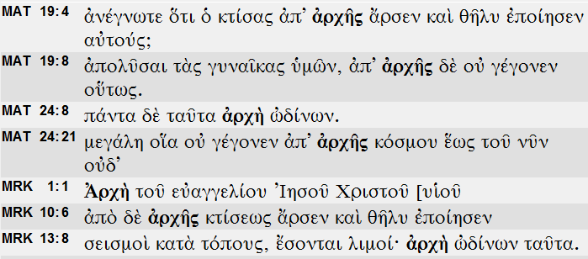
If you hold down the Ctrl key while selecting one of the options that ask for a list of occurrences, the output will be displayed in context.
Return to Menu

Slide 16
The Source Language Search Tool accompanies the Source Language Text window to allow searching for a combination of lemmas and/or morphological forms occurring in a particular order, and with a maximum number of words in between. Searches can be performed within one source language text or across different texts. There are three ways to launch the Source Language Search Tool.
Return to Menu

Slide 17
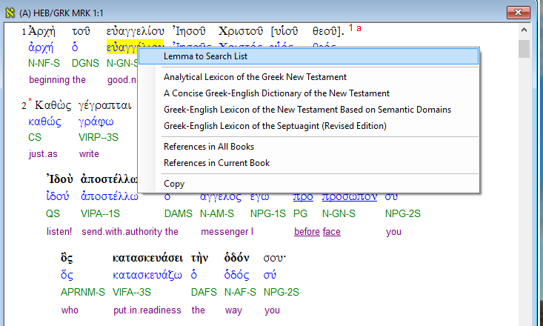
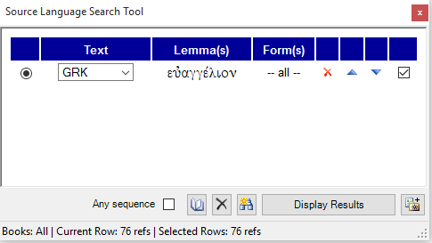
The Source Language Search Tool can be launched by right clicking on a lemma in the Greek interlinear, then clicking on Lemma to Search list. This will open the Tool with the lemma already inserted as search criteria
Return to Menu

Slide 18
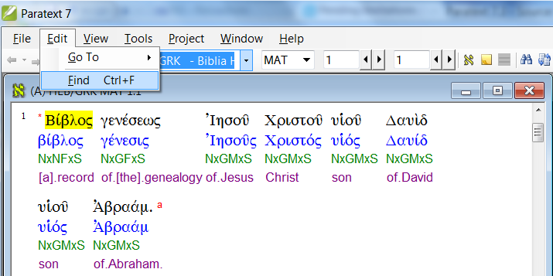
The Source Language Search Tool can be launched as well by selecting the Find option from the Edit menu. Make sure, however, that the Source Language Text window is active when you do that.
An alternative way to do this is by clicking the Find button on your toolbar or by using the shortcut Ctrl-F.
Return to Menu

Slide 19
If you hold down the Ctrl key while selecting a word, lemma, or form, you can select multiple items. A right click will produce a popup menu with only one option: Load the Source Language Search Tool and start an advanced search featuring all selected items.
Return to Menu

Slide 20
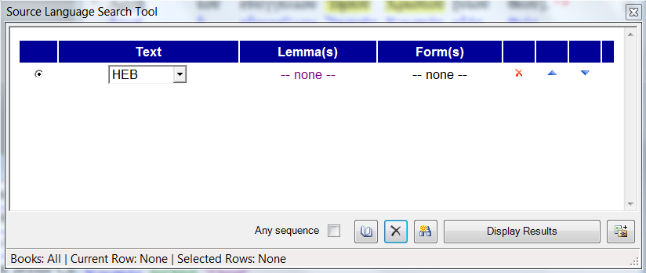
The Source Language Search Tool can be populated manually:
(Click on the black X near the bottom to clear the search items and start a new search like shown here.)
Select a text (default is Hebrew Old Testament)
Select one or more lemmas from a list.
Select morphological form(s)
Click here to clear the search.
Return to Menu

Slide 21
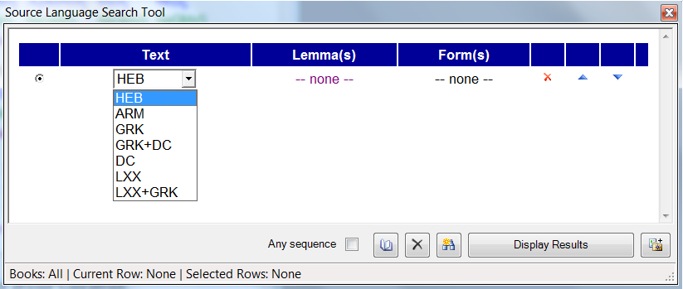
The following (combinations of) texts can be searched:
The Hebrew Old Testament (HEB)
The Aramaic parts of the Old Testament (ARM)
The Greek New Testament (GRK)
The Greek NT with the Deutero-Canonical Books (GRK+DC)
The Deutero-Canonical Books only (DC)
The Septuagint (LXX)
The Septuagint and the Greek New Testament (LXX+GRK)
Return to Menu

Slide 22
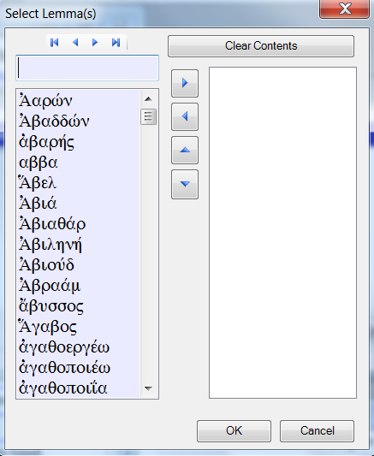
This is how you select one or more lemmas:
All available words in the text(s) you have selected are listed on the left, and all selected words are displayed on the right. Use the arrow keys to move a word from one list to the other. You can also do this by double clicking on a word.
Type the first characters of the word of your choice and the cursor will move to the first match in the list.
Click OK to finish your selection.
Note: Transliteration is not available in this view.
Return to Menu

Slide 23
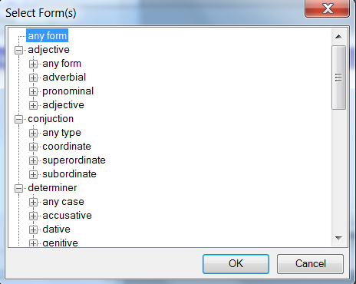
This is how you select one or more forms:
If you click the Form link, a window will appear listing all of the available morphological (sub)categories.
The default is any form, which, when selected, lists all occurrences of a word, regardless of its form.
Click on the pluses of the tree diagram to make your search as specific as you want by including additional subcategories.
Click OK to finish your selection.
Return to Menu

Slide 24
Note that a query can contain multiple items. The search can specify a sequence, that they are separated by a specified number of words, or that the words simply are in the same verse.
Add an additional item to your query by clicking here:
Click here to remove one of the items from a query
Click here to select a range of books
Return to Menu

Slide 25
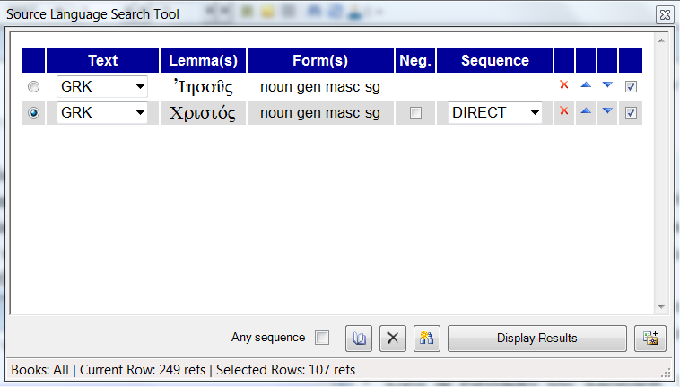
The query below looks for all passages where the genitive forms of ᾿Ιησους and Χριστος occur in a direct sequence. Please pay attention to the information on the status bar. It says that the word Χριστος is found 249 times whereas the combination is found 107 times.
Indicates which is the “current row”
The tick boxes indicate which rows are selected and hence included in the query.
Number of books selected
Return to Menu

Slide 26
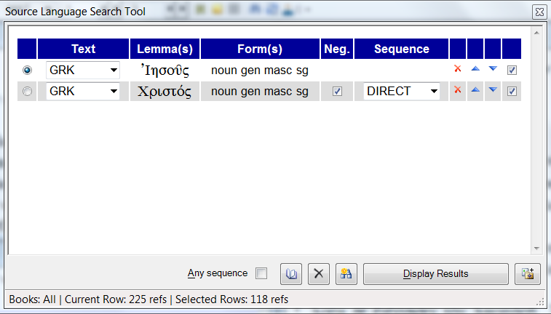
The query below looks for all passages where the word ᾿Ιησους is NOT followed directly by the word Χριστος. According to the status bar, the genitive singular of the word ᾿Ιησους is found 225 times. In 118 passages, however, it is found without Χριστος following it.
Tick this box to negate the row, which means that you are looking for passages where this item is NOT found.
Return to Menu

Slide 27
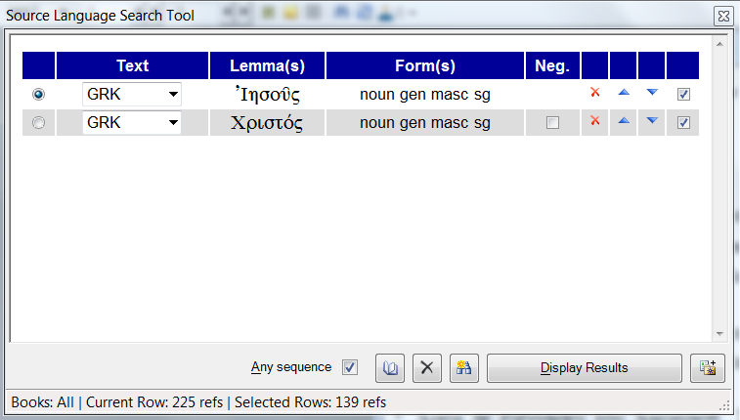
The query below looks for all passages where the words ᾿Ιησους and Χριστος occur together in a single verse regardless of the sequence. According to the status bar, there are 139 verses that contain both words.
Tick this box to indicate that you are not interested in a specific sequence.
Return to Menu

Slide 28
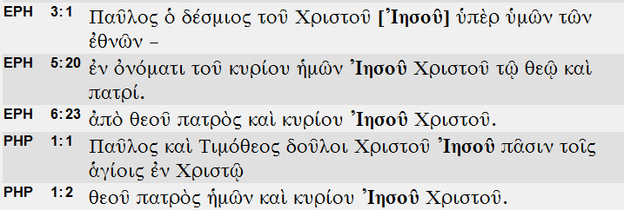
The search results are displayed with a click on the Display Results button. Hold down the Ctrl key if you want to see the results in context.
Return to Menu

Slide 29
Some final notes regarding the Source Language Search Tool:
Delete this row
Move a row up or down
Add the results of a query to your custom Biblical Terms list
Return to Menu

Slide 30
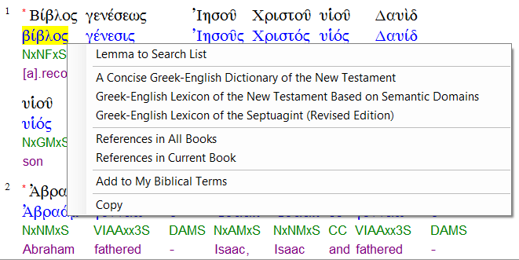
The Source Language Dictionary window is often launched from the popup menu that appears when the user right clicks on a word in the Source Language Text Window.
Return to Menu

Slide 31
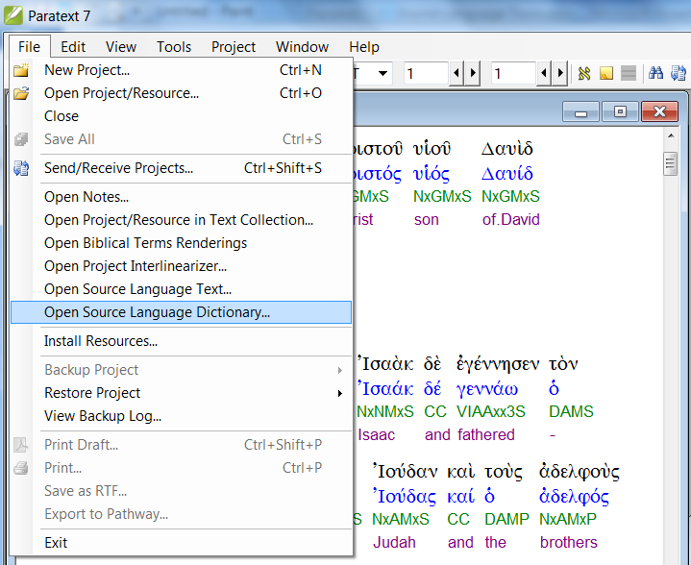
The Source Language Dictionary window can be launched manually as well by selecting the corresponding option from the File menu.
Return to Menu

Slide 32
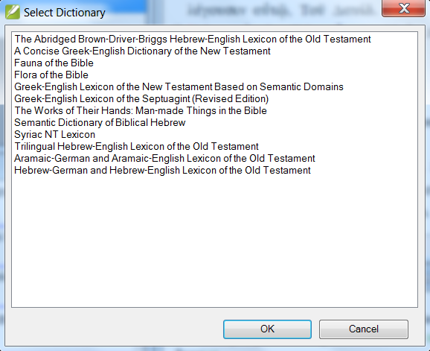
When the Source Language Dictionary window is launched manually, a popup will appear prompting the user to select a database.
Return to Menu

Slide 33
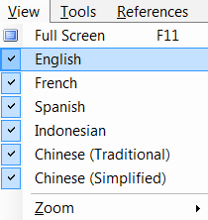
Some of the databases have versions in different languages.
Use the View menu to make a selection.
Return to Menu

Slide 34
Most scripture references are links. A click on a link will display the text. If you hold down the Ctrl key while clicking a new Source Language Text window will be opened.
Click to display all nine references in the list window.
Click to display a single reference
Return to Menu

Slide 35
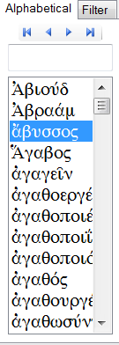
On the left side of the window you see a panel with two tabs. The one labeled Alphabetical contains a list of all entries in the database. The one labeled Filter contains the results of an advanced search.
Type the first characters of the word of your choice and the cursor will move to the first match in the list and the corresponding entry will be displayed.
A simple search is done by selecting the Find option from the Edit window (Ctrl-F).
It simply moves the cursor to this text box:
Return to Menu

Slide 36
A more advanced search is done by selecting the Find Advanced option from the Edit window (Ctrl-G). With this tool you can look for entries containing a certain text string, either in one specific field or in the entire entry.
Select the field that you want to search, e.g. “Definition English”.
Select a language.
Type the string that you want the program to search for, e.g. “apostle”.
Return to Menu

Slide 37
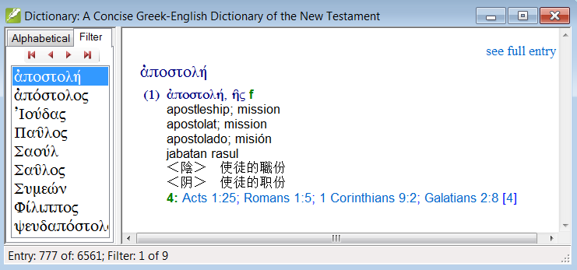
According to the status bar there are nine entries with the string “apostle” in the English definition field. They are all listed in the Filter tab and the first entry is displayed immediately.
Return to Menu

Slide 38
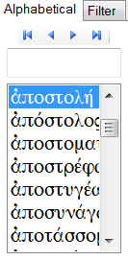
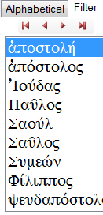
Tip: It is easy to switch from one tab to another: Use Ctrl-Up and Ctrl-Down to navigate through the entries listed on the Alphabetic tab. Use Alt-Up and Alt-Down to navigate through the entries listed on the Filter tab.
You can also use the small blue/red arrow buttons at the top to navigate through the lists.
Return to Menu

Slide 39
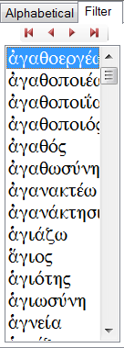
The Greek-English Lexicon of the New Testament Based on Semantic Domains has a few additional features.
If you click on a semantic (sub)domain, all (sub)entries belonging to this domain will be displayed in the Filter.
Return to Menu

Slide 40
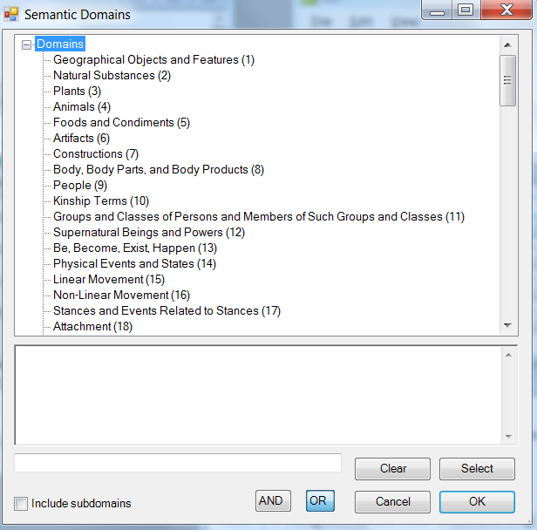
If you do an advanced search (Ctrl-G), there are two additional fields where you can specify a semantic domain and/or subdomain. You can also select them from a list.
Return to Menu

